Slide 1
CYB-4203/6203
Secure and Trustworthy AI
Presentation 9: Bio/Neuro/Psych connections to AI/ML Systems, Lifecycles, and Security
Wednesday, February 25, 2026
Topics: 5.1, 5.2, 5.3

Slide 2


Housekeeping – Schedule Update!
Assignment 5: Posted Today
Assignment 6: Posted Mar 4
I’ll be gone to Spain next week for ICISSP conference
  Monday Mar 2: Dr. Pei Weiping
  Wednesday Mar 4: Dr. Yi Ting Chua
Midterm Exam Date: Wednesday March 11
  Comprehensive through Mar 4
  I’ll post a study guide
Spring Break: March 16-20
Midterm Projects Due: Friday March 25 11:59 pm
  Will incorporate Assignments 5 and 6

Slide 3

Housekeeping – Course Website
https://dallaselleman.github.io/cyb-4203-6203-spring-2026

Slide 4
Overview
Today's Agenda
Material inspired by interactions from our previous session
5.1 Biology, neuroscience, and psychology connections with AI/ML systems
5.2 Core architecture of modern AI/ML systems and how they differ from traditional software
5.3 AI/ML system lifecycle / pipeline: data collection and preparation, model training and evaluation, deployment and integration, monitoring and maintenance
Assignment 5

Slide 5
5.1 Bio/neuro/psych connections
to AI/ML Systems

Slide 6

Last session: Grant Sanderson (3 Blue 1 Brown)
Text is broken into tokens, each mapped top an embedding vector in high-dimensional space
Directions in embedding space encode semantic meaning (woman – man ≈ queen - king)
Vectors flow through alternating attention blocks and MLP blocks, enriching with context at each step
All learned behavior lives in weight parameters
– 175B in GPT-3
Final output: a probability distribution over possible next tokens, shaped by temperature
Transformers, the tech behind LLMs
Neural Networks Playlist Ch. 5

Slide 7
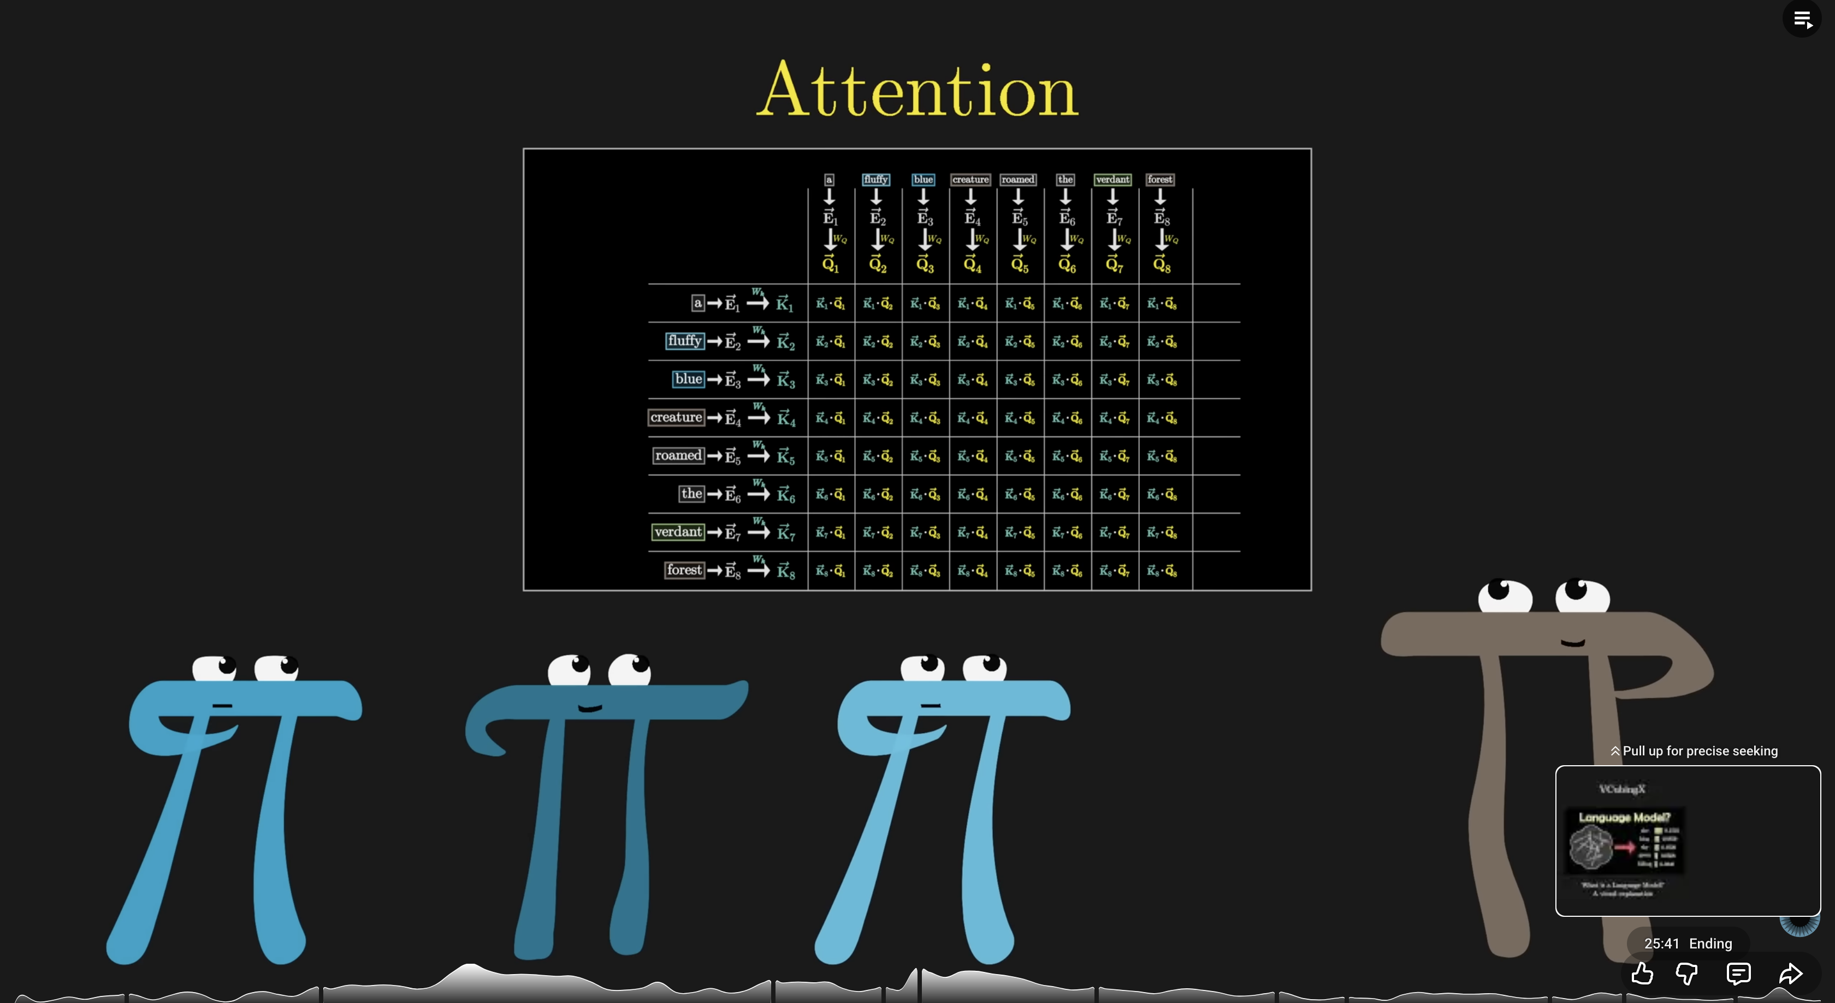
Last session: Grant Sanderson (3 Blue 1 Brown)
Query-Key-Value: each token produces a query (“what I want”), a key (“how to find it”), and a value (“what I get”)
Dot products between queries and keys score relevance; softmax normalizes into weights
Multi-headed attention (96 parallel heads in GPT-3) captures many types of contextual relationships
This resolves ambiguity: “mole” means different things depending on surrounding tokens (context)
Stacking layers builds increasingly abstract representations – from syntax to semantics to reasoning
Attention in transformers, step-by-step
Neural Networks Playlist Ch. 6

Slide 8


Last session: “Are LLMs just glorified auto-complete?”
At the mechanical level, yes: LLMs predict the next token
But the same reductive logic applies everywhere
  Neurons are just “electrochemical switches”
  Computers are just “flipping bits”
The important thing is the emergence of novel behaviors at scale
GPT-3: 175B parameters.
Human brain: 86B neurons, ~100T synaptic connections
Emergence: complex capabilities arising from the composition of simple operations
Example: BOIDS – 3 simple rules (Cohesion, Separation, Alignment) combine to produce flocking behavior
Original author: Craig Reynolds (amazing webpage)
Boids - The Emergence of Flocks
Coding Adventure: Boids

Slide 9
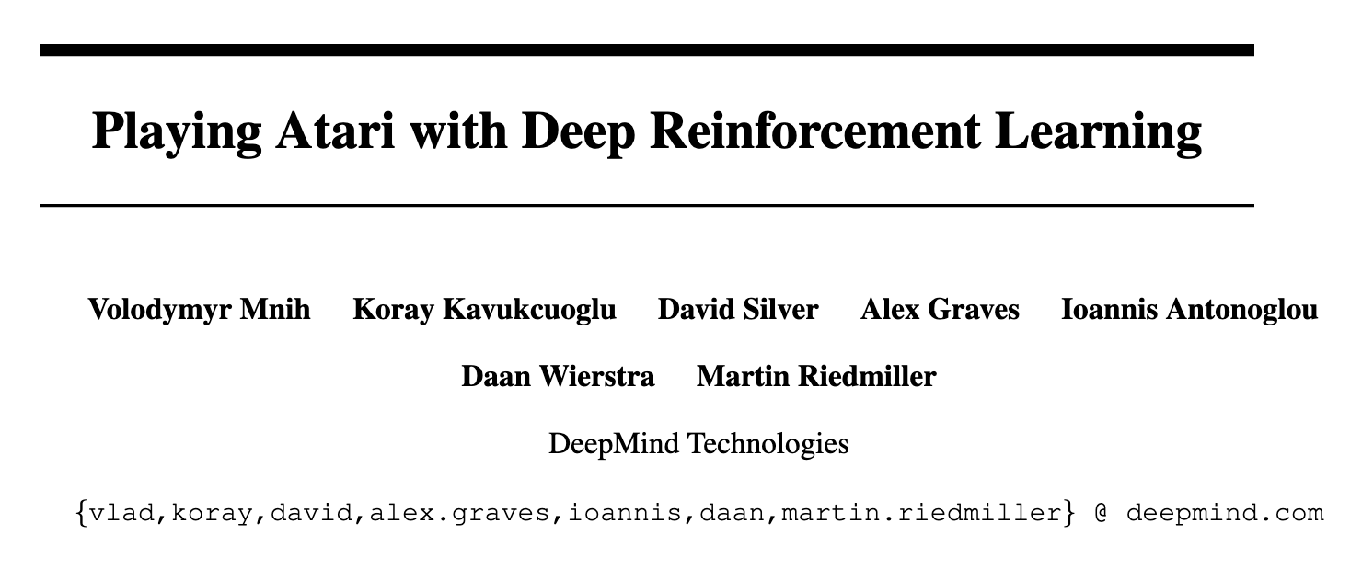


Last session: AI reflection i.e., windshield time / shower thoughts
Related neuroscience / psychology: Default Mode Network, Incubation
During sleep, the brain replays experiences and consolidates memories (hippocampal replay)
DeepMind’s DQN (2015): Experience replay – re-sampling past experiences during training – directly inspired by neuroscience
Deep Reinforcement Learning: Combines deep neural networks (DNN) with reinforcement learning (RL)
Offline consolidation: models reorganize internal representations between training phases, analogous to memory consolidation during sleep
Complementary learning systems: fast learning (hippocampus) + slow integration (neocortex) inspires dual-system AI architectures
Original DQN paper
Google DeepMind blog
‘The Power of Self-Learning Systems’ - Demis Hassabis lecture at IAS

Slide 10
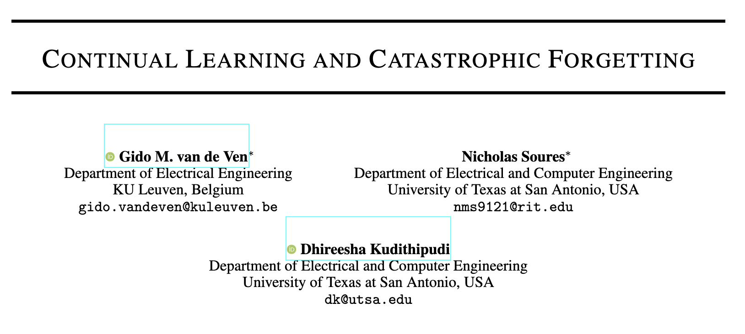
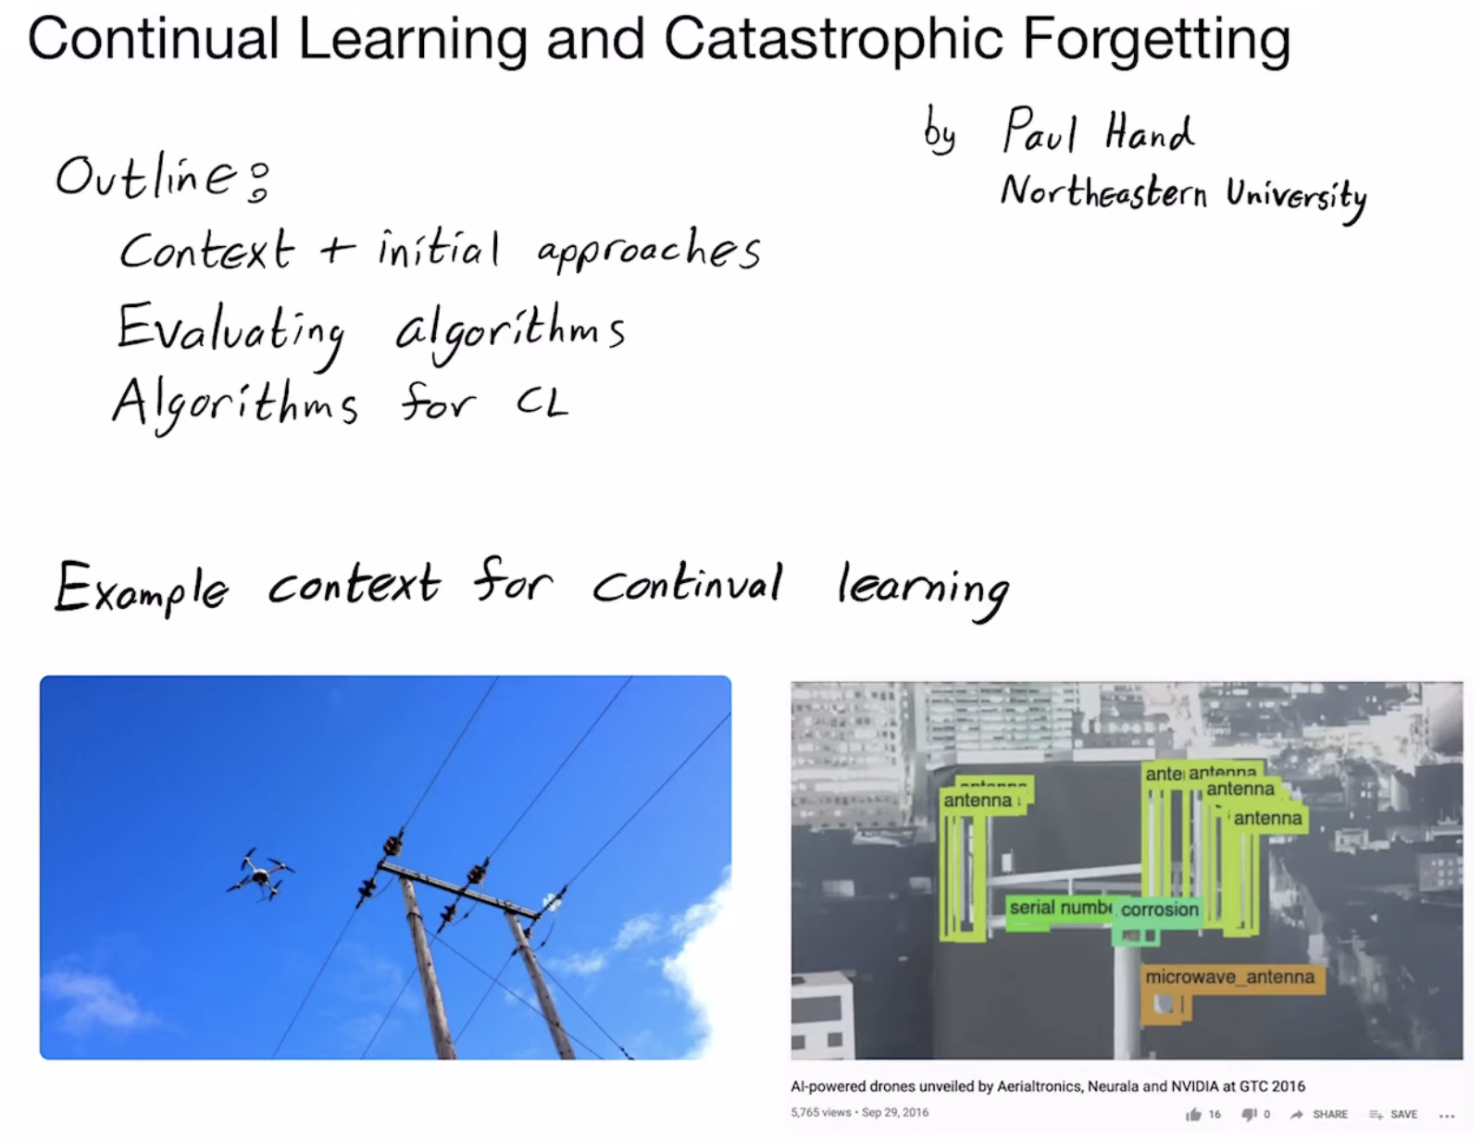
Last Session: Continual Learning and Catastrophic Forgetting
Humans learn continuously; learning to read doesn’t make you forget how to walk
Neural networks suffer catastrophic forgetting – new training can overwrite previous knowledge
Biological solution: synaptic consolidation, complementary learning systems, sleep-based replay
AI approaches inspired by biology: elastic weight consolidation, progressive networks, rehearsal, etc.
An active research frontier – and directly relevant to AI security (retraining risks, model drift)
Arxiv paper link
Paul Hand (Northeastern
University) video

Slide 11
Last Session: Biological / Artificial Intelligence Feedback Loop
AI borrows not just metaphors, but mechanisms from biology
The influence between neuroscience and AI runs both directions; advances in one unlock new questions in the other
Biology → AI examples: Neurons → Perceptron; Visual Cortex → CNNs (cat video, Nobel Lecture); Hippocampal Replay → Experience Replay; Cognitive Attention → Transformer Attention
AI → Biology examples: DNNs now predict neural responses better than hand-built models; Transformer attention generates new hypotheses about how brains allocate processing
Current frontier: ‘in silico’ neuroscience – using AI models to understand biological brains

Slide 12
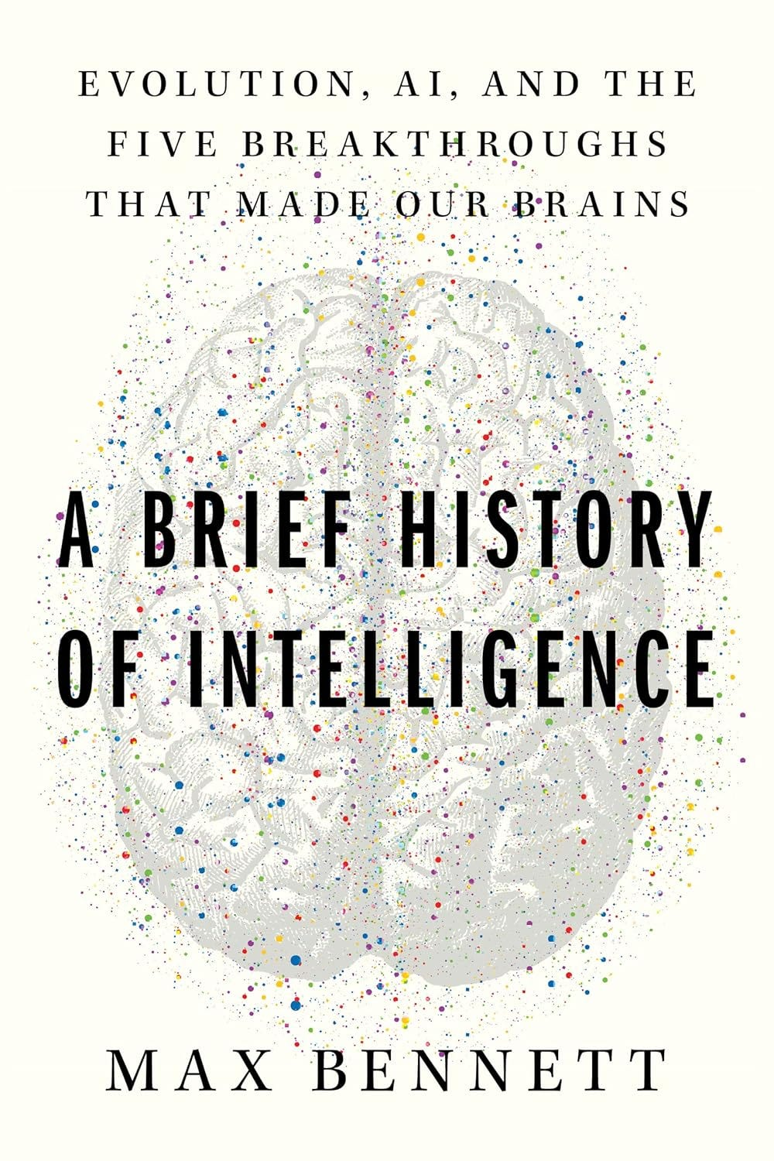
AMAZING Book: A Brief History of Intelligence – Max Bennett
Discusses 5 intelligence breakthroughs in biological evolution, makes connections to developments and analogs in AI
  Steering (chemical gradient valence stimulus in first bilaterians, ~550M years ago)
  Reinforcement learning (dopamine-driven loops in basal ganglia in first vertebrates ~500M years ago)
  Simulation (generative models in neocortices of first mammals, ~200M years ago)
  Mentalizing (social intelligence and theory of mind in first primates ~50-60M years ago)
  Symbolic language (communication and grammar in early humans, ~100-300K years ago)
Online slow-flip version - Spotify audiobook
Medium article: Book review

Slide 13
Why Biological / Artificial Intelligence Matters for CYB-4203-6203
Understanding what AI is and isn’t (“just autocomplete”) is prerequisite to reasoning about its security
Biology, neuroscience, and psychology can inform and illuminate AI capabilities, vulnerabilities, and failure modes (and vice versa)
Examples:
  Continual learning challenges create model drift and retraining vulnerabilities
  AI’s black box problem ↔ neurosci’s challenge understanding biological brains
  Prompt injection ↔ deception and lying
  Data poisoning ↔ human misinformation & belief formation

Slide 14
5.2 AI/ML system architectures:
Contrast with traditional software

Slide 15
Traditional Software vs. AI/ML: Design Philosophy
Traditional Software | AI/ML
Encoded Decisions | Approximated Functions
Behavior defined by explicit rules & logic | Behavior learned from data and training
“If X, then Y” – every decision path is authored by a human | “Given enough examples of X to Y, learn the mapping.”
Deterministic: same input always produces same output (mostly) | Probabilistic: outputs are predictions with confidence levels
Correctness is provable for many domains | Correctness is statistical, not absolute

Slide 16
Traditional Software vs. AI/ML: Development Process
Traditional Software | AI/ML
Requirements, design, code, test | Data collection, training, evaluation, tuning
Software is authored line-by-line | Models are trained, not written (i.e., grown not built)
Version control tracks every change | Experiment tracking (hyperparameters, datasets, metrics)
Code review ensures quality | Evaluation on held-out test sets
Developer skill determines capability | Data quality and quantity determine capability

Slide 17
Traditional Software vs. AI/ML: Failure Modes & Debugging
Traditional Software | AI/ML
Bugs are reproducible | Failures are often probabilistic
Stack traces point to the failing ‘line of code’ | No ‘line of code’ to blame
Logic errors can be stepped through | Model behavior emerges from training data and architecture
Root cause is identifiable | Interpretability is an active research challenge
Fix the code to fix the bug | Fix the data? The architecture? The training process?

Slide 18
Traditional Software vs. AI/ML: Testing & Verification
Traditional Software | AI/ML
Unit tests, integration tests, end-to-end tests | Evaluation metrics: accuracy, precision, recall, F1
Formal verification for critical systems | Benchmark datasets and leaderboards
Code coverage as a quality metric | Adversarial testing and red-teaming
You can prove a sorting algorithm correct | You cannot prove a classifier will never misclassify

Slide 19
Traditional Software vs. AI/ML: Advantages & Use Cases
Traditional Software | AI/ML
Well-defined business rules | Pattern recognition in unstructured data
Regulatory compliance logic | Natural language understanding and generation
Deterministic calculations | Computer vision and image analysis
Transaction processing | Anomaly detection in complex systems
Real-time control systems | Tasks too complex to hand-code rules for

Slide 20
5.3 – AI/ML system
Lifecycle / Pipeline

Slide 21
AI/ML System Lifecycle / Pipeline
Data Collection & Preparation | Model Training & Evaluation | Deployment & Integration | Monitoring & Maintenance
Data defines what the model learns – and what biases it inherits | Architecture choice determines what patterns the model can learn | Inference: running a trained model on new inputs to produce predictions | Data drift: the real world changes, but the model was trained on yesterday’s data
Feature engineering transforms raw data into model-ready representations | Training requires massive compute: GPUs/TPUs running for days to months | Latency vs. accuracy tradeoffs: model compression, quantization, distillation | Concept drift (input – output relationships), continual learning, catastrophic forgetting
Data versioning: tracking which data produced which model | Model weights are the learned parameters – often the most valuable intellectual property | Deployment targets: cloud APIs, on-device (mobile, IoT), embedded systems | Track accuracy, latency, fairness, input distribution
Security implications: data poisoning, privacy leakage, supply chain risks | Security implications: model theft, embedded backdoor attacks | Security implications: adversarial inputs, prompt injection, model inversion, resource exhaustion | Security implications: feedback manipulation, blind spot monitoring

Slide 22
Assignment 5: Published later today

