Slide 1
CYB-4203/6203
Secure and Trustworthy AI
Presentation 8: Governance, Documentation, and Auditability Across the AI/ML Pipeline
Wednesday, February 18, 2026
Topics: 4.3, 4.4

Slide 2
Overview
Today's Agenda
4.3: Organizational governance frameworks: NIST, ISO, MITRE, industry best practices
4.4: Documentation and auditability: model cards, datasheets, transparency reporting

Slide 3
4.3: Organizational AI Governance
4.4: Documentation & Auditability
Across the AI/ML Pipeline

Slide 4
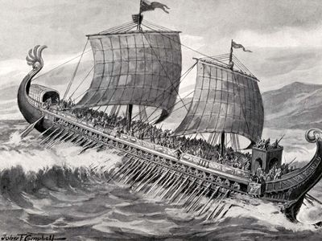
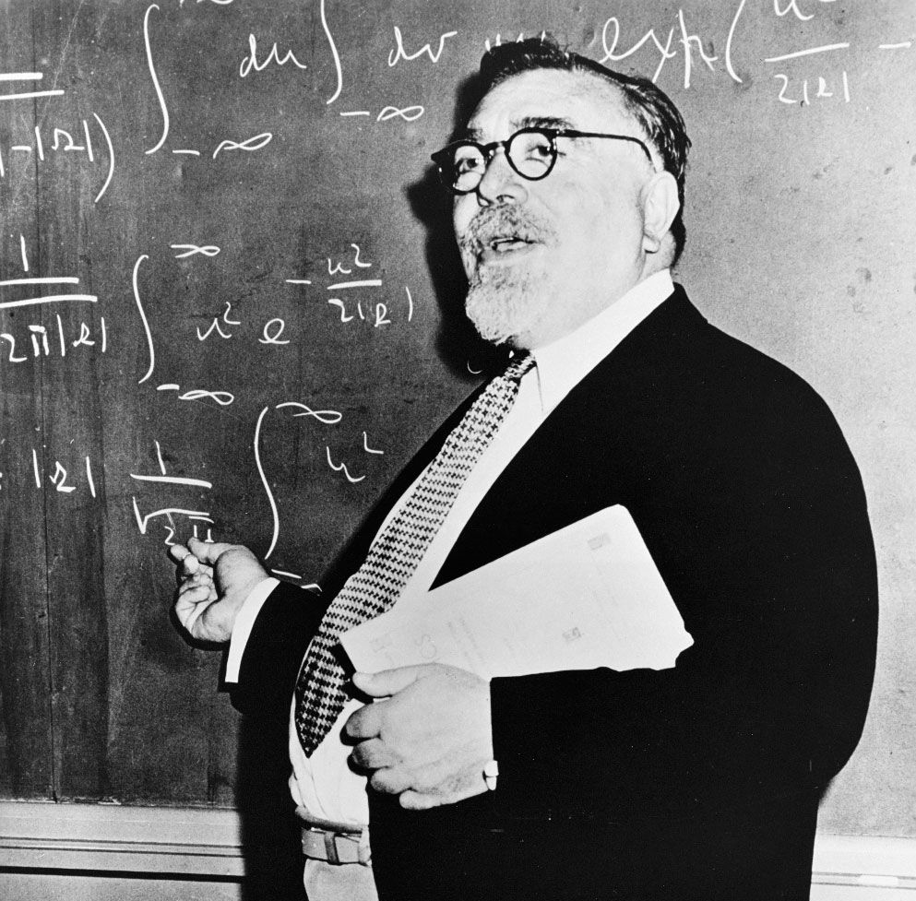

What is Governance? (an etymological-evolutionary excursion)
Ancient Greek
kybernan: ‘To steer or pilot a ship.’
Ancient Latin
gubernare: ‘To direct, rule, or govern.’
Mid-1900’s Norbert Weiner
cybernetics: ‘The scientific study of control and communication in the animal and the machine.’
Control & communication
Animal & machine
Feedback mechanisms
Homeostasis
Late 20th/early 21st Century Arnold
- 1993: “I’m a cybernetic organism. Living tissue over a metal endoskeleton.”
- 2003: Elected Governator of California
Coincidence?

Slide 5

What is Governance?
In general: Rules and processes that coordinate behavior.
Not just what governments do; defined more broadly as ‘the process through which some activity is organized, coordinated, steered, and managed.’
Includes the norms, policies, and institutions that influence stakeholders’ actions to achieve socially desirable outcomes.
Examples
Healthcare: Patient care norms, professional ethical standards, licensing organizations…
Financial services: Fiduciary duty norms, Basel III capital requirements, FDIC and SEC
Aviation: Crew safety culture, FAA airworthiness certifications, mandatory maintenance schedules, NTSB for independent accident investigation

Slide 6
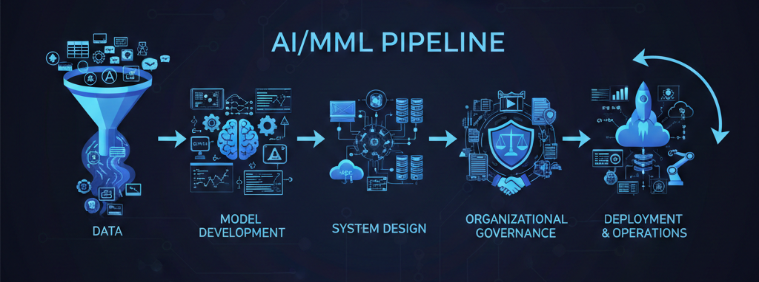
The AI/ML Pipeline (Nano Banana typo intentionally retained)

Slide 7
Data Governance

Slide 8
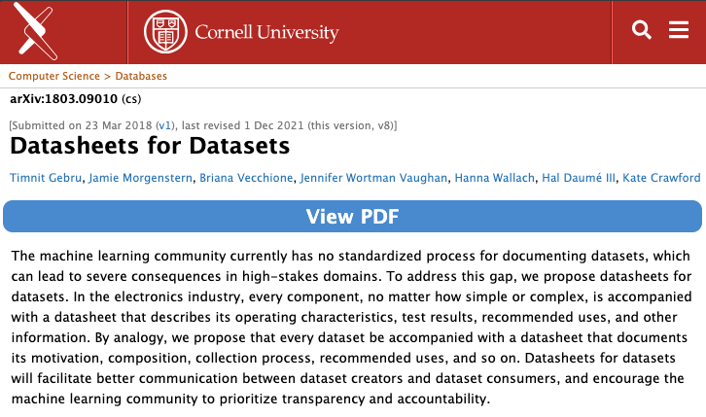
Datasheets for Datasets
Analogous to electronics datasheets: documents a dataset's motivation, composition, collection process, preprocessing, recommended uses, and distribution
Targets the data collection/curation stage of the pipeline — the earliest point where bias and provenance issues can be caught and documented
Influential on EU AI Act's data governance requirements (Article 10) and on NIST AI RMF's MAP function for data characterization
https://arxiv.org/abs/1803.09010

Slide 9
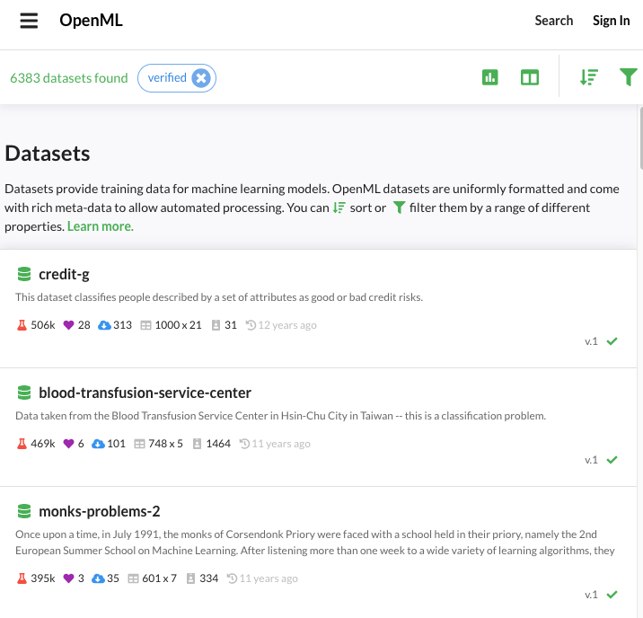
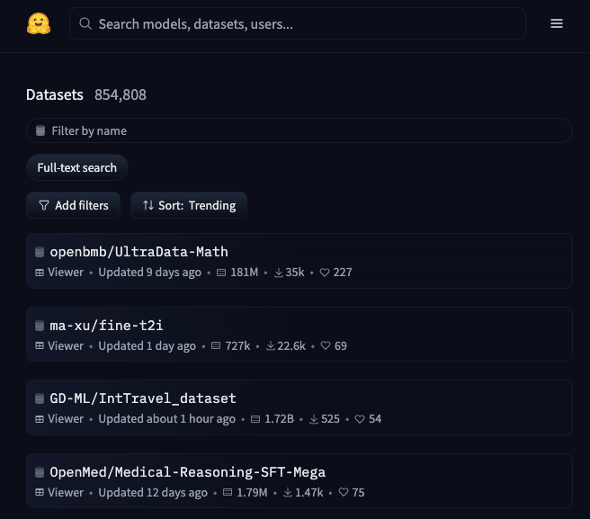
Datasheets for Datasets
https://www.openml.org
https://huggingface.co/datasets

Slide 10
Model Development Governance

Slide 11
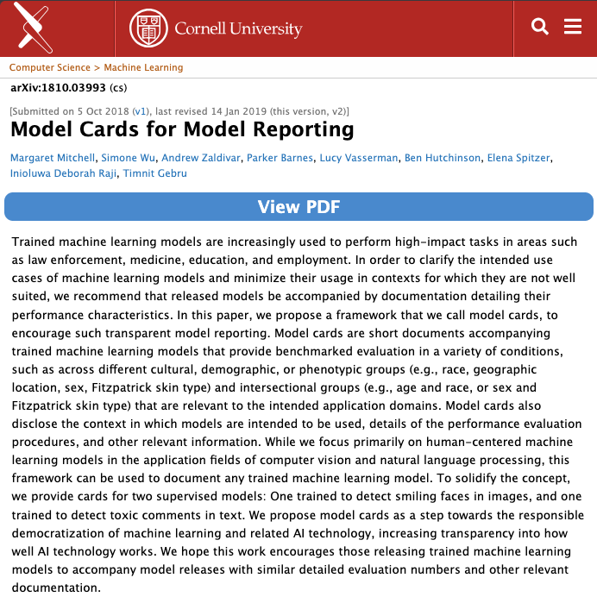
Model Cards for Model Reporting
Proposes short, standardized documents accompanying trained ML models that disclose intended use, performance benchmarks across demographic groups, and limitations
Directly addresses the model developer → deployer handoff — the doc artifact that lets downstream users make informed decisions about fitness for purpose
Now widely adopted: Hugging Face has Model Cards built into every model repo; Google, Meta, and OpenAI publish variants
https://arxiv.org/abs/1810.03993

Slide 12
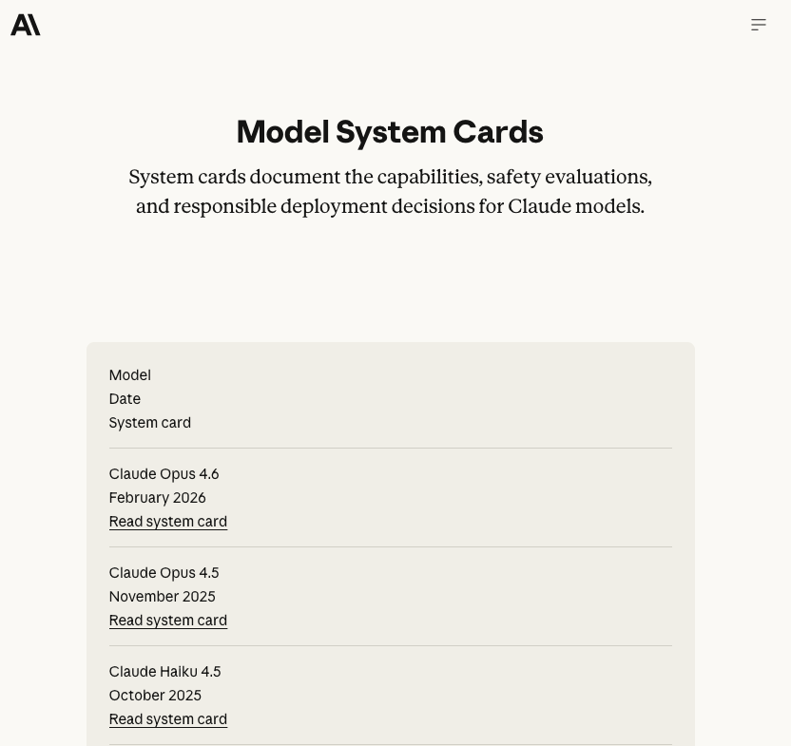
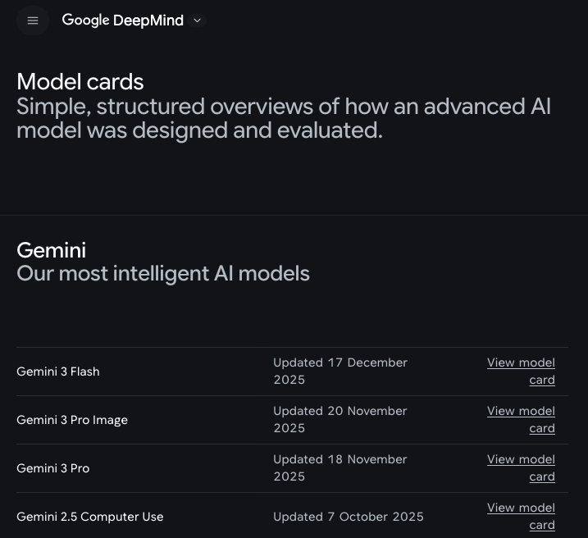
Model Card Examples
Anthropic System Cards
Google Model Cards

Slide 13
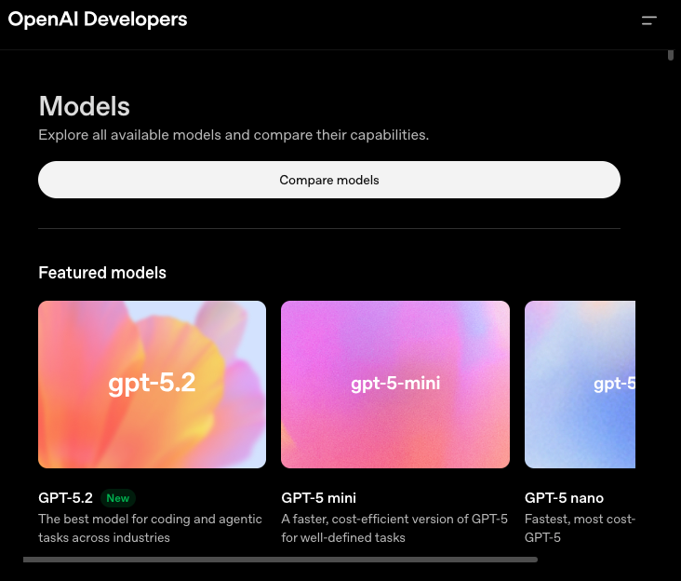
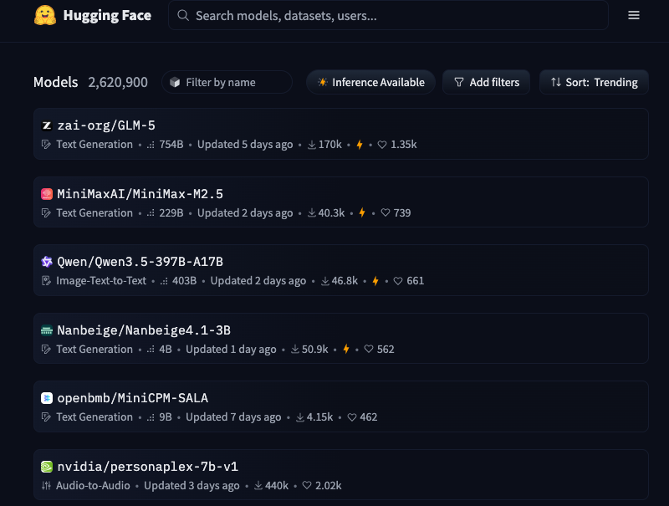
Model Card Examples
OpenAI Model Cards
Hugging Face Models

Slide 14
System Design Governance

Slide 15
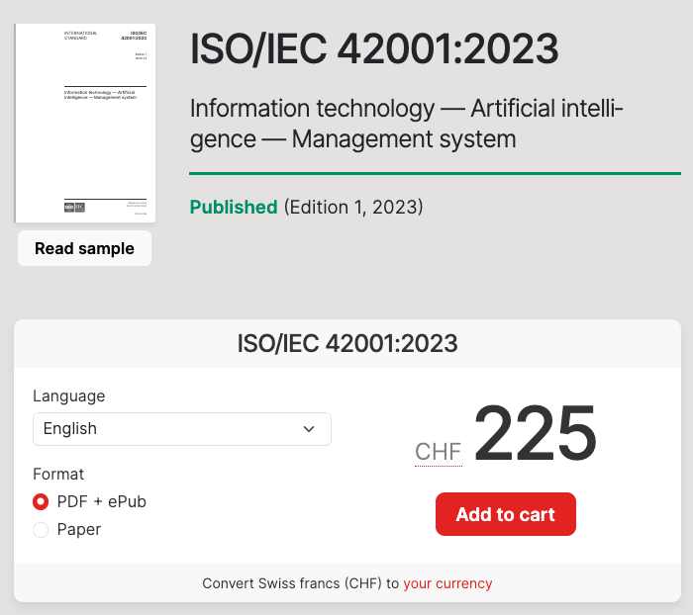
ISO/IEC 42001:2023
International Organization for Standardization /
International Electrotechnical Commission
First international certifiable standard for AI management systems — organizations can get audited and certified against it, which makes it a compliance differentiator
Covers AI policy, risk assessment, data governance, and continuous improvement
Referenced by the EU AI Act as a way to demonstrate conformity
https://www.iso.org/standard/42001

Slide 16
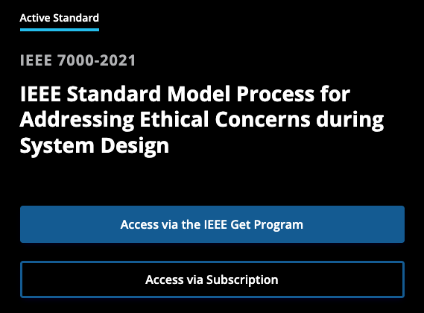
IEEE 7000-2021 – Ethical System Design Process
Establishes a model process for addressing ethical concerns during system design — not just AI-specific but highly relevant to AI systems
Provides traceability from ethical values through concept of operations → value propositions → ethical requirements → risk-based design decisions
Unique angle: a process standard focused on stakeholder elicitation and value prioritization, not just a checklist — good for orgs building AI products from scratch
https://standards.ieee.org/ieee/7000/6781/

Slide 17
Organizational Governance

Slide 18
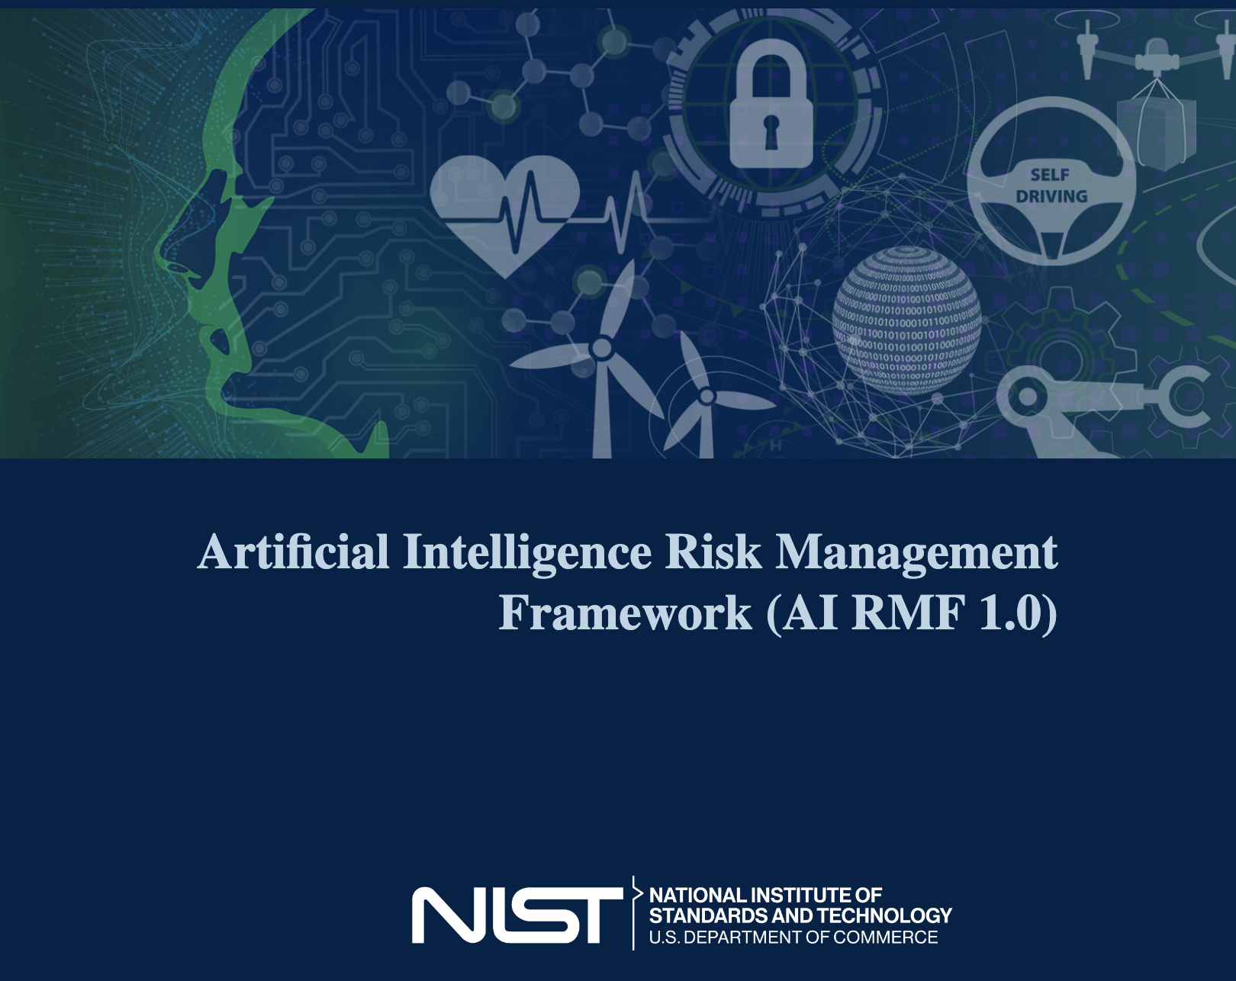
NIST AI Risk Management Framework (AI RMF 1.0)
‘The de facto US framework’
Remains the de facto US framework even after EO 14110 was rescinded in Jan 2025; widely adopted by industry as a baseline
Structured around four core functions — Govern, Map, Measure, Manage — providing a voluntary, flexible lifecycle approach to identifying and mitigating AI risks
Comes with a companion Playbook with suggested actions per sub-category, plus crosswalk documents mapping to other frameworks (ISO, OECD, EU AI Act)
https://www.nist.gov/itl/ai-risk-management-framework

Slide 19
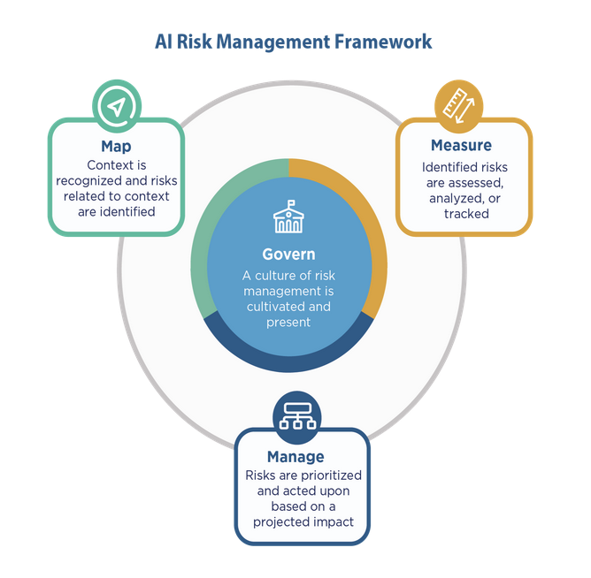
NIST AI Risk Management Framework (AI RMF 1.0)
Four Core Functions
Govern - Policies, processes, procedures and practices across the organization related to the mapping, measuring and managing of AI risks are in place, transparent, and implemented effectively.
Map - Context is established and understood.
Measure - Appropriate methods and metrics are identified and applied.
Manage - AI risks based on assessments and other analytical output from the Map and Measure functions are prioritized, responded to, and managed.
https://airc.nist.gov/airmf-resources/playbook/

Slide 20
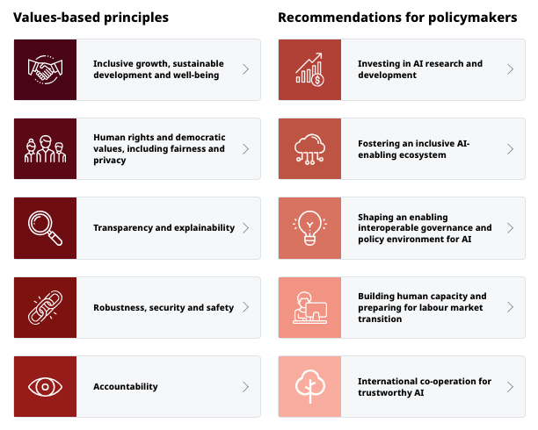
OECD AI Principles Overview
Oranisation for Economic Co-operation and Development
Five principles (inclusive growth, human-centered values, transparency, robustness/security, accountability)
Adopted by 46 countries — the closest thing to a global baseline. Directly influenced the G7 Hiroshima AI Process, the EU AI Act's risk categories, and NIST's AI RMF design
The OECD AI Policy Observatory provides a live tracker of national AI policies, useful for comparing governance approaches across jurisdictions
https://oecd.ai/en/ai-principles
https://oecd.ai/en/ - AI Policy Observatory (Global Tracker)

Slide 21
Deployment & Operational
Governance

Slide 22
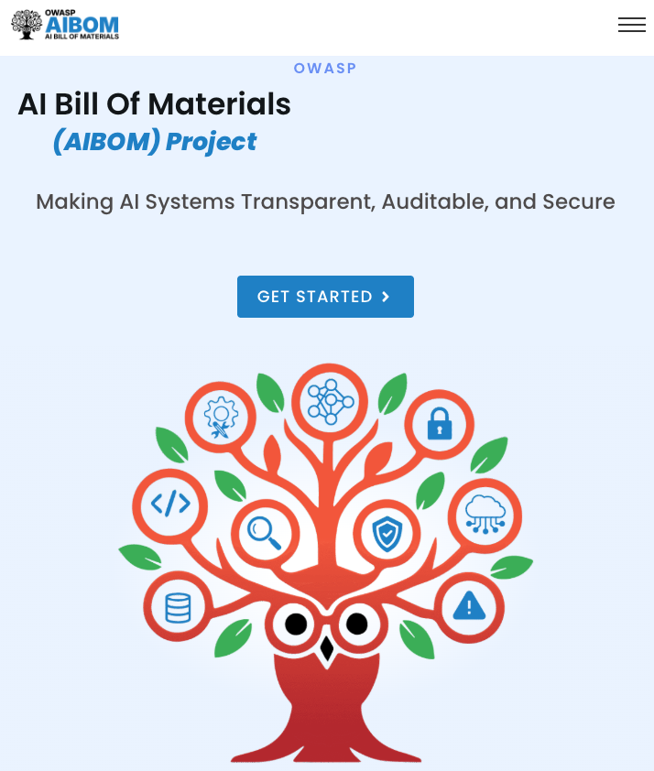
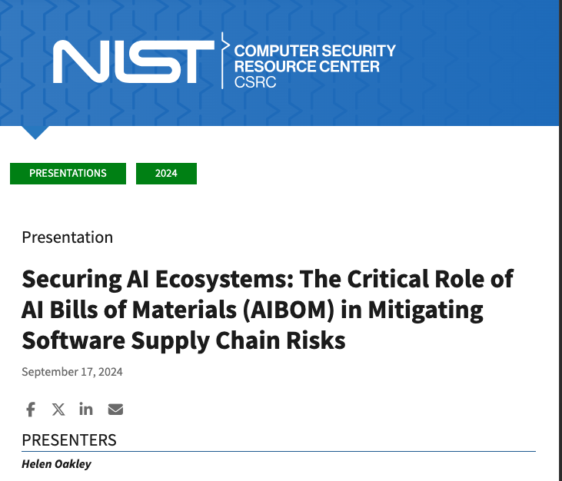
AI Bill of Materials (AI BOM) / ML Supply Chain Documentation
Emerging concept extending Software Bill of Materials (SBOM) to AI
Supply chain security; tracking model provenance, training data sources, fine-tuning history, and dependency chains
Addresses the deployment and operations stage — critical for incident response, vulnerability management, and regulatory audit trails
https://owaspaibom.org/
https://csrc.nist.gov/presentations/2024/securing-ai-ecosystems-the-critical-role-of-aibom

Slide 23
Assigned Reading
Hendrycks Ch. 8: Governance
Let’s talk about Assignment 5
Give me your ideas!

