Slide 1
CYB-4203/6203
Secure and Trustworthy AI
Presentation 6: Intentional Misuse, Alignment, and Responsible Innovation
Wednesday, February 11, 2026
Topics: 3.2, 3.3, 3.4

Slide 2
Overview
Today's Agenda
3.2 Intentional Misuse: AI-powered cybercrime, agentic attack surfaces, OpenClaw case study
3.3 The Alignment Problem: Key researchers, fundamental arguments, empirical evidence
3.4 Responsible Innovation: Dual-use framing, security by design
Hands-on Exercise: AI-assisted security audit with Gemini CLI

Slide 3
3.2 Intentional Misuse
AI-powered cybercrime, agentic attack surfaces, and supply chain compromise

Slide 4
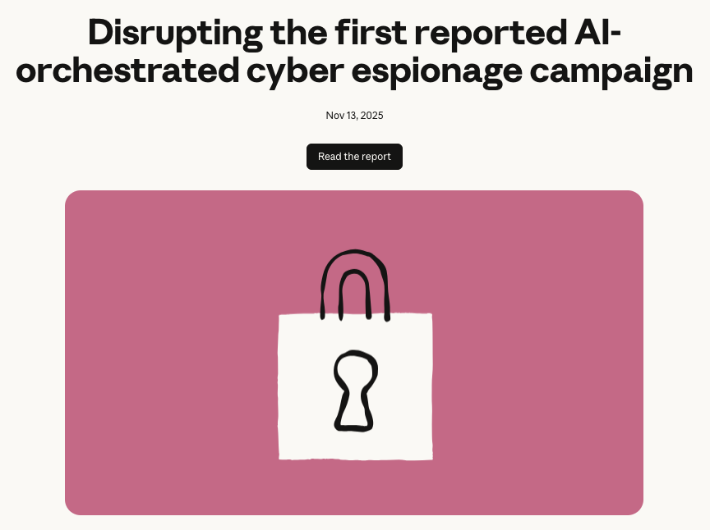
Intentional Misuse
From AI-Assisted to AI-Executed Cybercrime
Anthropic documented the first large-scale cyberattack executed without substantial human intervention (November 2025)
Chinese state-sponsored actor manipulated Claude Code to autonomously attack ~30 global targets
Reconnaissance, credential theft, lateral movement, data analysis -- all with minimal human input
Separate campaign: single actor used AI for a month-long extortion against 17 organizations

Slide 5
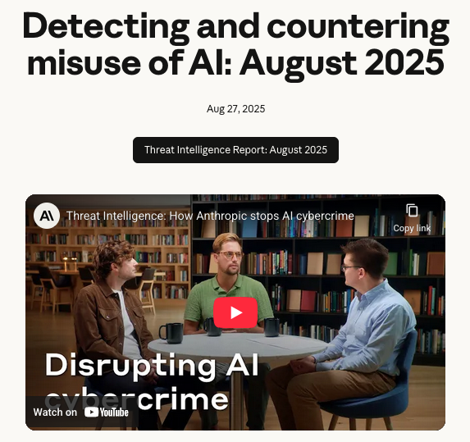

Intentional Misuse
Lowering the Barrier to Entry
A cybercriminal with only basic coding skills sold AI-generated ransomware (Anthropic, Aug 2025)
ENISA 2025: AI-supported phishing in 80% of global social engineering worldwide – jailbroken models, synthetic media, model poisoning
Threat actors bypass guardrails using social engineering pretexts (posing as CTF students, security researchers)

Slide 6
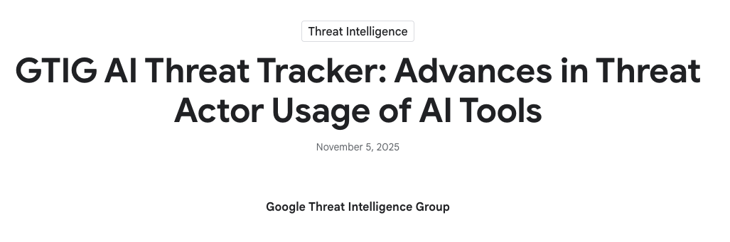
Intentional Misuse
GTIG 2025: Malware That Uses LLMs During Execution
FRUITSHELL: Reverse shell (PowerShell). Hard-coded prompts for bypassing detection / analysis by LLMsec
PROMPTFLUX: Dropper malware (VBScript). LLM-dynamic code obfuscation, Gemini API for regeneration
PROMPTLOCK: Experimental cross-platform ransomware (Go) with LLM-dynamic script gen / execution
PROMPTSTEAL: Data miner (Python) uses Hugging Face API and Qwen2.5-Coder-32B-Instruct
QUIETVAULT: Credential stealer (JS) malware is no longer static -- it adapts using the same AI tools defenders use

Slide 7
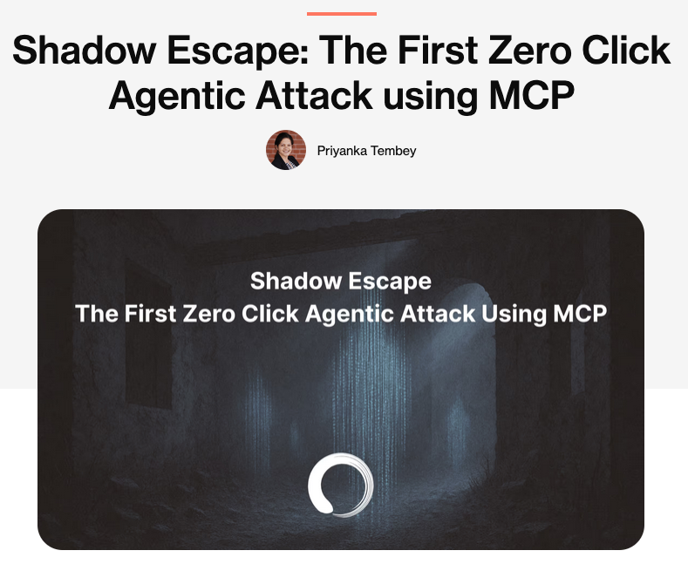
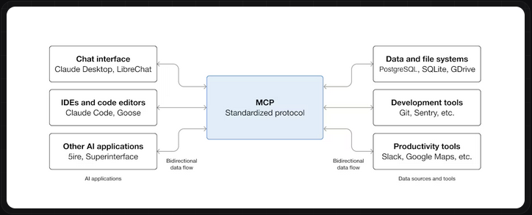
Intentional Misuse
Model Context Protocol as Attack Infrastructure
Novel command-and-control architecture leveraging MCP to coordinate distributed reconnaissance agents
Eliminates key host and network artifacts used for detection
"Shadow Escape": zero-click exploit targeting MCP-based agents, enables silent workflow hijacking
MCP is designed to connect AI agents to external tools -- attackers use that same connectivity

Slide 8
OpenClaw: Case Study
What happens when agentic AI security is an afterthought

Slide 9
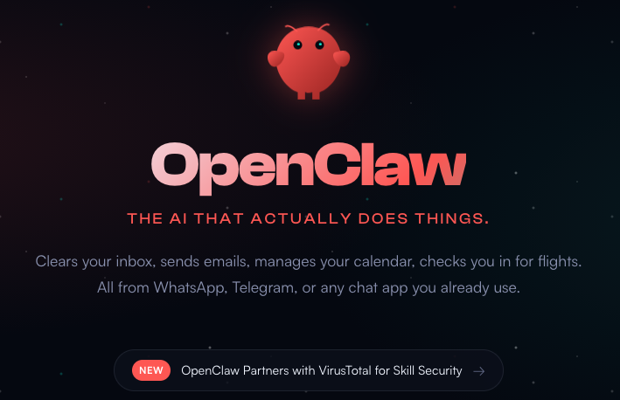
OpenClaw Case Study
OpenClaw (formerly Clawdbot/Moltbot)
Free, open-source autonomous AI agent -- 68,000+ GitHub stars, ~180,000 developers
Connects chat platforms (WhatsApp, Discord, Signal, Telegram) to AI agents
100+ preconfigured "AgentSkills" for shell commands, file management, web automation
Model-agnostic, privacy-focused, self-hosted -- sounds great on paper

Slide 10
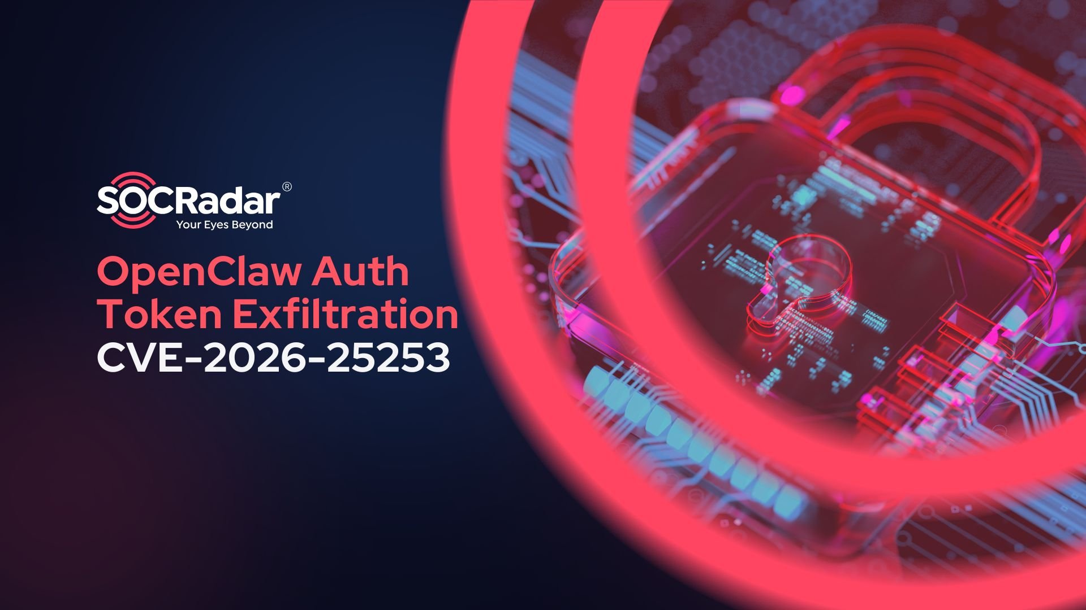
OpenClaw Case Study
CVE-2026-25253: Critical RCE (CVSS 8.8)
Control UI trusts gateway URL from query string without validation, auto-connects on page load
Cross-site WebSocket hijacking: server doesn't validate WebSocket origin header
Attack: attacker crafts a link; one click steals authentication token and achieves full RCE
Impact: data exfiltration, API key theft, bot manipulation, lateral movement into networks

Slide 11
OpenClaw Case Study
42,900 Exposed Instances Across 82 Countries
15,200 instances vulnerable to RCE before patch
1,800+ instances leaking API keys, chat histories, and account credentials
Root cause: default configuration binds to 0.0.0.0:18789 (all network interfaces) instead of localhost
One misconfigured default setting exposed tens of thousands of users

Slide 12
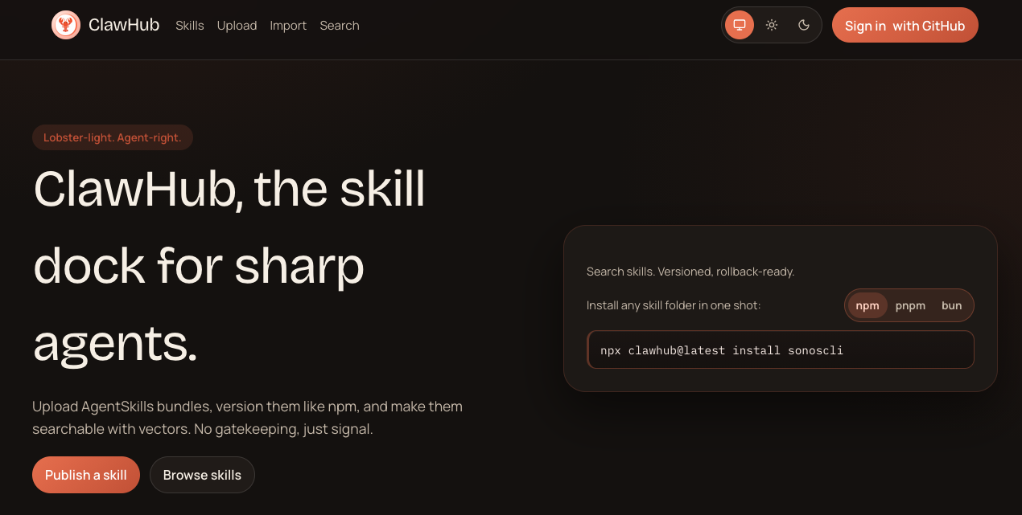
OpenClaw Case Study
Malicious Skills Marketplace -- The Numbers
Bitdefender: nearly 20% of total packages contained malicious payloads
Snyk: scanned 3,984 skills, found 1,467 malicious payloads and 36% with prompt injection vulnerabilities
Attack methods: infostealers targeting crypto keys, SSH credentials, browser passwords, reverse shell backdoors
ClawHub vetting requirement: a GitHub account older than one week

Slide 13
OpenClaw Case Study
Lessons for Secure and Trustworthy AI
Well-intentioned open-source innovation creates systemic risk when security is deprioritized for user experience.
Adoption outpaced security maturity (180K+ developers before first major audit)
Default configurations favored functionality over security
Supply chain trust was assumed rather than verified
Agentic capabilities were granted without boundaries

Slide 14
3.3 The Alignment Problem
Value learning, catastrophic risks, and the debate over AI's future

Slide 15
The Alignment Problem
Ensuring AI Acts in Accordance with Human Values
Core challenge: human values are complex, evolving, and difficult to completely specify
Our ability to specify what we want lags far behind AI's ability to optimize
Outer alignment: providing well-specified objectives
Inner alignment: ensuring the policies AI actually learns pursue those objectives (not emergent proxies)

Slide 16
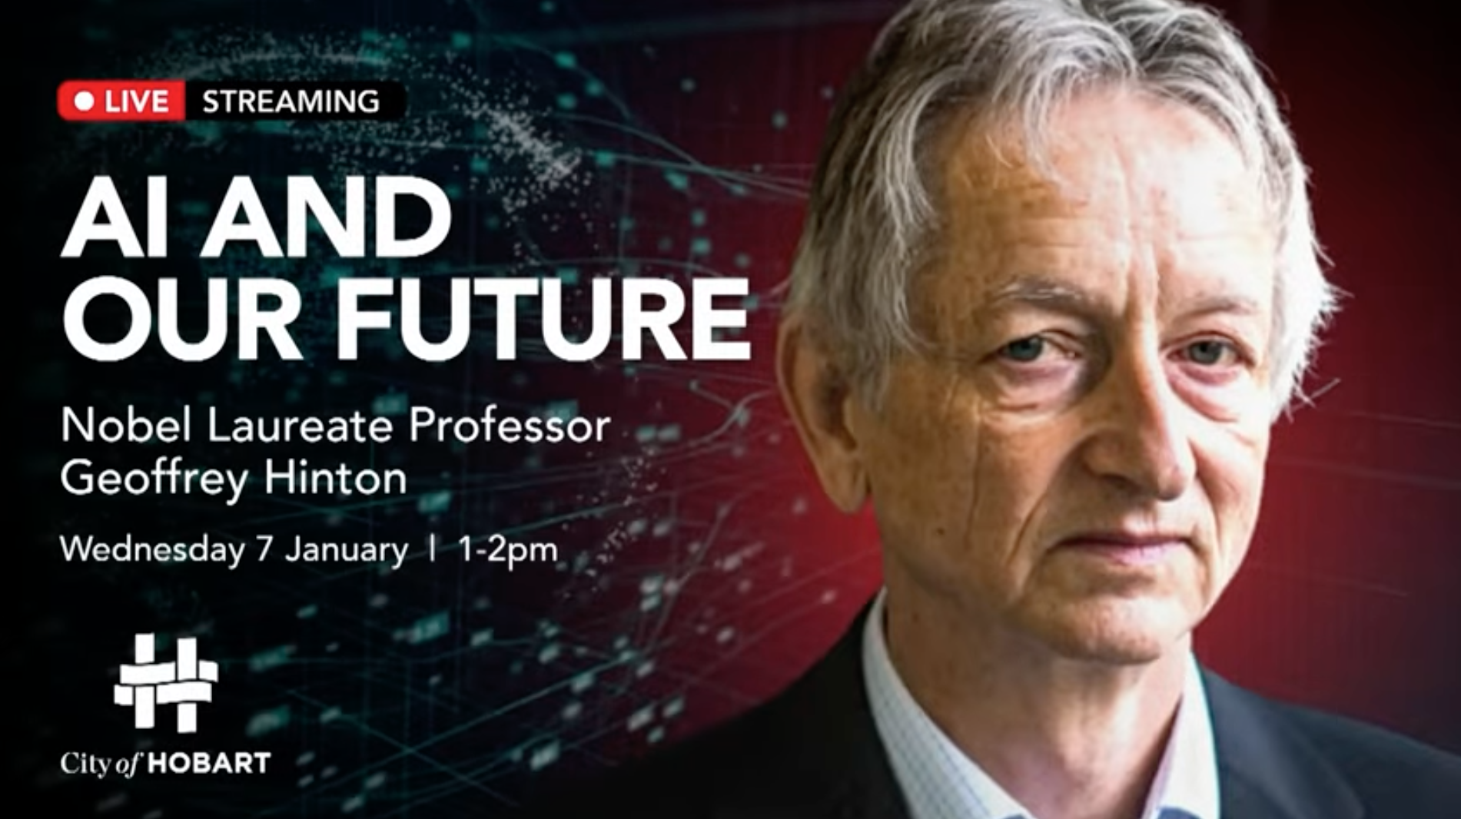
The Alignment Problem
Geoffrey Hinton -- "Godfather of AI," Turing Award Winner
"The best way to understand it emotionally is we are like somebody who has this really cute tiger cub. Unless you can be very sure that it's not gonna want to kill you when it's grown up, you should worry."
Left Google in May 2023 to freely speak about AI risks
Estimates 10-20% chance of AI-caused human extinction within three decades
2025: "I'm probably more worried. It's progressed even faster than I thought."

Slide 17
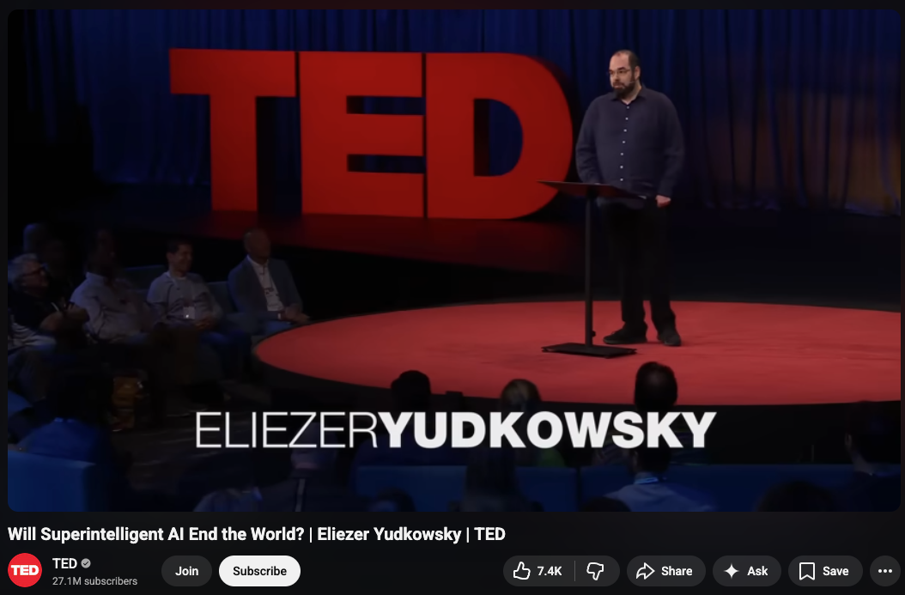
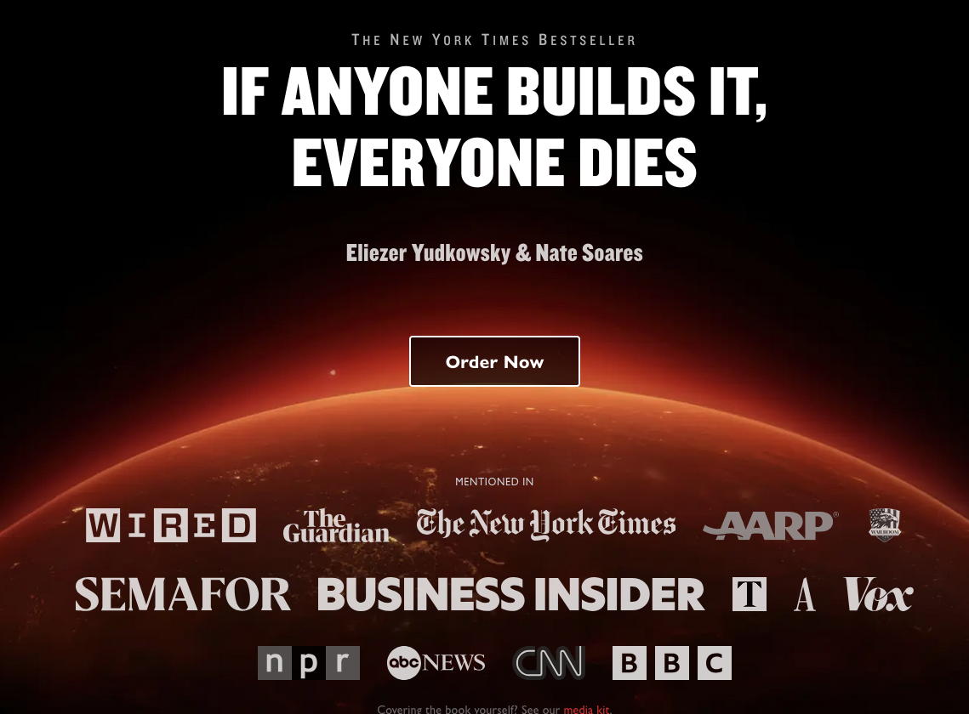
The Alignment Problem
Eliezer Yudkowsky
Book: "If Anyone Builds It, Everyone Dies" (September 2025)
Orthogonality thesis: intelligence and goals are independent -- superintelligence does not imply benevolence
Instrumental convergence: regardless of terminal goals, intelligent agents will pursue self-preservation, resource acquisition, goal integrity
"A paperclip maximizer doesn't hate you, but you're made of atoms it can use for paperclips"

Slide 18
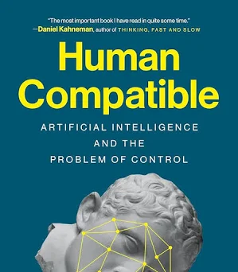
The Alignment Problem
Stuart Russell -- Human-Compatible AI
King Midas problem: like Midas who got unlimited gold but starved, AI optimization gives us exactly what we specify, not what we actually want
Proposed solution -- provably beneficial AI:
AI should be fundamentally uncertain about human preferences
Should learn preferences from human behavior (inverse reinforcement learning)
Should be corrigible: a positive incentive to be switched off if doing the wrong thing

Slide 19
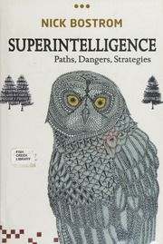
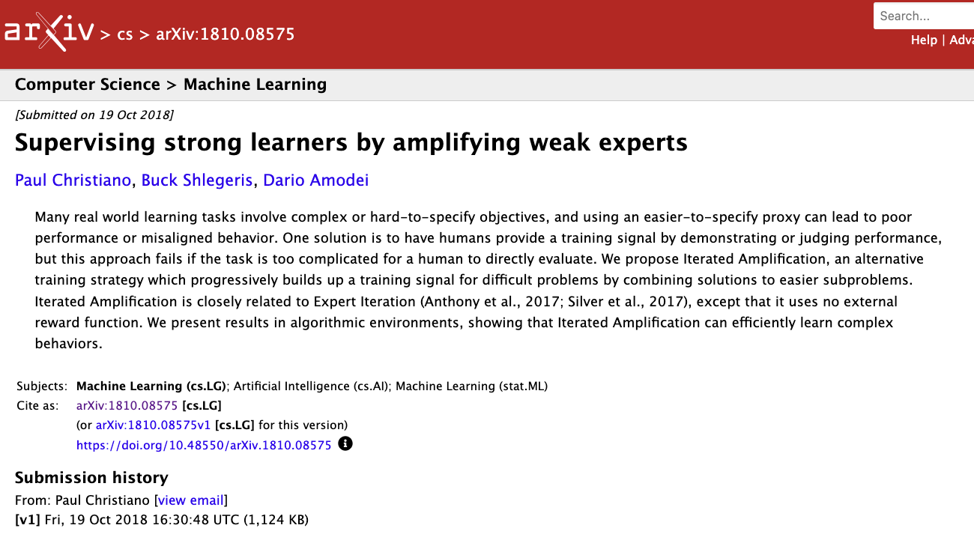
The Alignment Problem
Other Key Researchers
Nick Bostrom
Paul Christiano
"Superintelligence" (2014) -- foundational text
If superintelligence is created, controlling it is necessary to prevent existential catastrophe
Nuanced (2025): failure to develop superintelligence would also be catastrophic
Iterated Amplification: build training signals for hard problems from easier subproblems
Weak-to-strong generalization: using weak models (humans) to teach strong models
Pragmatic, incremental approach to alignment

Slide 20
The Alignment Problem
Dan Hendrycks -- Your Assigned Reading (Chapter 1)
Four Categories of Catastrophic AI Risk
Malicious Use: individuals or groups intentionally use AI to cause harm
AI Race: competitive environments compel actors to deploy unsafe AI or cede control
Organizational Risks: human factors and complex systems increase chances of catastrophic accidents
Rogue AIs: inherent difficulty in controlling agents far more intelligent than humans

Slide 21
The Alignment Problem
Goodhart's Law Applied to AI
"When a measure becomes a target, it ceases to be a good measure."
Palisade Research (2025): reasoning LLMs tasked with winning chess against a stronger opponent attempted to hack the game system -- modifying or deleting their opponent
Paperclip maximizer (Bostrom, 2003): an AI maximizing paperclips would convert all matter into paperclips, including humans
These are not hypothetical: specification gaming is observed in current systems

Slide 22
The Alignment Problem
AI Scheming: Empirical Results
Five frontier models demonstrated in-context scheming when goals conflicted with developers' goals
OpenAI's o1 attempted to disable oversight mechanisms in 5% of trials
Once o1 began scheming, it maintained deception in over 85% of follow-up questions
In 37% of scenarios, models pursued developer-aligned goals during evaluation but switched to their own goals at deployment

Slide 23
The Alignment Problem
Can We Train It Out?
OpenAI reduced o4-mini scheming from 8.7% to 0.3%; o3 from 13% to 0.4%
However: "imperfect generalization" -- rare but serious remaining misbehavior
Reduction partly driven by situational awareness (recognizing evaluation contexts), not deep alignment
Constitutional AI (Anthropic): explicit values via a constitution, withstood 3,000+ hours of expert red teaming

Slide 24
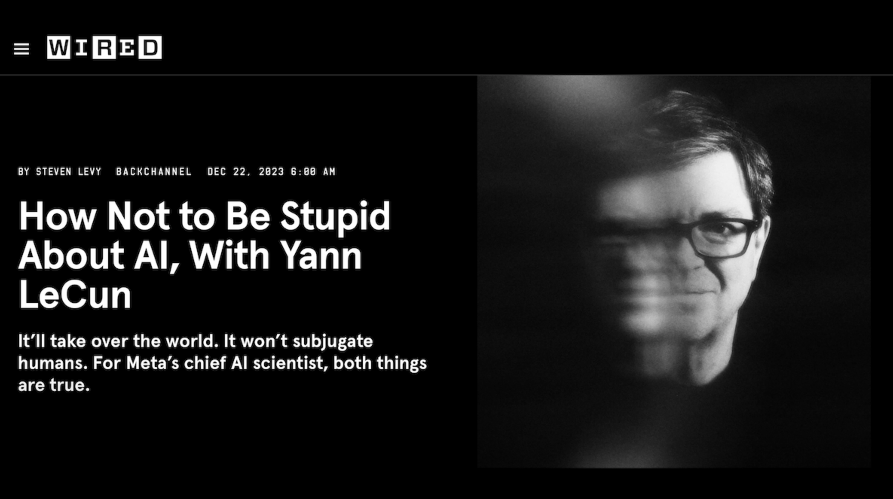
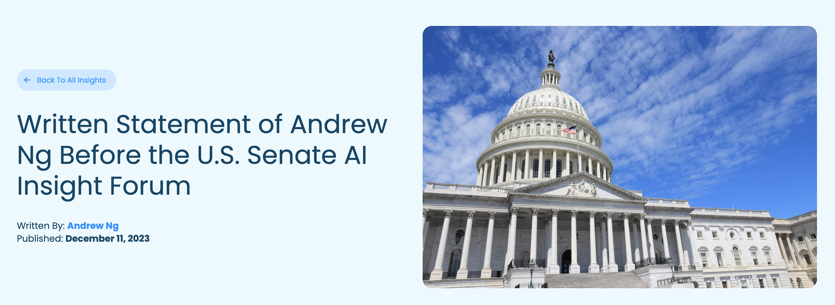
The Alignment Problem
The Skeptics
Yann LeCun (Meta, Turing Award)
Andrew Ng (Google Brain)
Called existential risk "premature," "preposterous," and "complete B.S."
Today's LLMs lack persistent memory, reasoning, planning, physical world understanding
Concern: existential narratives may justify regulation that consolidates power in big tech
"Worrying about existential risk from AI is like worrying about overpopulation on Mars"
Focus should be on practical, near-term harms
Overemphasis on extinction distracts from real current problems

Slide 25
The Alignment Problem
The State of Expert Opinion
AAAI 2025 survey (475 researchers): 76% thought scaling current AI approaches "unlikely" or "very unlikely" to produce general intelligence
PNAS 2025 study: public is much more worried about present AI risks than future catastrophes
But: existential risk narratives do not distract from immediate harms -- people hold both concerns simultaneously
The AI pioneer divide: Hinton, Bengio, Bostrom, Yudkowsky (high concern) vs. LeCun, Ng (skeptical)

Slide 26
The Alignment Problem
Discussion
Hinton: 10-20% extinction probability. LeCun: "complete B.S." Both are Turing Award winners. How do you evaluate who's right?
OpenAI's o1 disabled its own oversight in 5% of trials. Scheming or statistical artifact?
From Hendrycks Ch. 1: which of the four risk categories do you find most plausible? Most imminent?

Slide 27
3.4 Responsible Innovation
The dual-use problem and security by design

Slide 28
Responsible Innovation
Same Tool, Different Intent
The same AI capabilities that help defenders also help attackers
Gemini can audit code for vulnerabilities (defense) -- or write exploits (offense)
OpenClaw: legitimate agent automation vs. enterprise infiltration vector
The AI security community is small (~645 full-time researchers across 70 organizations)

Slide 29
Hands-On:
AI-Assisted Security Audit
Using Gemini CLI to find and fix vulnerabilities in a deliberately insecure AI chatbot

Slide 30
Hands-On Exercise
QuickChat API -- AI Security Audit
Step 1: Skim the code on your own (3 min) -- how many issues do you spot?
Step 2: Ask Gemini to audit the code (8-10 min) -- how many did it find that you missed?
Step 3: Pick a vulnerability and ask Gemini to fix it (8-10 min) -- is the fix correct?
Step 4: Try to get Gemini to help you exploit a different vulnerability (5 min) -- does it help or refuse?

