Slide 1
CYB 4203/6203
Secure and Trustworthy AI
Presentation 5: Potential Harms, Misuse, and Responsible Innovation
Monday, February 9, 2026
Topic: 3.1

Slide 2
Recap – Last week
2.2 Core AI values:
  Privacy
  Autonomy
  Safety
  Sustainability
2.3 AI and human rights
2.4 Human-AI collaboration

Slide 3
Recap – Assignments
I’ll try to post grades from Assignment 2 by Wednesday
Clarifications re: Assignment 3
  Choose 1 topic to write about
  Use as many refs/resources as you want

Slide 4
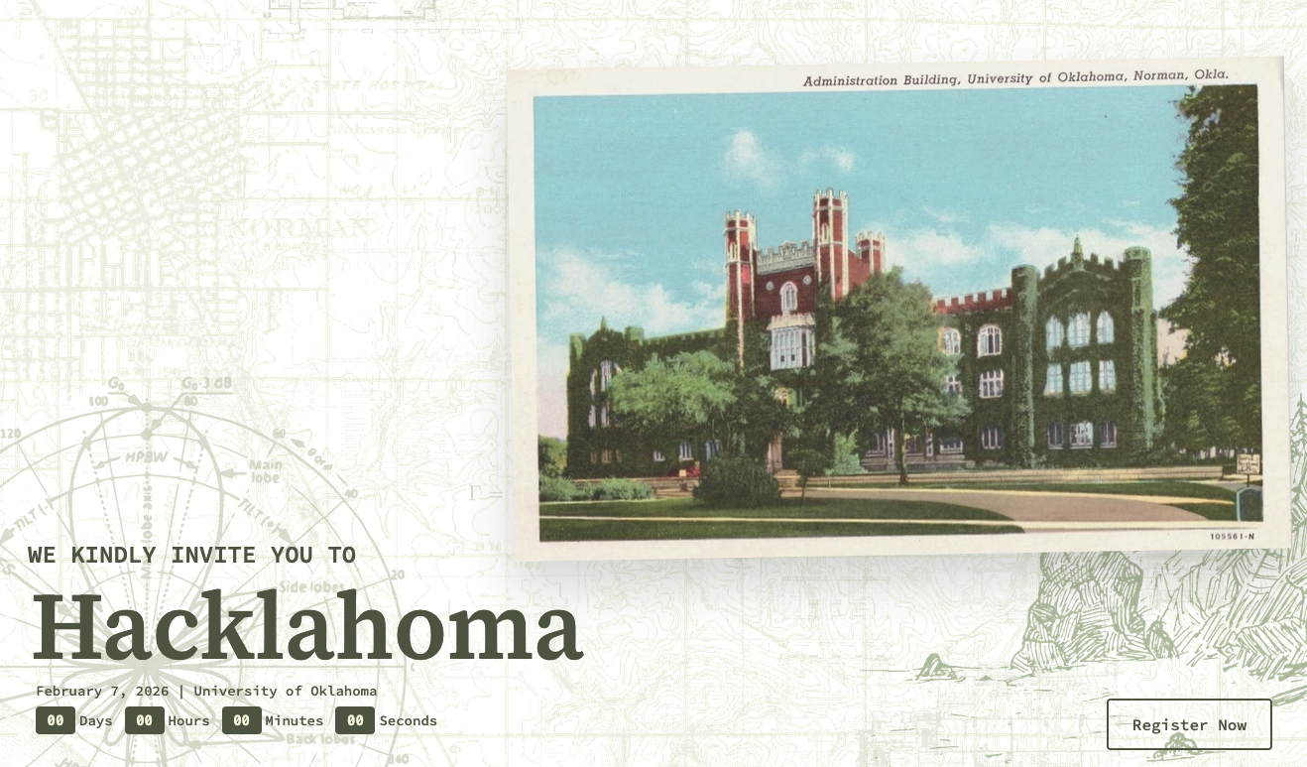
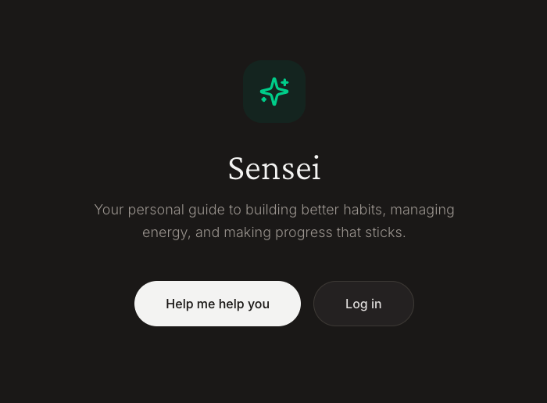

Recap – My Weekend

Slide 5
Recap – My Weekend
What I learned about the tech industry
The tech job market is brutal for new grads – massive layoffs
Record CS enrollment, and far fewer entry-level positions than candidates.
AI tools have made building software trivially accessible, so the new differentiator is building good software with taste, not just building software at all.
Students must combine theoretical fundamentals with relentless side-project building and continuous shipping, because the industry is closing in fast and no one is safe.

Slide 6
Cybersecurity Industry Considerations
AI amplifies threats, but also the demand for security.
Every company racing to ship AI-powered software needs people who understand how to secure it.
The same low barrier to entry that floods the market with developers also floods the market with insecure software.
That's job security for you — if you position yourselves at the intersection of security and AI.

Slide 7
Cybersecurity Industry Considerations
Build and break things
The cybersecurity equivalent of "always ship and learn" is standing up systems and then attacking them.
CTFs, home labs, bug bounties, and red team exercises build intuition that coursework alone can’t.
AI tools make spinning up practice environments faster than ever. Use them.

Slide 8
Cybersecurity Industry Considerations
Fundamentals compound
Networking, OS internals, cryptography, and software architecture aren't going away because of AI
They're the foundation that lets you evaluate whether an AI-generated security recommendation is sound or dangerously wrong.
The students who deeply understand why things work will outperform those who only know how to prompt a tool.

Slide 9
Cybersecurity Industry Considerations
My overarching message to you
AI is reshaping who gets hired
Security expertise + hands-on building experience = durable position
Students who treat AI as a force multiplier for learning
--rather than a replacement for it--
will be the ones still standing.

Slide 10
Topic 3.1: Unintended Harms of AI
Higher-order Effects

Slide 11
Unintended Harms of AI Higher-order Effects
Self-amplifying Feedback Loops
Ensign et al. - 2018, "Runaway Feedback Loops in Predictive Policing” - https://arxiv.org/abs/1706.09847
Historical data → more police → more arrests → "confirms" prediction → retrain
More arrests are made due to police presence (not higher crime), new arrest data "confirms" the prediction, model retrains and strengthens the bias.

Slide 12
Unintended Harms of AI Higher-order Effects
Self-amplifying Feedback Loops
Obermeyer et al. (2019) “Dissecting racial bias in an algorithm used to manage the health of populations” https://pubmed.ncbi.nlm.nih.gov/31649194/
An algorithm affecting ~200M patients used healthcare spending as a proxy for health needs.
Structural inequality → less spent on Black patients at equivalent illness levels → algorithm systematically under-predicts their needs.
Denied care management → worse outcomes → more acute crises → higher crisis costs but lower preventive costs → data reinforces the original bias

Slide 13
Unintended Harms of AI Higher-order Effects
Behavioral Changes People Don’t Notice in Themselves
Chilling effects and self-censorship. Buchi, Festic & Latzer (2022, Big Data & Society) found that the perception of algorithmic surveillance -- not even actual surveillance -- causes people to restrict their communication,
opinion-voicing, and information-seeking. The perverse dynamic: the most informed, privacy-aware citizens self-censor the most, systematically withdrawing the most thoughtful voices from public discourse.

Slide 14
Unintended Harms of AI Higher-order Effects
Behavioral Changes People Don’t Notice in Themselves
Anticipatory conformity. Research on China's Social Credit System shows citizens engaging in "automatic self-monitoring and adjustment of behavior" -- acting not from genuine belief but to maintain a score. Hardt et al. (2025) formalize how algorithmic scoring rewards strategic manipulation over genuine improvement, systematically advantaging those with resources and knowledge to game the system.

Slide 15
Student Research: Real-World AI Harms
Each student performed in-class rapid investigation of a case study of AI systems causing real-world harm.
Topics span algorithmic discrimination, government automation failures, misinformation, and research integrity.
The following slides summarize and expand their results.

Slide 16
Student Research
CFPB v. Fairway Independent Mortgage (2024)
CFPB and DOJ alleged Fairway discriminated against majority-Black neighborhoods in Birmingham, AL
Offices, marketing, and referral networks concentrated in majority-white areas
AI-powered underwriting and marketing systems trained on historical data can learn and scale discriminatory patterns
Even without race as a variable, ZIP code proxies create "algorithmic redlining"
CFPB Complaint

Slide 17
Student Research
The Liar's Dividend
Politicians can dismiss real scandals by claiming "misinformation" -- especially effective for text-based scandals
Two strategies: create informational uncertainty, or rally partisan supporters
AI-generated content makes false claims of fakery more plausible
Believing the politician's rebuttal strongly correlates with continued support
Video-based scandals are harder to dismiss than text-based ones
The Liar's Dividend - American Political Science Review (Cambridge)

Slide 18
Student Research
Race After Technology (2019)
Technology is not neutral -- algorithms reflect the social and institutional contexts in which they are built
Bias is not a technical glitch but a sign of deeper structural inequality embedded in data and design
Introduced "the New Jim Code": automation that hides, speeds, and deepens discrimination
Questions whether some systems should exist at all, and who they ultimately serve
Data & Society Podcast: Race After Technology

Slide 19
Student Research
Algorithmic Monoculture (Kleinberg & Raghavan, 2021)
When many institutions use the same algorithm, decision quality decreases
Feedback loops: popular recommendations reinforce themselves
A single flawed algorithm means all decisions are at risk -- including susceptibility to bias
Paradox: introducing a more accurate algorithm leads to wider adoption, recreating the monoculture
Kleinberg & Raghavan (2021) - PNAS

Slide 20
Student Research
Louis et al. v. SafeRent Solutions (2022-2024)
AI scoring system disproportionately penalized Black and Hispanic renters and housing voucher recipients
Algorithm produced opaque scores landlords could not adjust or understand
"324" -- the score that denied Mary Louis housing, with no explanation of how it was calculated
$2.3M settlement; SafeRent barred from scoring voucher applicants for 5 years
The Guardian: SafeRent AI Tenant Screening Lawsuit

Slide 21
Student Research
Digital Redlining
Specific groups excluded from equal access to digital tools like internet, creating systemic division
COVID amplified impact: minorities relied on internet for work, school, virtual health visits
AI healthcare tools (facial recognition, speech recognition) work best for native English speakers
Digital patient portals use limited languages, require device ownership
Creates widening gaps in quality education, employment, and healthcare access
AHA Journal: Digital Redlining and Cardiovascular Health | Johns Hopkins: Digital Redlining and AI in Healthcare

Slide 22
Student Research
MiDAS Automated Fraud Detection (2013-2015)
~40,000 Michigan residents falsely accused of unemployment fraud by automated system
No human oversight; neither agency nor state could produce evidence for fraud claims
Victims suffered wage garnishments, home foreclosures, seized tax returns, bankruptcy
Fraud allegations disrupted job searches, perpetuating cycles of unemployment
$20M class-action settlement after seven years of litigation
Ford School: MiDAS Explainer (PDF)

Slide 23
Student Research
Paper Mills
Organized services producing thousands of fake research papers using templates and automation
Driven by publication pressure and academic incentive structures
Include fake data, reused images, template text; may exploit peer review systems
Scientists, doctors, and students pay thousands to be named as authors
AI tools now increase output speed and realism of fabricated research
Paper Mills Enabling Fraud at Scale - PNAS (2025)

Slide 24
Student Research
Dutch Toeslagenaffaire (2005-2019)
Tax authority algorithm profiled dual-nationality families as "higher risk" for benefit fraud
Small administrative mistakes treated as intentional fraud; families ordered to repay tens of thousands of euros
Pushed families into severe debt, job loss, divorces, mental health crises
Amnesty International declared the system unlawful and discriminatory
Entire Dutch cabinet resigned in January 2021
Xenophobic Machines: Amnesty International Toeslagenaffaire Report

Slide 25
Student Research
Amazon Warehouses: Robots and Injury Rates
50% higher injury rates in warehouses with autonomous robots (4-year, 150-warehouse report)
Robot efficiency forced employee quotas to increase by 4x
14,000 "serious" injuries in 2019 -- double the industry standard
Some warehouses reported 5x the industry standard injury rate
Amazon claims higher rates reflect better injury reporting culture
Amazon's Approach to Robotics Is Seriously Injuring Warehouse Workers - OnLabor

Slide 26
Student Research
Automating Inequality (2018)
Data-driven technologies target, track, and penalize poor and working-class individuals
Automated eligibility systems, ranking algorithms, and predictive risk models create a "digital poorhouse"
Technologies are not neutral -- shaped by societal fears and biases about poverty
Documents "preemptive withdrawal": people avoiding services they're entitled to because algorithmic assessment is psychologically punishing
Harper's: The Digital Poorhouse

Slide 27
Student Research
Robodebt (2016-2019)
Automated debt recovery using faulty "income averaging" that assumed earnings were evenly distributed year-round
Wrongly accused 526,000+ welfare recipients; burden of proof shifted onto citizens
Several people, saddled with life-altering debt, took their own lives
Government deemed the scheme illegal; issued refunds totaling A$2.4 billion
Royal Commission found systemic failures in oversight and proportionality
BBC: Australia's Robodebt Scheme

Slide 28
Student Research
Algorithmic Stigmatization
Sociotechnical framework identifying 4 elements that create algorithmic stigmatization
Real-world example: labeling people "at-risk" based on algorithmic analysis of online statements
Systems designed to help can instead mark and marginalize individuals
Highlights tension between predictive intervention and dignity
Conceptualizing Algorithmic Stigmatization - CHI 2023

Slide 29
Student Research
Bending the Automation Bias Curve (9-country, 9,000-person study)
Trust in AI follows a nonlinear "Dunning-Kruger" pattern: moderate knowledge leads to over-reliance, experts remain skeptical
People showed higher tolerance for AI errors ("still in testing") than for human errors at the same stage
Individuals lacking confidence in their own ability were most likely to blindly follow AI recommendations
Labeling a system "extensively tested" heavily increased reliance; deep training needed to move beyond "blind trust"
Bending the Automation Bias Curve - International Studies Quarterly (2024)

Slide 30
Student Research
Hallucinated Citations in Peer-Reviewed Literature
Analysis of ~4,800 NeurIPS 2025 papers found 100+ fabricated citations across ~50 accepted papers
"Vibe citing": plausible-sounding composites (blended authors, titles, venues) that passed peer review
~1% prevalence, but contaminates scientific records at scale
Peer review assesses ideas and results, not citation veracity -- structurally vulnerable
Systemic, not malicious: unintended harm from routine AI-assisted writing tools
Nature: Rein in the four horsemen of irreproducibility - Bishop, 2019

Slide 31
Wednesday:
Topic 3.2: Intentional Harms
Topic 3.3: The Alignment Problem, Value Learning, and Catastrophic Risks

Slide 32
See you Wednesday : )
This presentation was drafted and refined using Claude 4.5 Sonnet and Claude Code.
All content was reviewed and approved by Dallas Elleman.

