Slide 1
CYB 4203/6203
Secure and Trustworthy AI
Presentation 4: Human Rights and Human-AI Collaboration
Wednesday, February 4, 2026
Topics: 2.2, 2.3, 2.4

Slide 2
Recap – Last Week
Key Themes: 2.2 – Core AI Values (part I)
Fairness types: distributive, procedural, interactional, personal vs. collective
Fairness challenges: context-dependence, provable impossibility, algorithmic (definition, measurement, optimization), data (world we have vs. want)
Fairness re: core machine learning tasks – (1) classification, (2) regression & prediction, (3) ranking & recommendation, (4) clustering & segmentation, (5) generation, (6) detection & recognition, (7) optimization & resource allocation

Slide 3
Recap – Last Week
Key Themes: 2.2 – Core AI Values (part I)
Transparency: Model, data, decision, trade-offs, stakeholder-appropriateness
Accountability: Ownership, governance, redress, liability, challenges

Slide 4
Today’s Agenda
2.2 Core AI values:
  Privacy
  Autonomy
  Safety
  Sustainability
2.3 AI and human rights
2.4 Human-AI collaboration

Slide 5
Topic 2.2: Core AI Values
Fairness – Transparency – Accountability
Privacy – Autonomy – Safety – Sustainability*
*not an exhaustive list

Slide 6
Core AI Value - Privacy
AI needs vast datasets – often collected without consent
Privacy threats: deepfake ID fraud, automated phishing, inference of sensitive info from seemingly unrelated data, etc…
Users sharing data with chatbots may not read TOS
  Stanford study: privacy risks of AI chatbot conversations
Fragmented regulatory landscape – GDPR, CCPA, EU AI Act
  2025: 1262 AI-related laws proposed in the U.S. (NCSL database)
Machine unlearning – technical process of removing the influence of specific training data from a ML model without retraining from scratch

Slide 7
Core AI Value - Autonomy
“You can choose a ready guide in some celestial voice
If you choose not to decide, you still have made a choice
You can choose from phantom fears and kindness that can kill…”
(what’s the next lyric?)

Slide 8

Core AI Value - Autonomy
“You can choose a ready guide in some celestial voice
If you choose not to decide, you still have made a choice
You can choose from phantom fears and kindness that can kill
I will choose a path that’s clear: I will choose Freewill.”
- Neil Peart (1952-2007), Freewill by Rush

Slide 9
Core AI Value - Autonomy
”… a person’s effective capacity to act on the basis of beliefs, values, motivations, and reasons that are in some relevant sense their own.”
- Carina Prunkl, 2024
Prunkl discusses several dimensions of autonomy:
Authenticity (internal): Are my beliefs truly ‘mine’?
  Example: adaptive preference formation from limited presented options
Agency (external): Can I act on my beliefs to control my life?
  Competency (skill), freedom (legal), opportunity (social access)
Discussion: How is AI impacting internal and external autonomy?

Slide 10
Core AI Value - Safety
Is it possible to make intelligence ‘safe’?
Core challenges: Alignment, Control, Interpretability, Robustness
February 2026 International AI Safety Report highlights:
  Gen-AI capabilities continue to improve, esp. math, coding, autonomy
  Fueled by both pre-training and post-training
  Rapid (faster than PC) but unevenly-distributed adoption
  Heightened concerns re: bio-weapons development, cyberattacks
Future of Life Institute Winter 2025 Safety Index Report
  AI experts rate leading AI companies on key safety/security domains

Slide 11
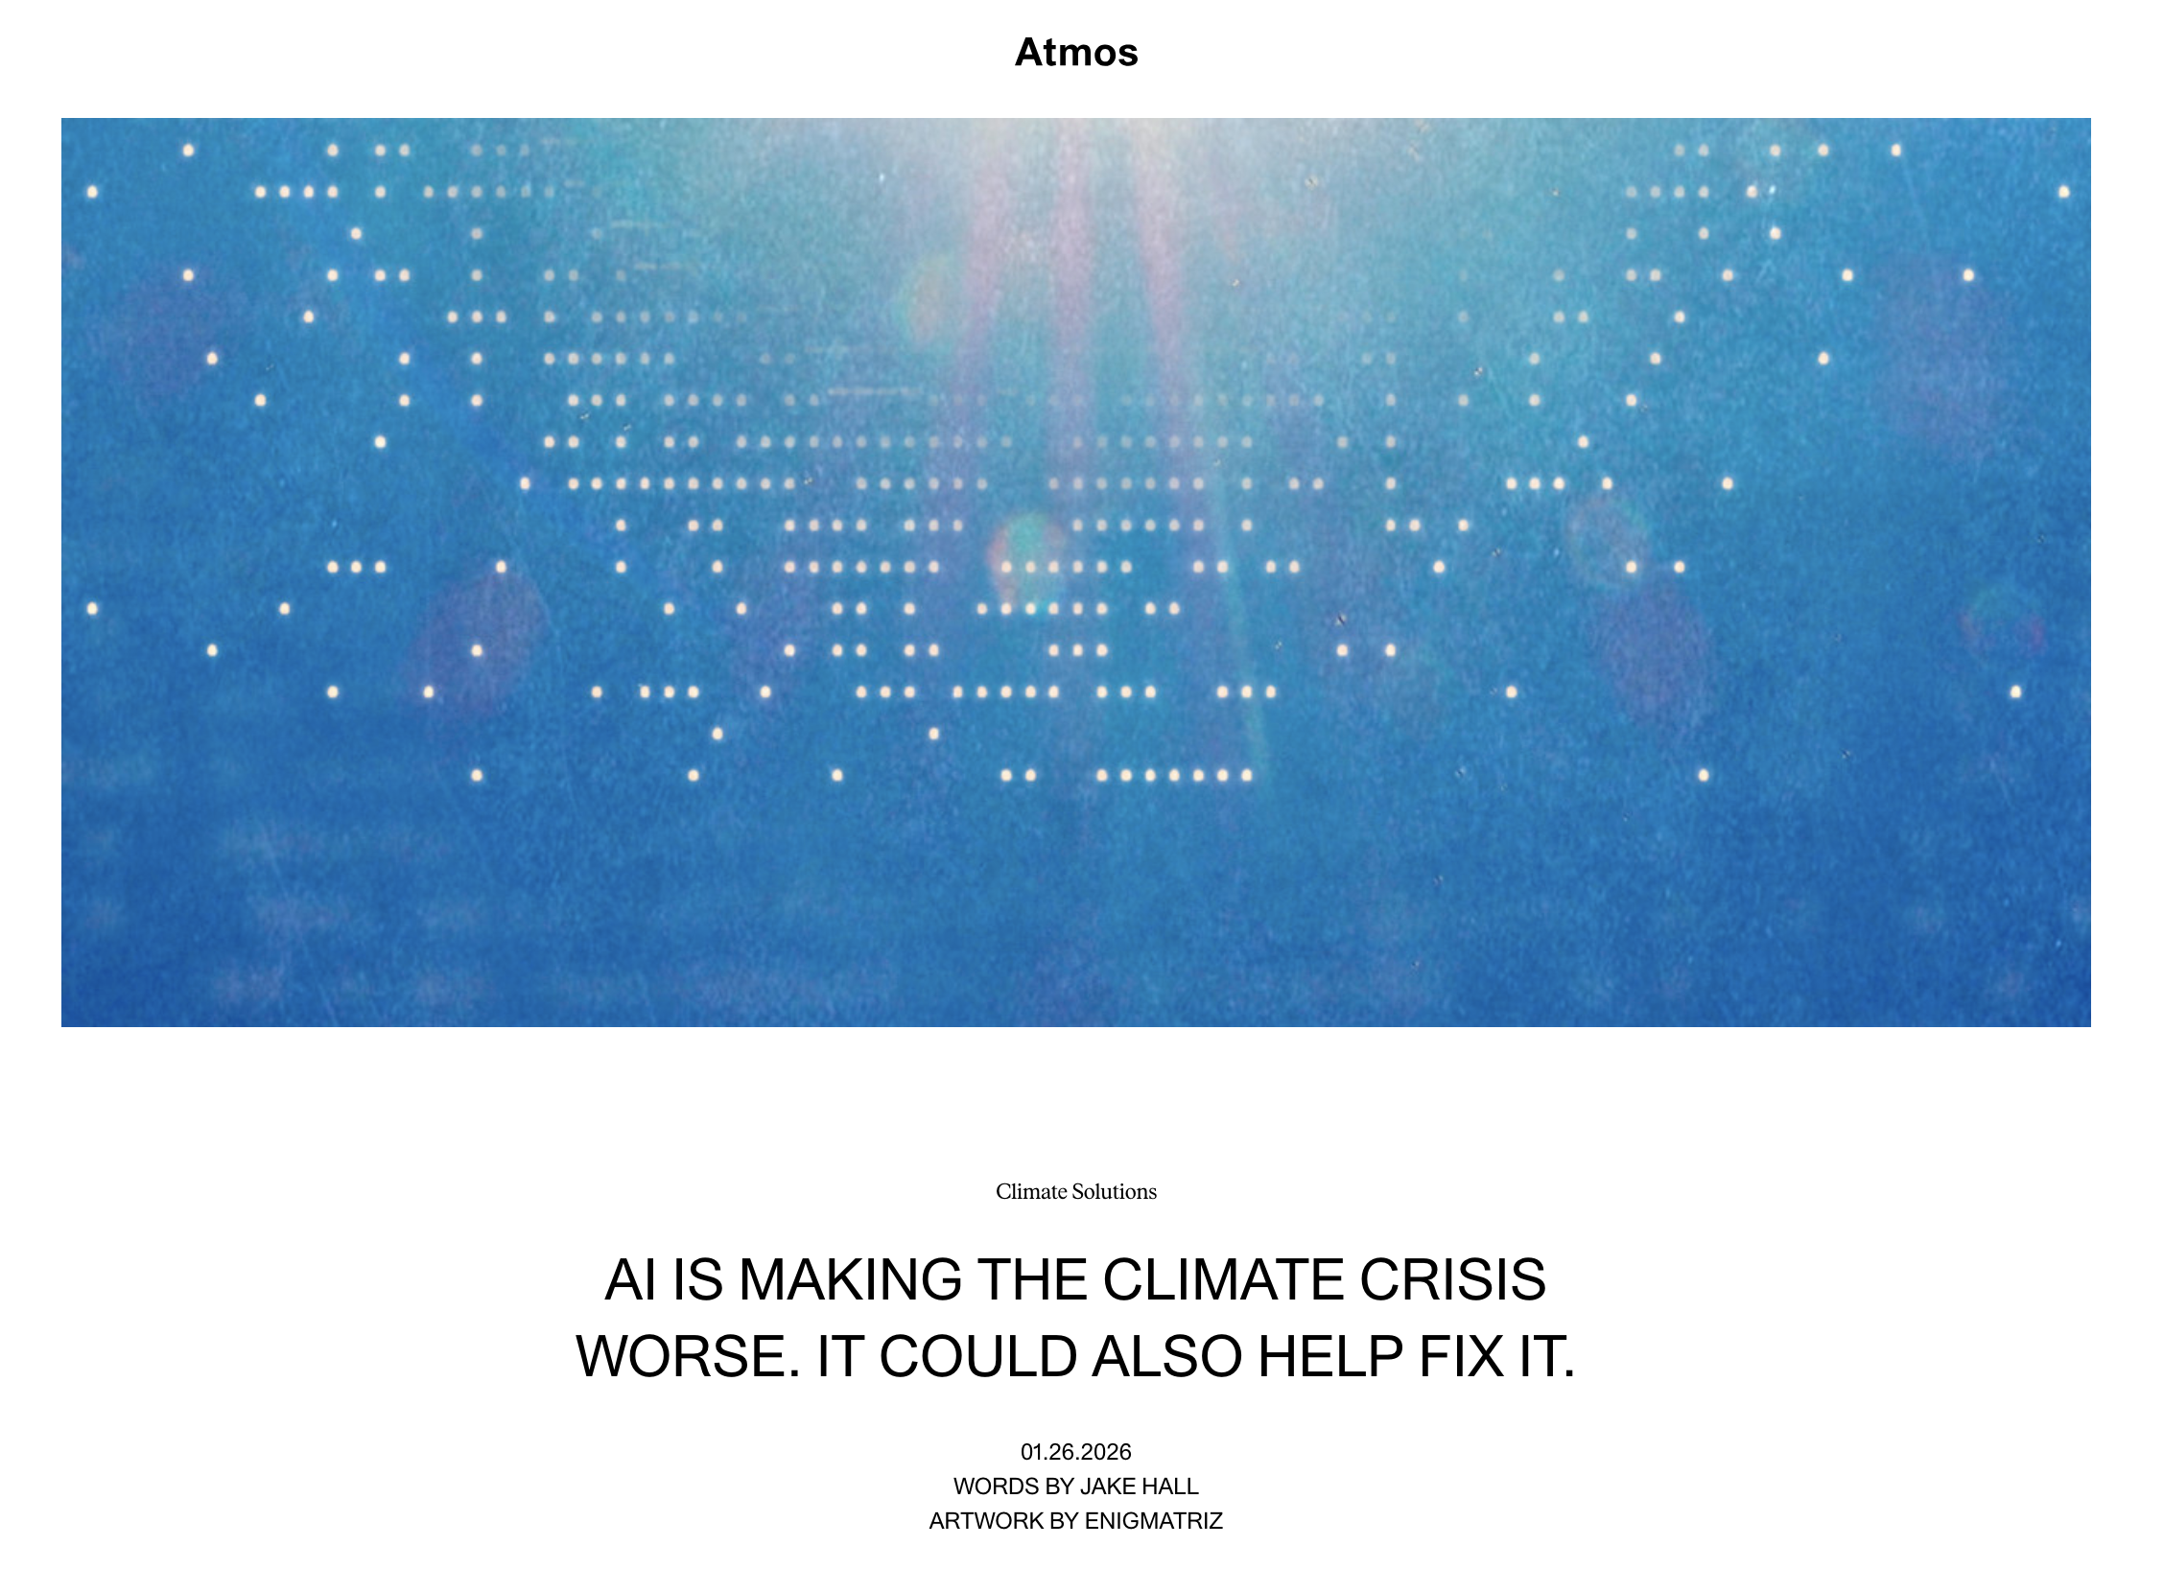
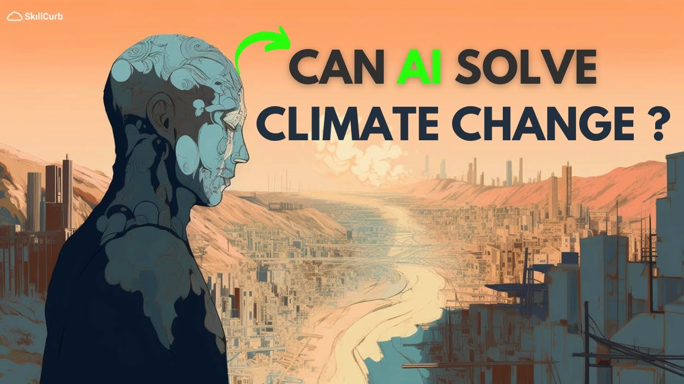
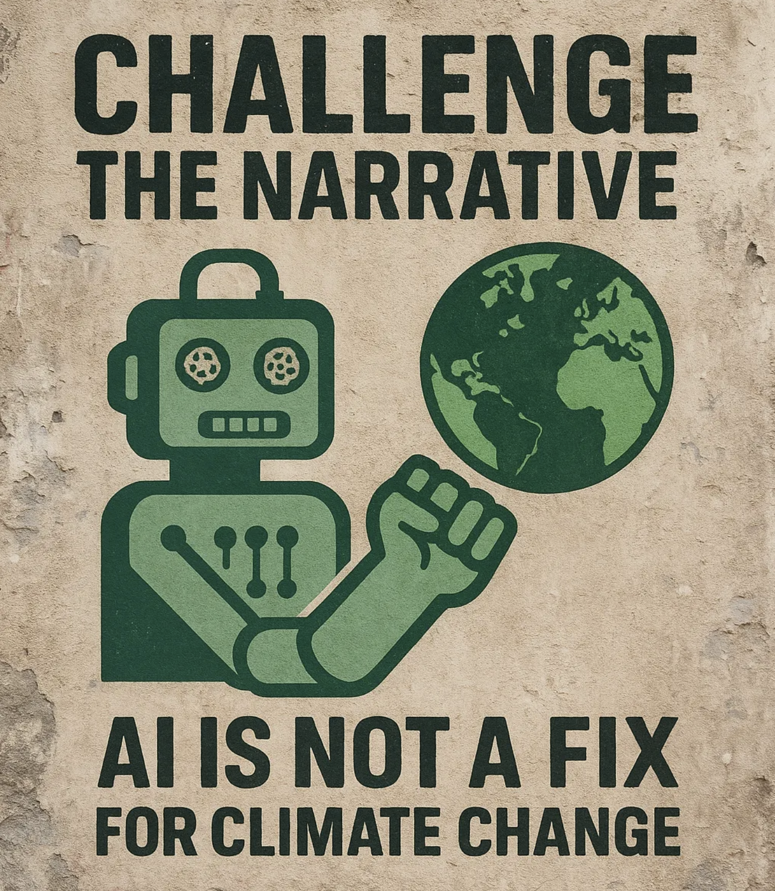
Core AI Value – Sustainability (click the images!)
IBM video
(pro)
Atmos article
(neutral?)
Medium article
(con)

Slide 12
Topic 2.3: AI and Human Rights
Cross-cultural, Legal, and Environmental Perspectives

Slide 13
AI and Human Rights: Cultural & Legal perspectives
A mix of good and bad news:
AI Bias & Representation
  Amazon Hiring Discrimination - Google Vision Racism
Creative Labor & Displacement
  SAG-AFTRA WGA – Anderson et al. v. Stability AI – Bartz v. Anthropic
Misinformation & Cultural Trust
  Political Deepfakes – AI Slop Journalism Spread
Invisible Labor & Exploitation
  OpenAI $2/hr Content Filtration – Empire of AI (Karen Hao)
Language & Knowledge Erasure
  Language Representation inequality – AI Preservation of Endangered Languages

Slide 14
AI and Human Rights: Environmental perspectives
Key concerns: Energy / water use. Mining / mfg. Unequal distribution.
MIT article: Generative AI’s environmental impact
GenAI clusters can consume 7-8x energy of typical workloads
  GPT-3 training: estimated 1,287 MWh (~120 homes for a year)
2026 projection: 1,050 TWh globally – 5th place (b/t Japan & Russia)
2030 projection: ~34 M metric tons CO² (7.5M cars), ~1B m³ water (1 km³)
  Intuition: Earth has ~1.5B cars & ~41M km³ accessible fresh water
Mining / manufacturing paradox:
  AI hardware → increased need for rare earth minerals
  AI-enhanced exploration, discovery, mining, processing, mfg.

Slide 15
Topic 2.4: Human-AI Collaboration
Designing systems that augment humans
(rather than replacing them)

Slide 16
Human-AI Collaboration
Keeping it light here – but there are many more examples out there.
Centaurs & Cyborgs on the Jagged Frontier – Ethan Mollick
Real-world examples of Human-AI Collaboration (unabashedly pro-AI perspective) – SmythOS
Human-AI Teaming in Healthcare – Nature Artificial Intelligence (NPJ)

Slide 17
Assignments for this week
Assignment 3: Core AI Values Case Study
Similar to Assignment 2, but you choose pro / con angle
I’ll release full details tomorrow at 12:30 pm
Assigned Reading:
Hendrycks, Chapter 1: Overview of Catastrophic AI Risks

Slide 18
NEXT WEEK:
Potential Harms & Misuse
3.1 Unintended harms (briefly)
3.2 Intentional misuse (more deeply)
3.3 The alignment problem (omg)
3.4 Responsible AI innovation practices & obligations

Slide 19
See you next time : )
This presentation was drafted and refined using Claude 4.5 Sonnet and Claude Code.
All content was reviewed and approved by Dallas Elleman.

