Slide 1
CYB 4203/6203
Secure and Trustworthy AI
Presentation 3: Core AI Values, Human Rights, and Human-AI Collaboration
Monday, February 2, 2026
Topics: 2.2

Slide 2
Recap from last session
Key Themes: Sadness and Despair (mostly)
1.2: Societal stakes: AI's dual-use nature and transformative potential
1.3: Prominent failures: COMPAS, facial recognition, autonomous vehicles, LLMs
1.4: Societal influence: Social, economic, and geopolitical impacts
2.1: Ethical frameworks: Virtue ethics, utilitarianism, deontology
Discussion: What did you learn during Assignment 2?
(AI risk / harm incident case study with virtue / deontology / utilitarian ethical analysis)

Slide 3
Today’s Agenda
Key Themes: Hope and Optimism (mostly)
Topic 2.2 - Core AI values
Last 15 minutes of class today: Grad student huddle

Slide 4
Topic 2.2: Core AI Values
Fairness – Transparency – Accountability
Privacy – Autonomy – Safety – Sustainability*
*not an exhaustive list

Slide 5
Core AI Value - Fairness
What does ‘Fairness’ mean?
Answer: No one really knows – it’s super complicated…
We could make this entire course just on Fairness in Machine Learning
  Here’s the book! (Fairness and Machine Learning: Limitations & Opportunities - Barocas, Hardt, Narayanan)
There is no one accepted definition that fits all contexts ¯\_(ツ)_/¯
Humans have been struggling with fairness since history began
Chances are slim that we’ll figure it out before AGI cooks us all

Slide 6
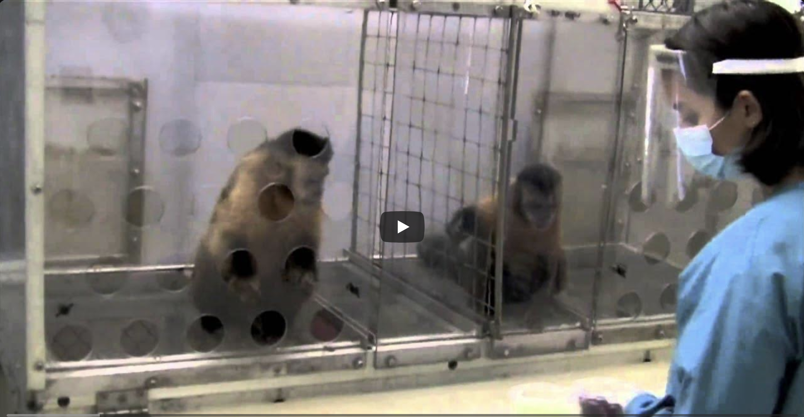
Core AI Value - Fairness
Ok actually, it’s not that hard : )
In fact, fairness is so easy that even capuchin monkeys understand it ➡️
Excerpt from Frans de Waal TED Talk – 2013
https://www.youtube.com/watch?v=meiU6TxysCg

Slide 7
Core AI Value - Fairness
So, what might we mean when we say “Fair”?
Distributive Fairness – Allocation of benefits & burdens
Equal shares for everyone?
Proportional to contribution or merit?
Prioritizing those with the greatest need?
What are some examples?

Slide 8
Core AI Value - Fairness
So, what might we mean when we say “Fair”?
Procedural Fairness – Was the process fair?
Were the rules applied consistently?
Did all affected parties have a voice?
Was the decision-maker impartial?
Examples?

Slide 9
Core AI Value - Fairness
So, what might we mean when we say “Fair”?
Interactional Fairness – Were people treated with dignity and respect?
Were individuals seen as individuals, and not just members of a group?
Were stereotypes or assumptions imposed on them?
So many examples…
Political, religious, racial, cultural, national, professional, etc. etc.

Slide 10
Fairness is Contextual
Are these scenarios ‘fair’?
A scholarship goes to the student with the highest GPA.
A kidney transplant goes to the youngest patient on the list.
A job goes to the candidate who interviewed best.
Insurance premiums are higher for people with pre-existing conditions.

Slide 11
WAIT!
What does this have to do with AI or Machine Learning?
Maybe exploring common ML tasks
will shed some light on fairness?

Slide 12
Fairness in Machine Learning Tasks
ML Task Category: Classification
Assign input to discrete categories based on learned patterns.
Email: Spam or Not Spam
Medical Imaging: Malignant or Benign
Loan Applications: Approve or Deny
Content Moderation: Violates policy or Acceptable
Hiring: Advance to interview or Reject
Is an AI/ML system making binary or categorical decisions that directly affect people?

Slide 13
Fairness in Machine Learning Tasks
ML Task Category: Regression and Prediction
Predicts a continuous value or probability based on input features
Predicting house prices
Estimating credit risk scores
Forecasting patient readmission likelihood
Predicting recidivism risk (probability of reoffending)
Estimating insurance premiums
Are the predictions equally accurate across groups?
Do errors concentrate in particular populations?

Slide 14
Fairness in Machine Learning Tasks
ML Task Category: Ranking and Recommendation
Order items by predicted relevance, quality, or fit for a particular user/query
Search engine results
Social media feeds
Product recommendations (ads, online marketplaces)
Resume ranking for recruiters
News article prioritization
Ranking creates visibility hierarchies with real consequences for people.
Are groups systematically ranked lower? Do filter bubbles limit exposure?

Slide 15
Fairness in Machine Learning Tasks
ML Task Category: Clustering and Segmentation
Discover data structure and group similar items together without predefined labels
ML Task Category: Generation
Create new content – text, images, audio, video, code – based on learned patterns
ML Task Category: Detection and Recognition
Identify specific patterns, objects, faces, speech, or events within input data
ML Task Category: Optimization and Resource Allocation
Find the best solution given constraints – allocating limited resources

Slide 16
Core AI Value - Fairness
Multiple Definitions; Persistent Challenges
Individual fairness: Similar individuals are treated similarly
Group fairness: Equitable outcomes across demographic groups
Substantive fairness: Concerned with end results, regardless of process
Mathematical tension: Definitions can be mutually exclusive, i.e.: under some conditions, it is provably impossible to satisfy all definitions*
Challenge: Fairness is context-dependent and value-laden
* Or is it?

Slide 17
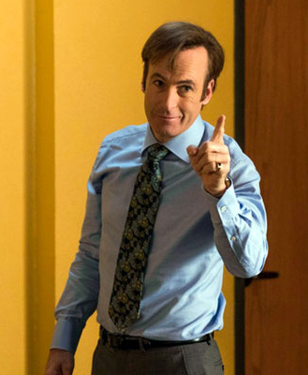
Core AI Anti-Value - Unfairness
YOU’VE been a victim!
Think of a time you were affected by an ‘unfair’ decision
What would have been ‘fair’?
What caused the unfair decision?
Could an algorithm / human have done better?
  Prove it!

Slide 18
Why else is ML Fairness so hard?
Because Algorithms!
When Algorithms enter the picture
Mathematical / logical algorithms need explicit definition
  Definition is hard
Defining groups / protected classes requires measurement
  Measurement is hard
Data reflects the world we have, not the world we want
Optimization creates trade-offs
* Or is it?

Slide 19
Core AI Value - Transparency
Easier to explain than Fairness, but still difficult to achieve
The degree to which an AI / ML system’s logic, data sources, development process, and performance are clearly communicated, understood, and auditable
Model transparency: Understanding system architecture and logic
Data transparency: Knowing training data sources and characteristics
Decision transparency: Explaining individual predictions or actions
Trade-offs: Performance vs. interpretability, IP vs. openness
Stakeholder-appropriate: Different audiences need different explanations

Slide 20
Transparency (AKA Explainability / Interpretability)
Resources
Interpretable Machine Learning: A Guide for Making Black Box Models Explainable
Christoph Molnar - https://christophm.github.io/interpretable-ml-book/
Van Der Schaar Lab – ML in Healthcare focus
https://www.vanderschaar-lab.com/interpretable-machine-learning/

Slide 21
Core AI Value - Accountability
Easy to define - Difficult to enforce
The degree to which individuals and organizations are responsible for the actions, decisions, impacts, and outcomes of their AI systems. Requires transparency, human oversight, and clear liability.
Clear ownership: Who is responsible when AI systems fail?
Governance structures: Oversight, audit trails, documentation
Redress mechanisms: Processes for appeals and corrections
Liability frameworks: Legal responsibility for AI harms
Challenge: ‘Many hands’ problem, diffusion of responsibility

Slide 22
AI Accountability Resources
AI Now Institute – New York University
Founded in 2017 – produces diagnosis and policy research on artificial intelligence, public accountability of AI industry for social consequences. https://ainowinstitute.org/
Algorithmic Justice League
Combines research, art, and advocacy to expose bias in AI systems and push for accountability mechanisms. https://www.ajl.org/
Ada Lovelace Institute
An independent research institute with a mission to ensure data and AI work for people and society. https://www.adalovelaceinstitute.org/

Slide 23
TO BE CONTINUED…
Next time:
Privacy
Autonomy
Safety
Sustainability
2.3: AI and Human Rights
2.4: Human-AI Collaboration

Slide 24
Grad student huddle time
This presentation was drafted and refined using Claude 4.5 Sonnet and Claude Code.
All content was reviewed and approved by Dallas Elleman.

