Slide 1
CYB-4203/6203
Secure and Trustworthy AI
Presentation 16: Transparency, Explainability, and Interpretability in AI/ML
Wednesday, April 1 2026

Slide 2
Today’s Agenda
7.2: Brief recap of bias types and sources
7.3: Algorithmic transparency and accountability in AI/ML
7.4: Explainability and interpretability
  Concepts, techniques, and tools (e.g., LIME, SHAP)

Slide 3
7.2: Bias in AI Systems
Brief recap of types and sources

Slide 4
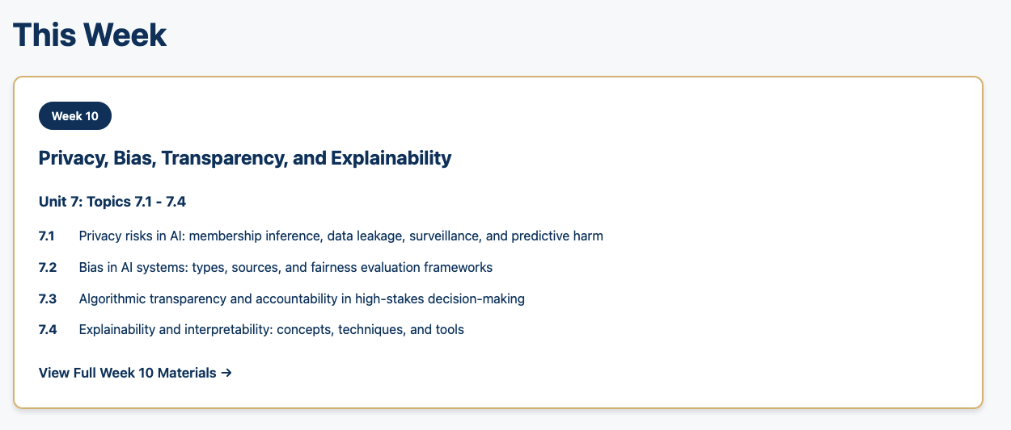

Bias: Examples across the AI/ML Lifecycle

Slide 5
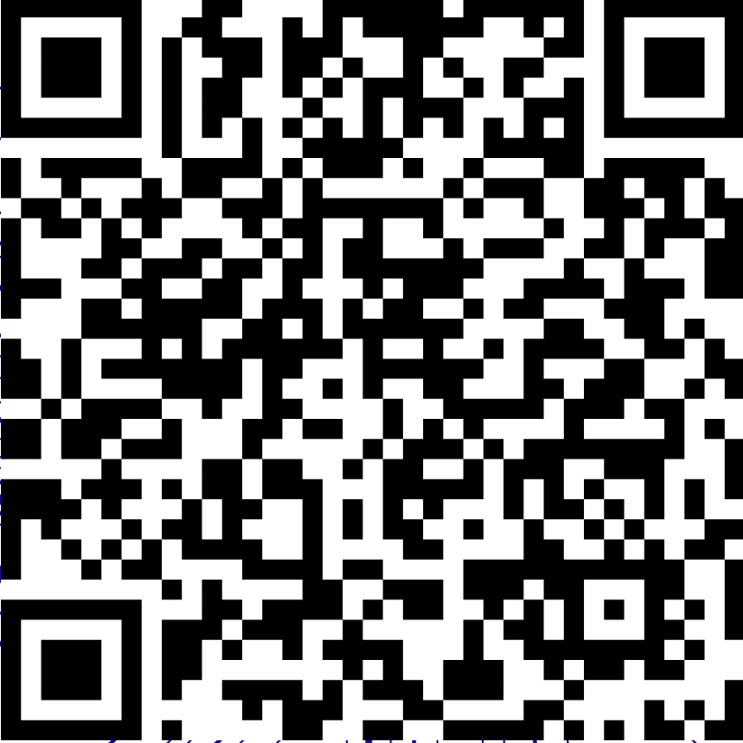
Bias: Examples across the AI/ML Lifecycle
https://dallaselleman.github.io/cyb-4203-6203-spring-2026/weeks/week-10/index.html

Slide 6
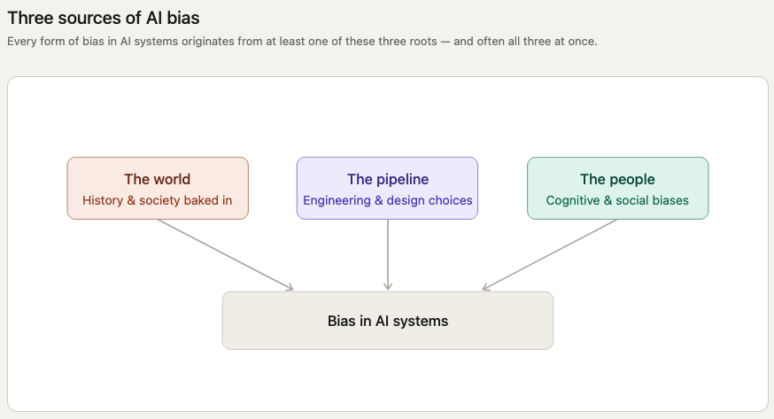
Sources of AI Bias

Slide 7
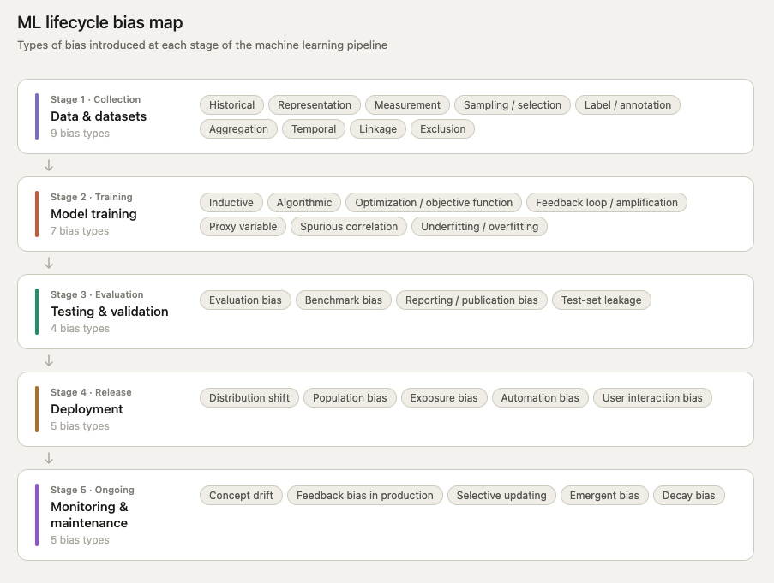
AI/ML Bias: Examples from The World and The Pipeline

Slide 8
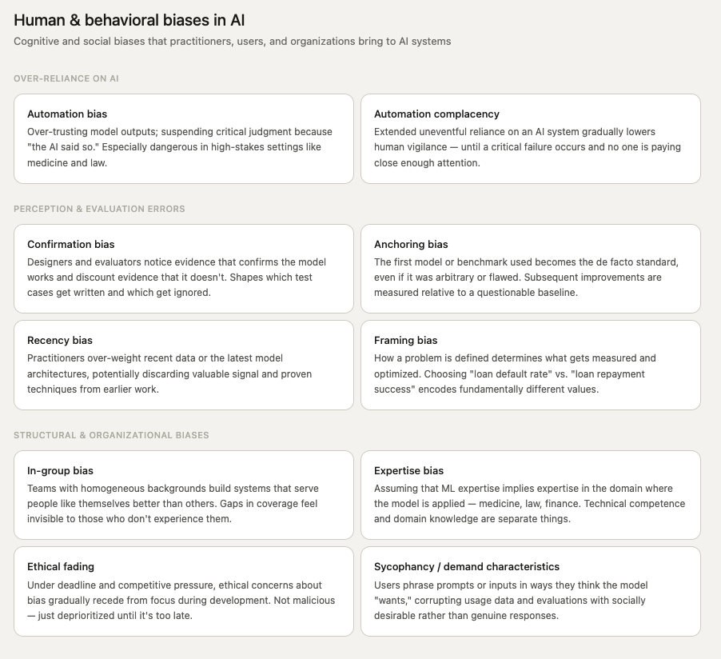
AI/ML Bias: Examples from The People

Slide 9
AI/ML Bias: Examples from The People

Slide 10
7.3 & 7.4:
Transparency, Explainability, Interpretability

Slide 11
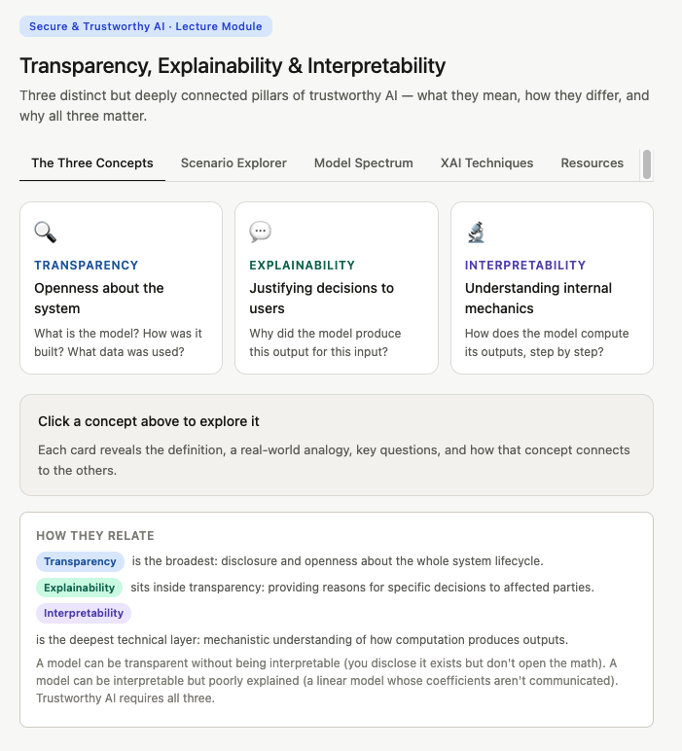
Transparency, Explainability, & Interpretability

