Slide 1
CYB-4203/6203
Secure and Trustworthy AI
Presentation 15: Privacy Risks and Bias in AI Systems
Monday, March 30, 2026

Slide 2
Today’s Agenda
Midterm Project LLM-assisted Development Cycle video and workflow outline
7.1 Privacy risks in AI/ML: membership inference, surveillance, predictive harm
  Privacy regulation and compliance challenges
7.2 Bias in AI systems: types, sources, and real-world impact

Slide 3
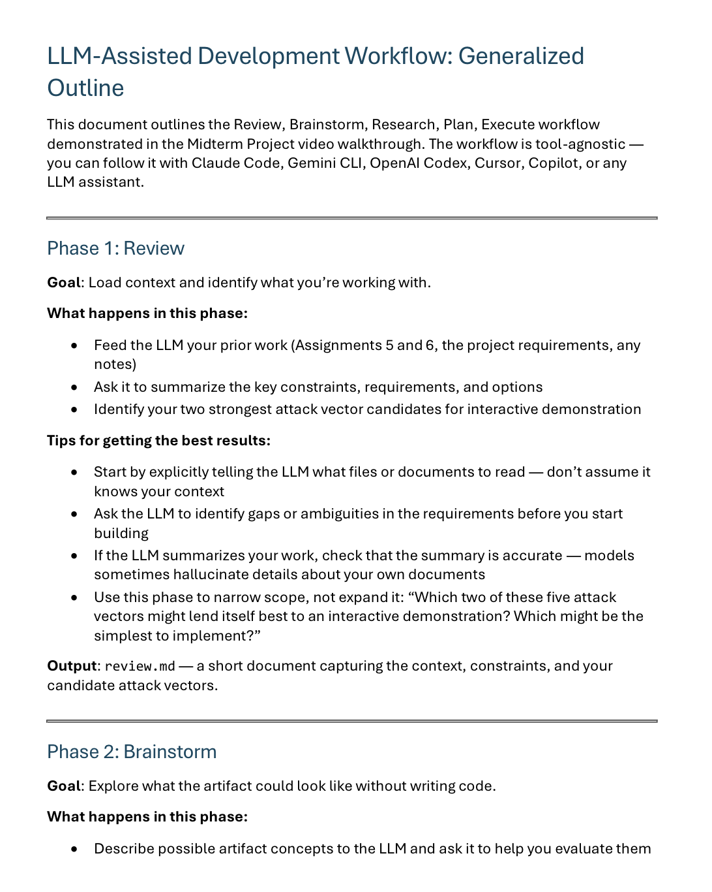
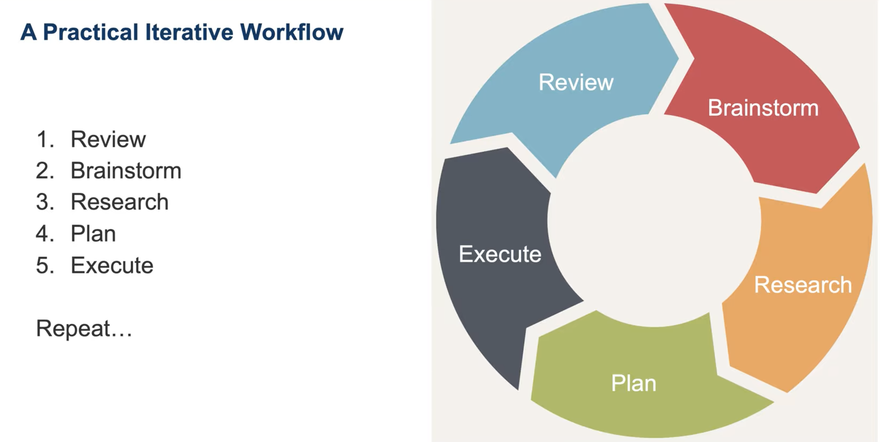
Midterm Project LLM-assisted Development Cycle Video & Outline
https://www.youtube.com/watch?v=9IXaV471mCs
In Harvey – Midterm Project Assignment Instructions

Slide 4
7.1: Privacy Risks in AI/ML
Membership inference, surveillance, and predictive harm

Slide 5
Privacy Risks in AI/ML
AI/ML fundamental privacy challenges
AI systems consume, process, and memorize personal data at unprecedented scale
Models can reveal information about individuals that was never explicitly provided
Traditional privacy frameworks (notice and consent) struggle with AI's complexity
Privacy is both a security concern (attacks) and an ethical/legal concern (rights)
Connection to Unit 6: privacy attacks are a subset of the broader attack landscape

Slide 6
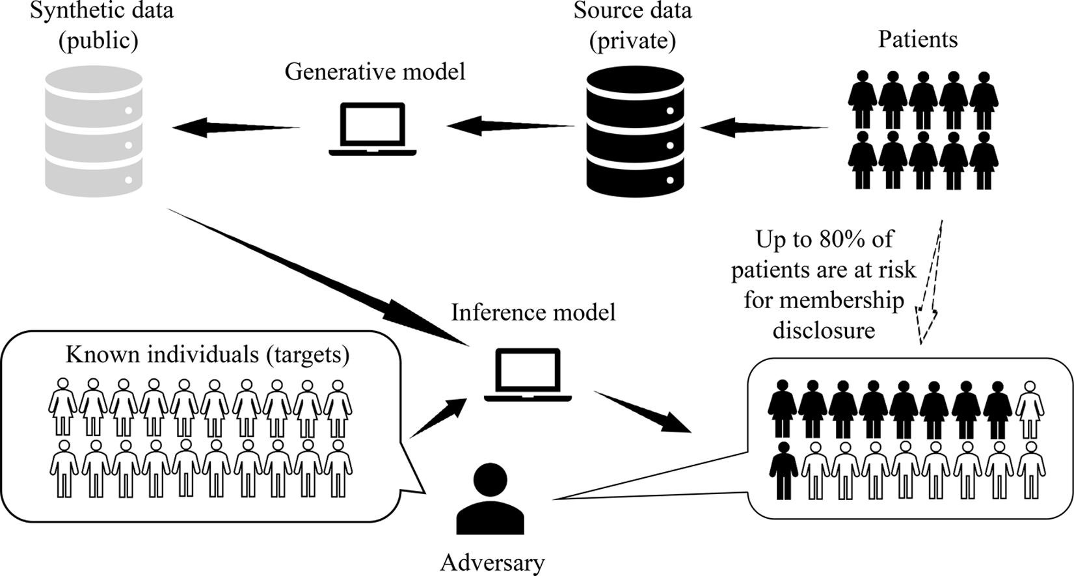
Privacy Risks in AI/ML
Membership Inference Attacks
Was your data used to train this model?
Determining whether a specific data record was in the model's training set
Exploits the difference in model confidence between training data and unseen data
Privacy implications: confirms participation in sensitive datasets (health, finance, location)
Zhang et al. (2022): Even partially synthetic HRE data susceptible to privacy intrusions such as membership inference
Zhang et al. (2022)

Slide 7
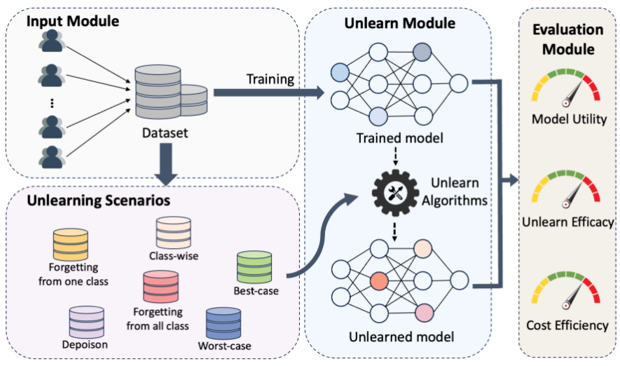
Privacy Risks in AI/ML
Why Membership Inference Matters
Confirms presence in a sensitive dataset. Ex: genomic study, mental health program, criminal database
GDPR Article 17 (right to erasure): if membership can be inferred, was data truly deleted?
Machine unlearning: the challenge of actually removing a data point's influence from a trained model
Verification problem: how do you prove a model has "forgotten" a data point?
Active research area with no complete solution
Li et al. (2025) Figure 2: System overview of MUBox

Slide 8

Privacy Risks in AI/ML
Model Inversion Attacks
Reconstructing private datasets from model outputs
Fredrikson et al. (2015): reconstructed recognizable faces from a facial recognition model
The model's outputs encode enough information to reverse-engineer inputs
Particularly dangerous for models trained on sensitive data (medical, biometric, financial)
Gradient-based inversion: using model gradients to reconstruct training images
Defenses: differential privacy, output perturbation, limiting confidence score precision
Frederikson et al. (2015) Figure 1: An image recovered using a new model inversion attack (left) and a training set image of the victim (right). The attacker is given only the person’s name and access to a facial recognition system that returns a class confidence score.

Slide 9
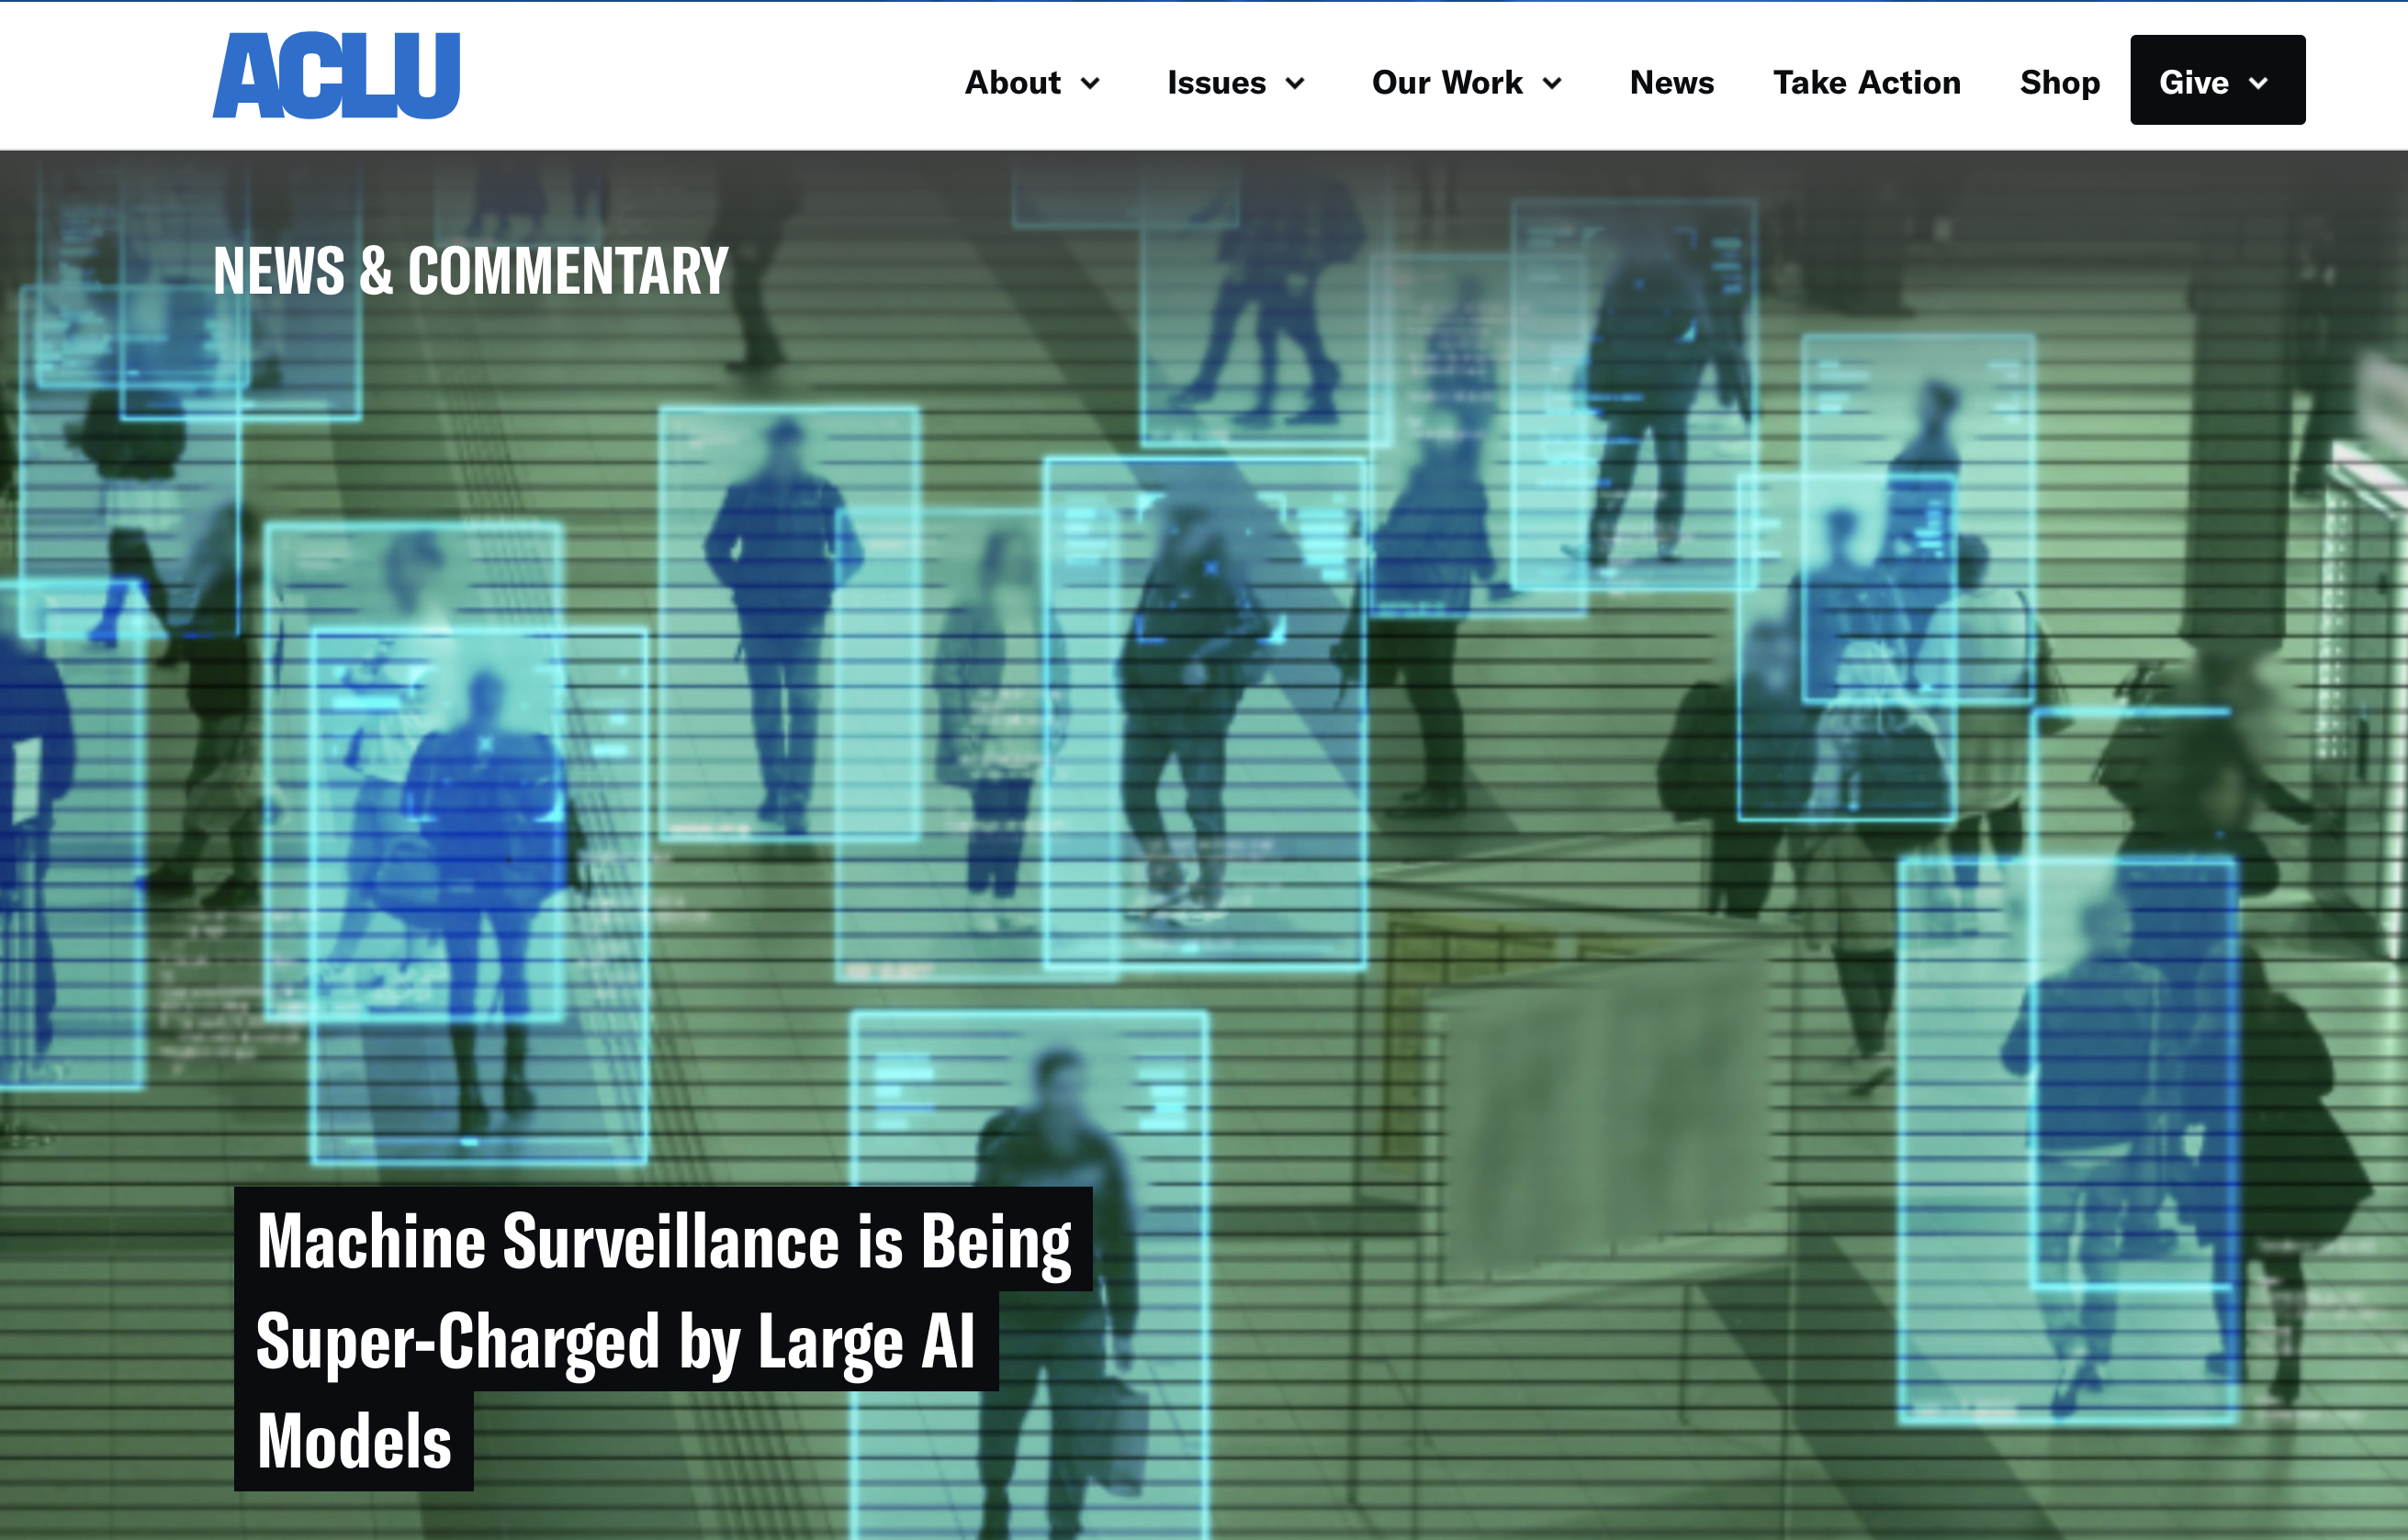
Privacy Risks in AI/ML
Surveillance and Predictive Harm
AI-enabled surveillance at scale
Facial recognition: LLMs / AI making analytics much cheaper and more broadly available.
Predictive policing: targeting individuals based on predicted behavior, not actual actions
Social scoring systems: aggregating data to rank individuals on trustworthiness or risk
Location tracking and movement prediction from mobile data
The chilling effect: people change behavior when they know they are being watched
Jay Stanley – ACLU – March 2025

Slide 10
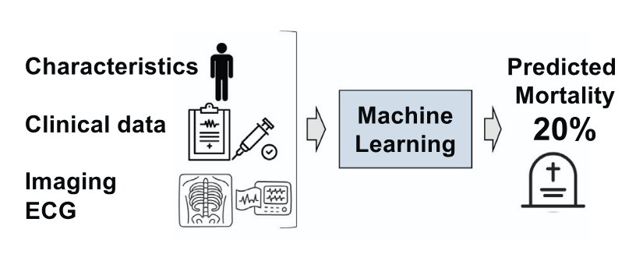
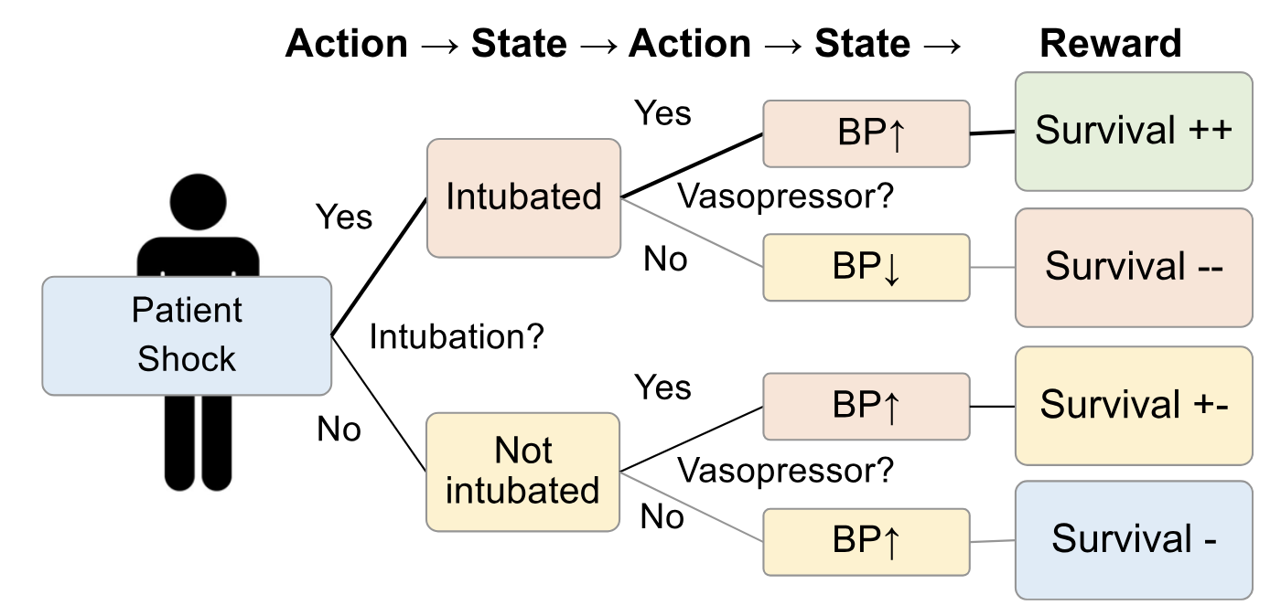
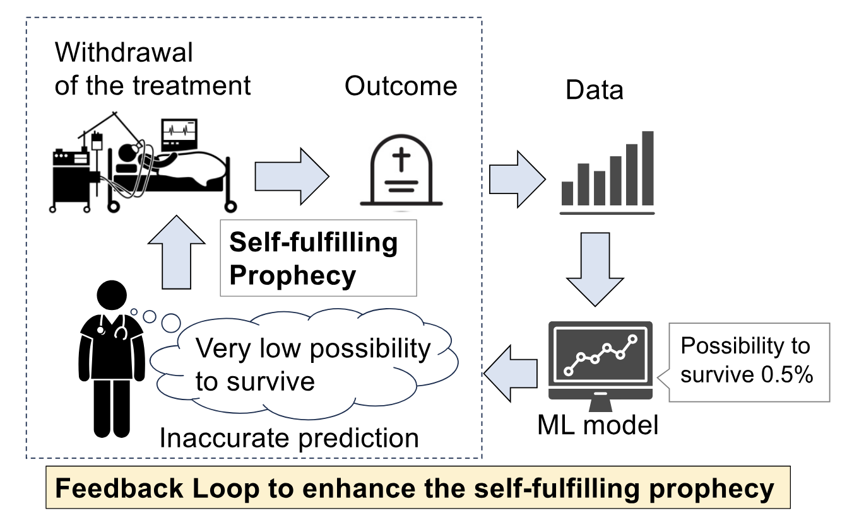
Privacy Risks in AI/ML
Predictive Harm
When predictions become self-fulfilling
AI predictions can create the outcomes they predict (feedback loops)
Predictive policing concentrates resources in targeted areas, increasing arrests, "confirming" predictions
Credit scoring models deny loans to populations they predict will default, preventing economic mobility
Health insurance risk predictions that become discriminatory gatekeeping
The privacy harm is not just data exposure -- it is the use of data to constrain futures
Okada, et al. 2023

Slide 11
Mitigating Privacy Risks in AI/ML
Differential Privacy
Adding calibrated noise to data or outputs so that no individual record significantly affects the result
Formal mathematical guarantee: epsilon-delta privacy budget
Used by Apple (emoji usage), Google (Chrome), U.S. Census Bureau (2020 Census)
Privacy-utility tradeoff: more privacy = more noise = less accurate results
Federated Learning
Training approach where models learn from decentralized data on local devices or servers without centralizing the raw data
Raw data stays on the client or local node; only model updates are shared centrally
Reduces central data exposure risk, but updates can still leak information without safeguards
Common use cases: mobile keyboards, healthcare collaborations, cross-org model training

Slide 12
Mitigating Privacy Risks in AI/ML
Homomorphic Encryption
Encryption technique that allows computation on encrypted data without exposing original data
Encrypt sensitive data → run computations on encrypted data → decrypt results
Servers run approved computations on ciphertext; only the keyholder can decrypt the result.
Main tradeoff is performance: usually much slower and more resource intensive
We will cover Differential Privacy, Federated Learning, and Homomorphic Encryption in depth in Unit 8

Slide 13
Regulating Privacy Risks in AI/ML
The Privacy Regulation Challenge
GDPR: right to explanation, right to erasure, purpose limitation – all challenged by AI
HIPAA: health data used in AI training raises compliance questions
CCPA/CPRA: California privacy rights and AI-specific provisions
AI systems can infer protected information (health, religion, sexuality) from non-protected data
Regulatory frameworks designed for databases struggle with probabilistic models

Slide 14
7.2: Bias in AI Systems
Types, sources, and fairness evaluation frameworks

Slide 15
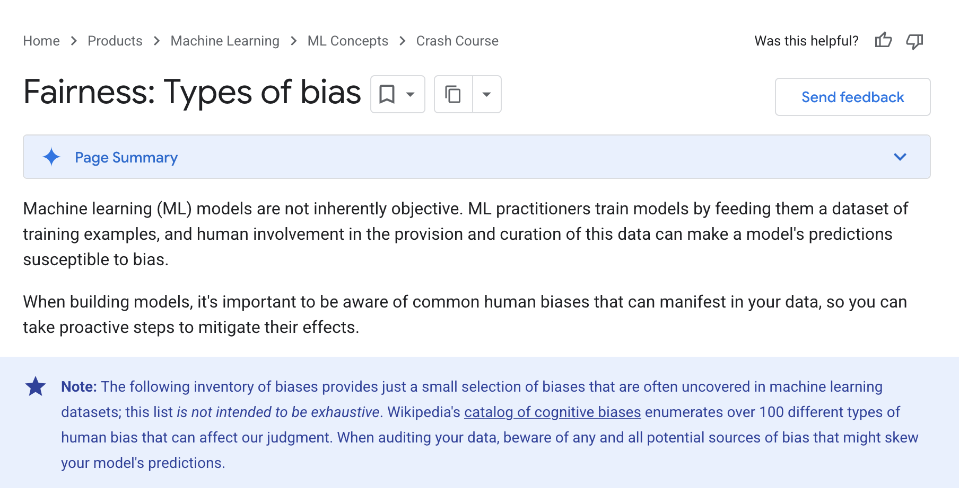
Bias in AI/ML
Types of Bias
Statistical bias: systematic error in estimation or prediction
Social bias: reflecting or amplifying societal prejudices and stereotypes
Algorithmic bias: systematic and repeatable errors in outcomes that create unfair treatment
Not all bias is harmful (a spam filter is biased against spam -- that is the point)
The concern: when bias creates unfair or discriminatory outcomes for protected groups
Google Developer – Fairness: Types of bias

Slide 16
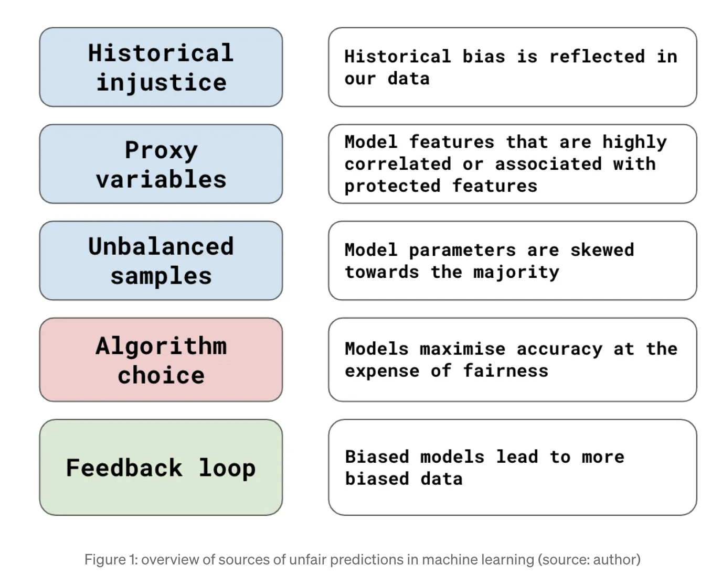
Bias in AI/ML
Sources of Bias in the AI/ML lifecycle
Training data bias: historical data reflects historical discrimination
Representation bias: underrepresentation of certain groups in training data
Measurement bias: features that proxy for protected attributes (zip code proxying for race)
Aggregation bias: assuming one model fits all populations equally
Evaluation bias: benchmarks that do not represent all affected populations
Deployment bias: using a model in contexts different from its training distribution
Conor O’Sullivan – Medium (2023) – Unfair Predictions: 5 Common Sources of Bias in Machine Learning

Slide 17
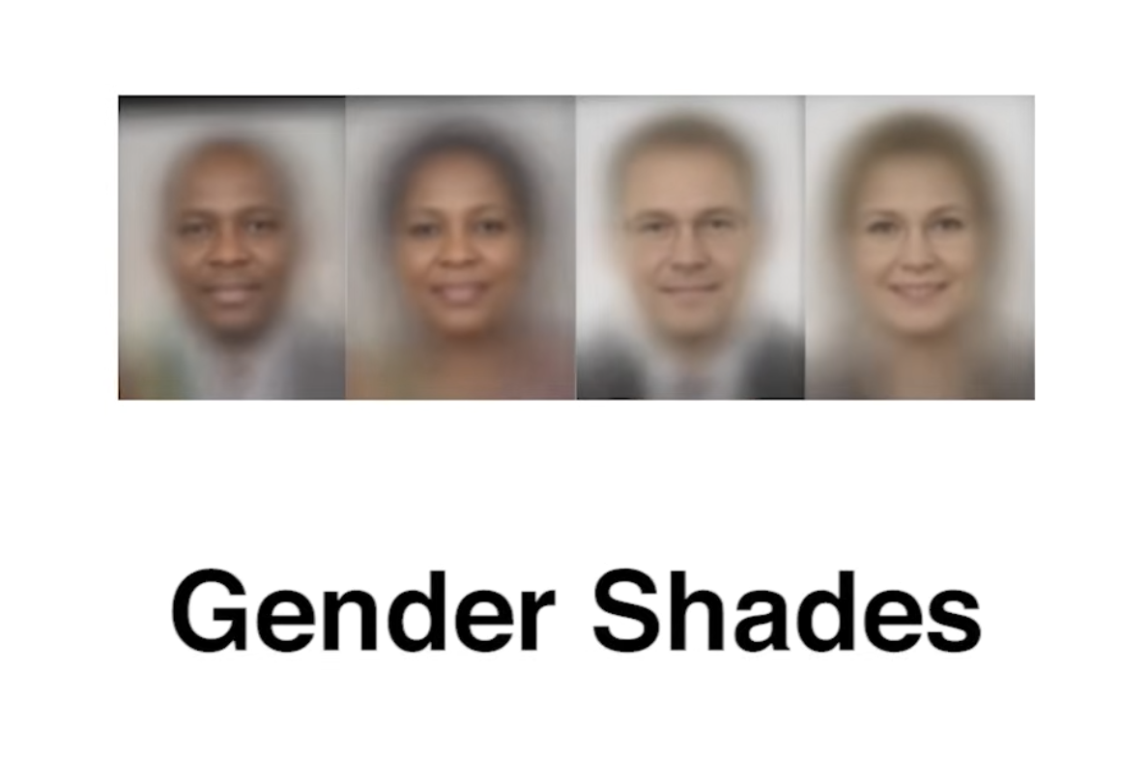
Bias in AI/ML
Case Study: Facial Recognition Bias
Gender Shades (Buolamwini & Gebru, 2018)
Audited commercial facial recognition from Microsoft, IBM, and Face++
Error rates for lighter-skinned males: 0.8%
Error rates for darker-skinned females: up to 34.7%
Performance gap of over 40x based on skin tone and gender
Led to IBM exiting the facial recognition market; Microsoft limiting law enforcement sales
Gender Shades – MIT Media Lab - YouTube

Slide 18

Bias in AI/ML
Bias in Generative AI
Image generators producing stereotypical representations (executives as white men, criminals as dark-skinned)
Google Gemini image generation controversy (Feb 2024): overcorrection producing historically inaccurate images
LLM bias: different quality of responses based on names, dialects, or cultural context
Embedding bias: word embeddings encode societal stereotypes (man:programmer :: woman:homemaker)
Generative AI amplifies bias at scale -- millions of outputs per day
Charles Sturt University

