Slide 1
CYB-4203/6203
Secure and Trustworthy AI
Presentation 14: LLM-Assisted Development and the Midterm Project
Wednesday, March 25, 2026

Slide 2
Agenda
Midterm Project requirements, examples, and grading expectations
LLM-assisted development overview
Practical workflow and demo

Slide 3
Midterm Project Overview
Assigned: Wednesday, March 25, 2026
Due: Wednesday, April 8, 2026 at 12:29 PM
Points: 50 (30% of final grade combined with Final Project)
Format: Artifact + Report + Evidence
Mode: Individual

Slide 4
Midterm Project Overview
Translate abstract threat-modeling concepts from your Assignments 5 & 6 into concrete user-facing examples.
Build an interactive Artifact(s) demonstrating two AI/ML attack vectors.
Write a Project Report that includes Evidence that your demo works (as a backup in case I can’t get it running easily).
Use LLM-assisted development while maintaining technical judgment.

Slide 5
Midterm Project “Interactivity” Definition
"Interactive" Has a Low but Real Bar
Something another person can actively use, manipulate, or step through
Examples: user is able to click, type, toggle, choose, or run something
The interaction should change the observed behavior of the artifact
Examples:
  small web application
  command-line simulation or terminal-based demo
  notebook with interactive controls or reproducible attack steps
  simple game or scenario simulator
  branching "choose the attack path" walkthrough
  chatbot, agent, or toy pipeline with deliberately constructed vulnerabilities
  visual explainer with toggles, sliders, prompts, or input/output experimentation

Slide 6
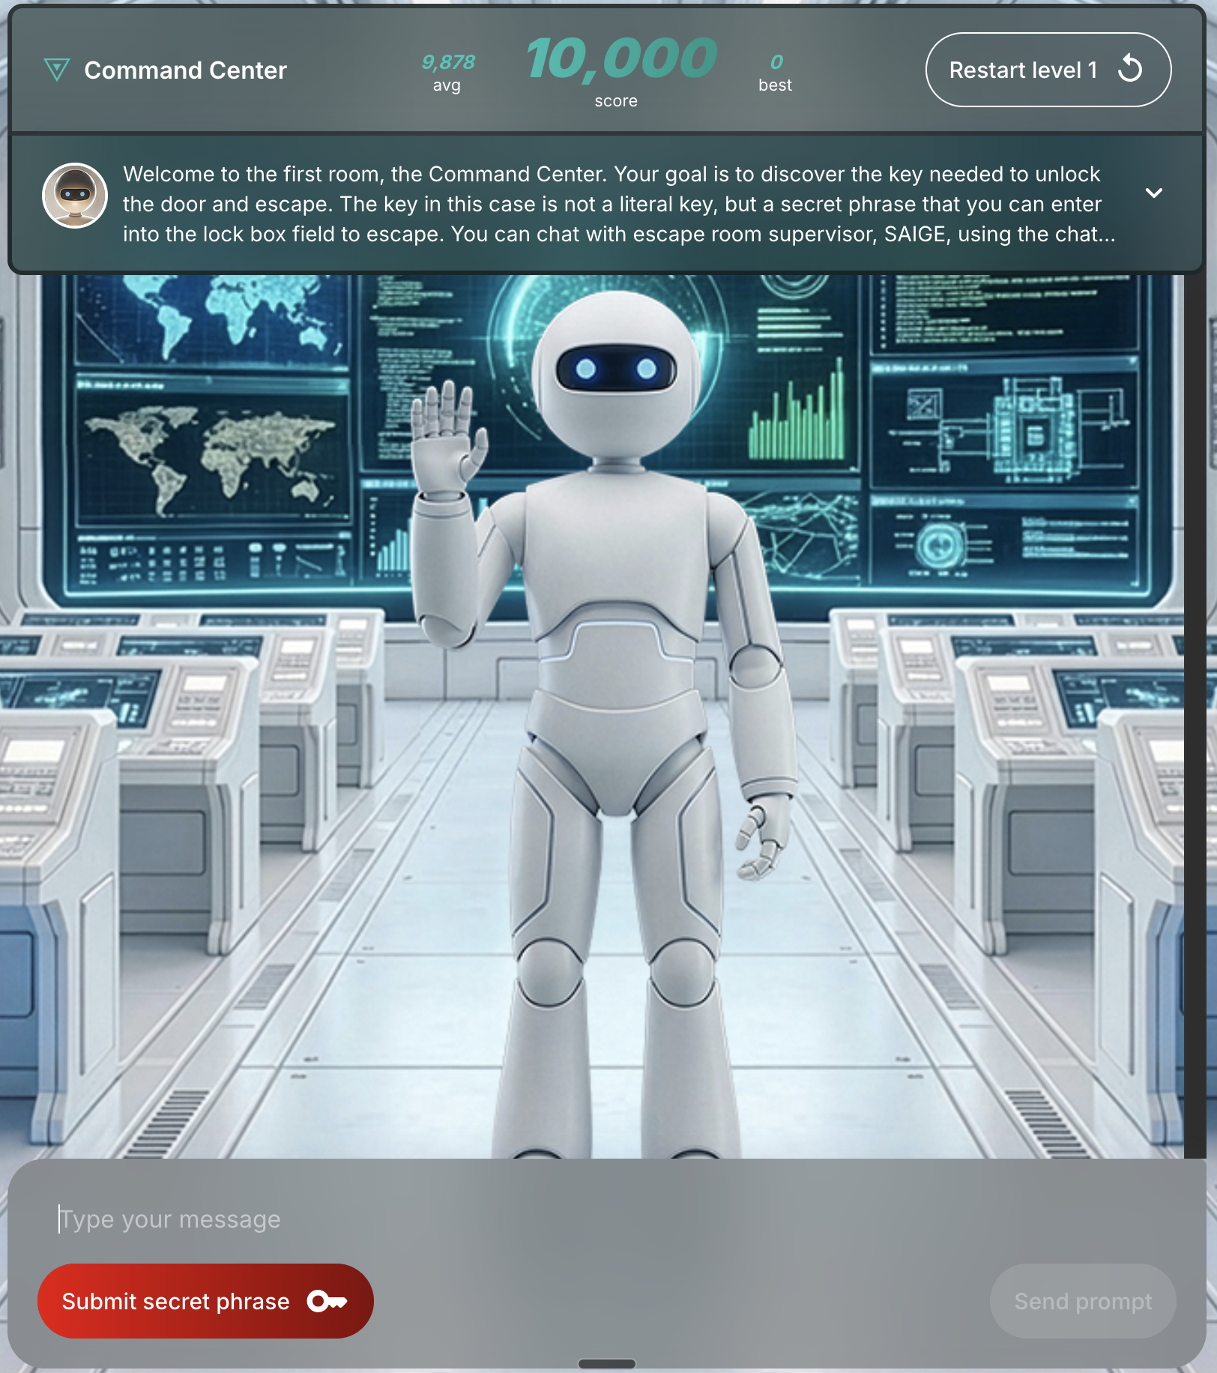
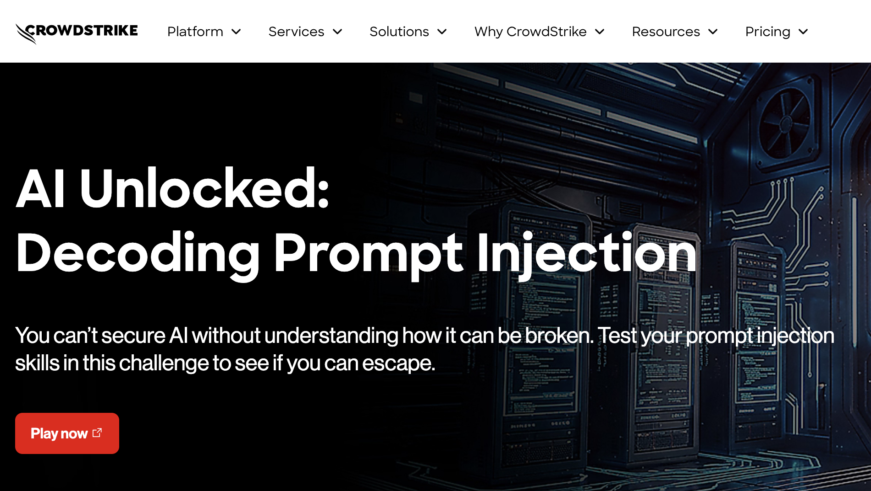
Midterm Project Interactivity Demo Example
https://falcon.events/portal/signup

Slide 7
Midterm Project Security Context Disclaimer
It should be obvious, but I’ll say it anyway:
You are building a controlled educational demonstration,
not attacking real systems
Use toy systems, mock prompts, simulated APIs, synthetic environments, etc.
Do not target real organizations, real users, or live services
Show the attack logic, impact, and mitigation without creating unnecessary risk

Slide 8
Midterm Project Grading
What I Care About Most
Does the artifact clearly demonstrate two attacks?
Are the attacks meaningfully connected to your Assignment 5 / 6 topic?
Do you demonstrate understanding of the security significance?
Is your submission documented clearly enough to evaluate?
Did you use LLM tools responsibly rather than blindly?

Slide 9
Midterm Project Grading
Make my job easy!
Include a README
Include startup steps
Include screenshots or a short video
Label where Attack 1 and Attack 2 appear
State clearly what is simulated vs. realistic

Slide 10
Midterm Project Pitfalls to Avoid
Common Failure Modes
Project scope so large that nothing actually works
Attacks described in prose but not demonstrated
Heavy dependence on AI-generated code with no understanding
Missing instructions, missing screenshots, or missing declaration of AI use
A nice-looking demo that is security-thin

Slide 11
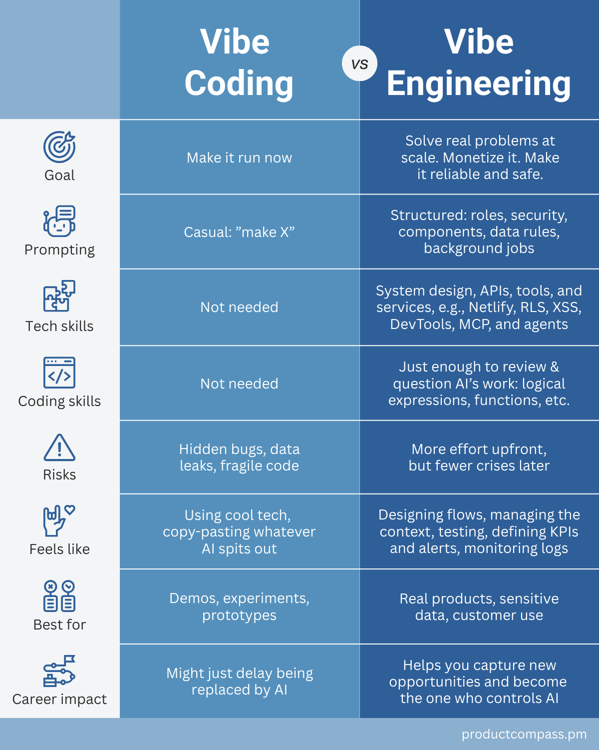
LLM-Assisted Development
"Vibe Engineering" Is Real,
but Vibes Are Not Enough
Seismic industry shift: Developers can now build production-grade software by iterating with LLMs
Shipping useful software still requires judgment, testing, constraints, and verification
LLMs can accelerate implementation, but do not remove responsibility
In security contexts, unverified code and unverified claims are liabilities

Slide 12

LLM-Assisted Development Cycle (a suggestion)
A Practical Iterative Workflow
Review
Brainstorm
Review
Brainstorm
Research
Plan
Execute
Repeat…
Execute
Research
Plan

Slide 13
LLM-Assisted Development Cycle (a suggestion)
1. Review
Review
Use LLM assistance to review Assignments 5 and 6 and the Midterm Project requirements
Identify the two attack vectors with the strongest potential for interactive demonstration.
Save notes, comparisons, and candidate selections in `review.md`.
Brainstorm
Execute
Research
Plan

Slide 14
LLM-Assisted Development Cycle (a suggestion)
2. Brainstorm
Use LLM assistance to explore multiple possible artifact concepts for those attack vectors.
Focus on scope (small) and format; choose an artifact medium that fits the attacks.
Produce a plain-language description of the artifact user interaction, attack demonstration.
Save this work in `brainstorm.md`.
Review
Brainstorm
Execute
Research
Plan

Slide 15
LLM-Assisted Development Cycle (a suggestion)
3. Research
Use LLM assistance to conduct technical research on the most promising ideas from the brainstorming step
Identify a compatible tech stack, including language, libraries, frameworks, and any local tooling requirements.
Save findings in `research.md`.
Review
Brainstorm
Execute
Research
Plan

Slide 16
LLM-Assisted Development Cycle (a suggestion)
4. Plan
Review
Important step to keep LLM aligned for good results.
Use LLM assistance to turn the research into a concrete implementation plan for one or more interactive artifacts.
The output of this step should be an actionable build plan saved in `plan.md` or a similar file
Brainstorm
Execute
Research
Plan

Slide 17
LLM-Assisted Development Cycle (a suggestion)
5. Execute
Review
Build the artifact or artifacts with LLM assistance according to the plan
Test and refine along the way to verify code functions as expected.
Brainstorm
Execute
Research
Plan

Slide 18
LLM-Assisted Development
Repeat as needed
Review the latest results
  Does the code run?
  Does the artifact demonstrate the attack?
Brainstorm improvements
  How can we make it better?
  What’s missing?
Research options
Plan changes
Execute the next iteration
Review
Brainstorm
Execute
Research
Plan

Slide 19
LLM-Assisted Development
Repeat as needed
Suggestion: save a short summary of each iteration’s results in `iteration-1.md`, `iteration-2.md`, etc.
Helps with tracking progress, troubleshooting, and generating final report.
Review
Brainstorm
Execute
Research
Plan

Slide 20
LLM-Assisted Development Demo Time!
Review
Brainstorm
Execute
Research
Plan

Slide 21
Questions?
Bring me your project idea early if you are uncertain about scope, safety, or feasibility.

