Slide 1
CYB-4203/6203
Secure and Trustworthy AI
Presentation 13: Midterm Review
Monday, March 9, 2026
Topics: 1.1 - 6.4

Slide 2
Today’s Agenda
From Presentation 11
  Briefly review all topics
  Highlight GRU attack example
  Cover AI/ML Threat Modeling Frameworks
Midterm review
Assignment 6
Midterm project look-ahead

Slide 3
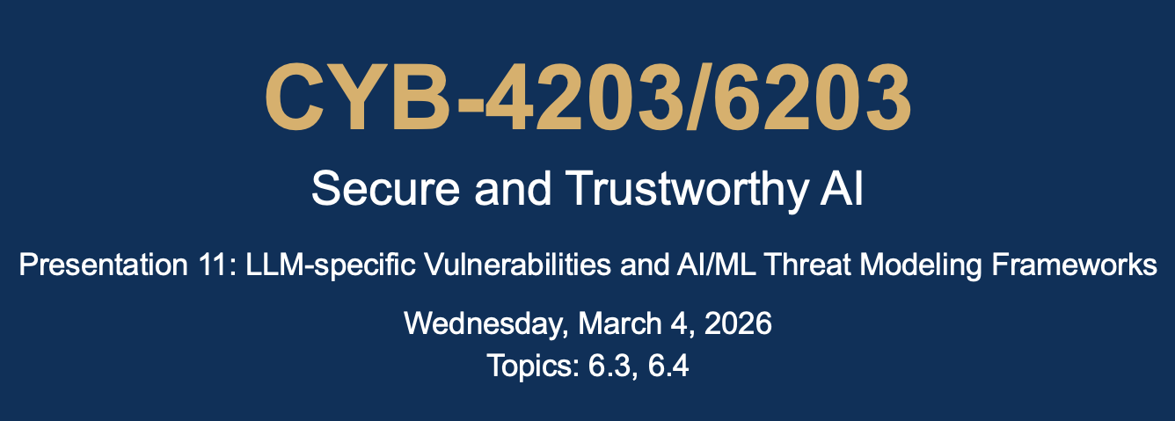
Midterm Review

Slide 4
Midterm Review
SEE MIDTERM REVIEW GUIDE ON HARVEY : )

Slide 5
Assignment 6
4-6 pages total – Due Wednesday March 23 (after Spring Break)
Step 1: Recall your Assignment 5 topic
Step 2: Attack Vector Analysis (2-3 pages) – Select 4-5 specific attack vectors that are most relevant to your topic and provide the following for each:
Attack Description
Bio/neuro/psych analogue
AI/ML Pipeline stage mapping
Feasibility and impact
Defenses and open problems
Step 3: Threat Model (2-3 pages) – Choose 1 of the threat modeling frameworks from Presentation 11 and apply it systematically to your topic.

Slide 6
Midterm Project Look-Ahead
Assigned Wednesday, March 25
Due Wednesday, April 8.
Synthesize your topic analysis from Assignments 5 and 6
Use Gemini CLI to help you create an interactive artifact (get creative!) that demonstrates 2 of the attack vectors you've analyzed.
As you complete Assignment 6, think about which of your attacks would be most compelling as interactive demonstrations.

