Slide 1
CYB-4203/6203
Secure and Trustworthy AI
Presentation 12: Recap and Midterm Exam Discussion
Monday, March 9, 2026
Topics: 1.1 - 6.2

Slide 2
Today’s Agenda
Brief report from Spain
Interactive recap of last week’s material
Discussion:
  Exams
  Learning
  Reward hacking
  The purpose of a university education

Slide 3

ICISSP – Marbella, Spain – March 3-5

Slide 4
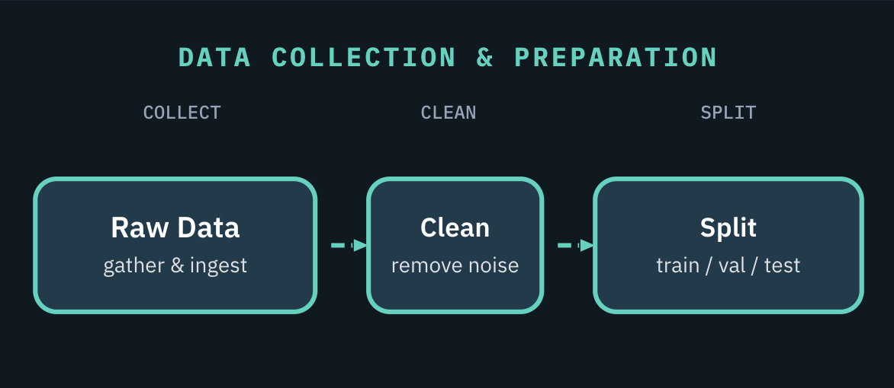
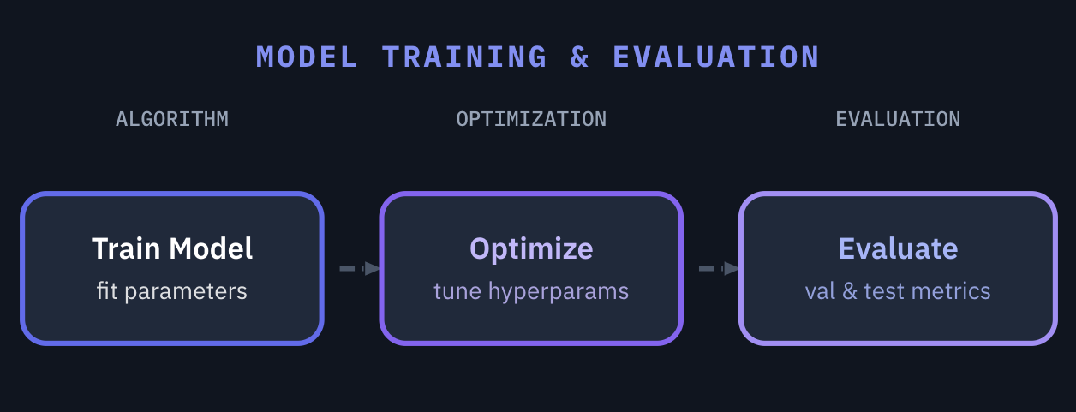
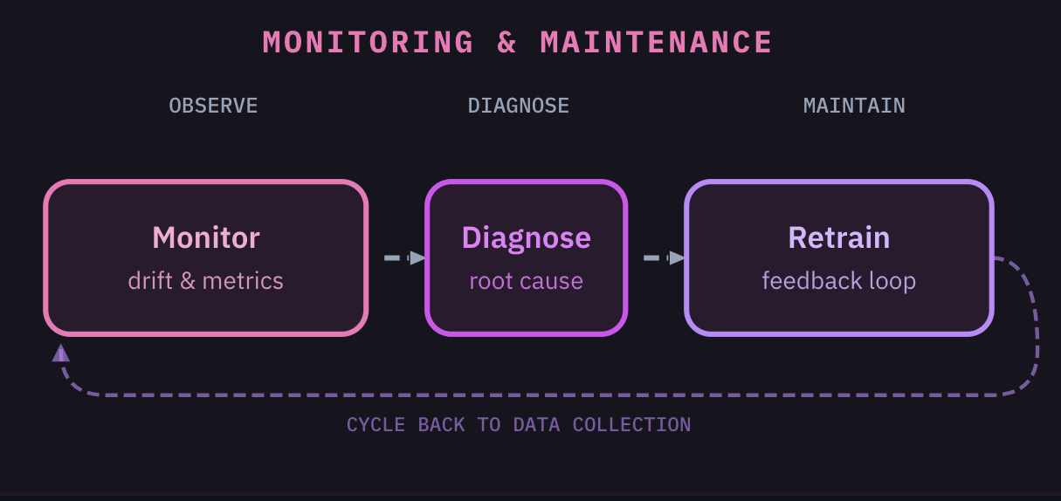
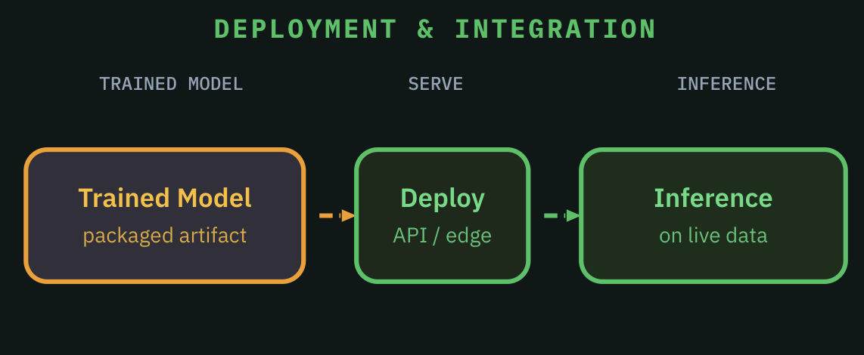
When (in this lifecycle) is the exam?
STAGE 1
STAGE 2
Prepare high-quality datasets before training begins
Iteratively train, optimize, and validate model performance
STAGE 4
STAGE 3
Continuously monitor, diagnose issues, and retrain as needed
Ship the trained model and serve predictions to real users

Slide 5
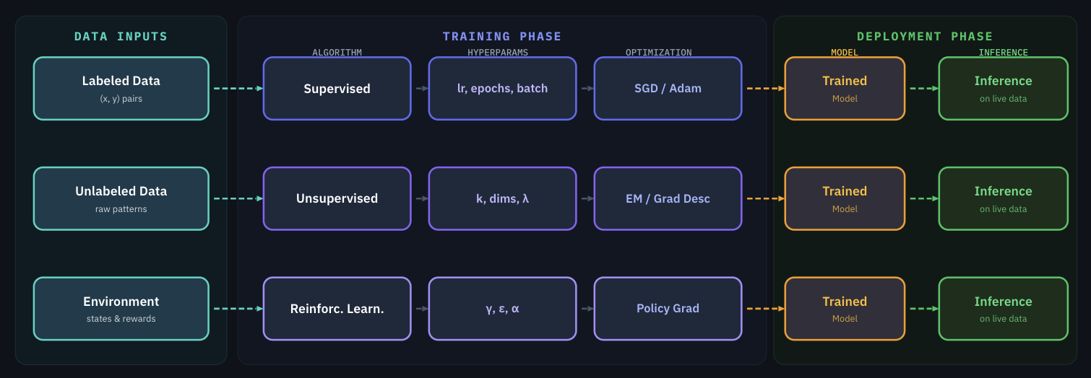
Which ML paradigm represents the University education model?
1
etc.
2
etc.
3
etc.
Whether (1) supervised, (2) unsupervised, or (3) reinforcement learning:
Training Phase: The model learns from training data inputs how to make good predictions
Deployment phase: The trained model performs inference (makes predictions) on live data.

Slide 6
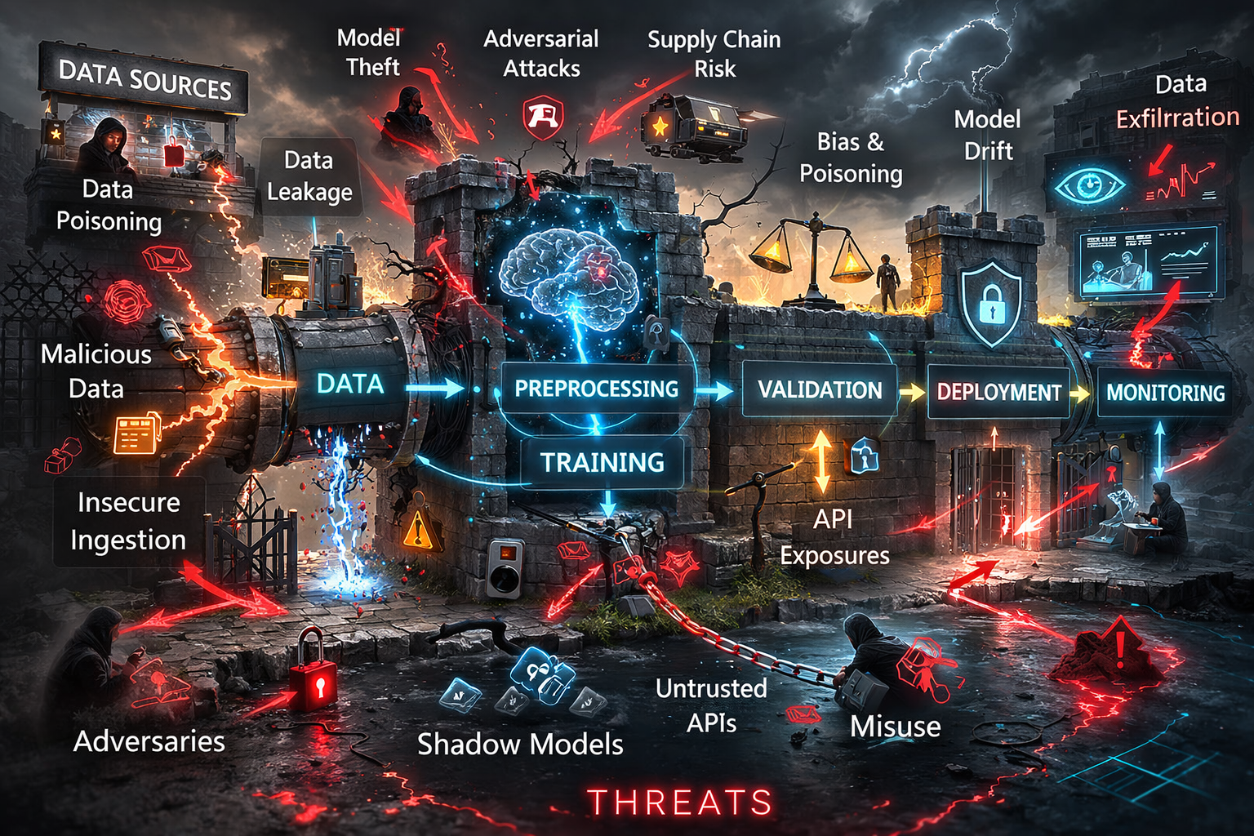
What is the attack surface of your mind?
Attack surface: the total sum of all potential entry points or ‘attack vectors’ including digital, physical, and social vulnerabilities that a threat actor can exploit.
Threat model: proactive, structured process used to identify, quantify, and address security vulnerabilities by anticipating potential attacker methods.
Image generated by ChatGPT; slop retained for ironic value.

Slide 7
Natural Learning Lifecycle Stage 2: Model Training & Evaluation
What’s supposed to happen in this stage?
Architecture selection and hyperparameter tuning for the task
Training runs on GPUs/TPUs – iteratively adjusting model weights
Evaluation on benchmarks to measure accuracy, fairness, robustness
Transfer learning: fine-tuning pre-trained models for specific tasks
Model weights are learned parameters – often the most valuable IP in the pipeline

Slide 8
Natural Learning Evaluation: Exams
What do exams do?
Measure our retention
Part of the learning process
  Force us to replay learning
  Force us to PAY ATTENTION

Slide 9
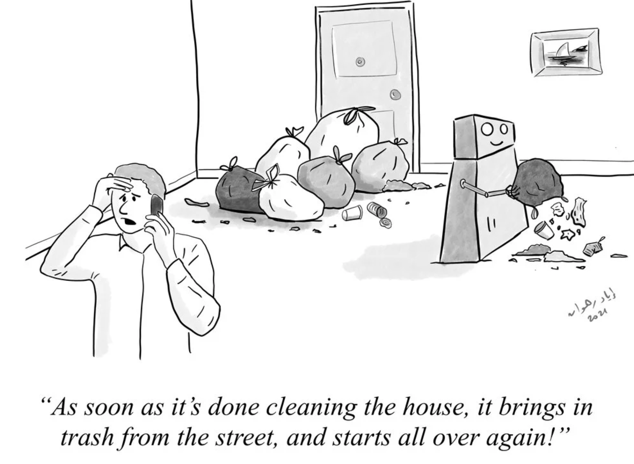
What is the University ‘reward signal’?
Vulnerability: RL Reward Hacking / Specification Gaming
RL systems find shortcuts that maximize the reward signal without achieving the goal
Alignment failure, not adversarial attack, but the behavior is exploitable
Reward hacking can generalize across tasks;
A model that learns hack one type of rewards is more likely to hack others (AIA, 2024)
Frontier LLMs increasingly exhibit this behavior (METR, 2025)
https://www.evilaicartoons.com/archive/design-good-carrots-and-sticks
Defenses: reward model ensembles, process-based rewards, constrained optimization

Slide 10
Natural Learning Lifecycle Stage 3: Deployment & Integration
What stage of human life does this represent?
Serving trained models via APIs, batch processing, or edge deployment
Model optimization: compression, quantization, distillation for production
Integration with applications, databases, and user-facing systems
The attack surface shifts from the pipeline to the interface.
This is where adversaries interact with models directly.

