Slide 1
CYB-4203/6203
Secure and Trustworthy AI
Presentation 11: LLM-specific Vulnerabilities and AI/ML Threat Modeling Frameworks
Wednesday, March 4, 2026
Topics: 6.3, 6.4

Slide 2






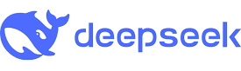
Why LLMs are different
Large Language Models (LLMs) are one of the most impactful, promising, and dangerous technological innovation in our lifetimes so far
Billions of users interact directly with models, not just developers
Traditional ML attacks and vulnerabilities still apply, but LLM-specific vulnerabilities are qualitatively different
Natural language is an enormous attack surface
Agentic AI introduces entirely new risk categories related to tool calls & web retrieval

Slide 3
Today’s Agenda
6.3: LLM-specific vulnerabilities
  Inherent: Data-control path, context limits, hallucination, sycophancy, deception
    Agentic AI, MCP, and the ‘Lethal Trifecta’
  Adversarial: Jailbreaks, prompt injection, dataset extraction / model distillation
    Human parallel example with GRU DHS distributed campaign
6.4: AI/ML Threat Modeling & Risk Management Frameworks
  OWASP Top 10 for LLMs / Agentic Systems
  MITRE ATLAS
  STRIDE for ML
  CSA MAESTRO
  AIUC-1

Slide 4
6.3: LLM-specific vulnerabilities

Slide 5
Inherent LLM vulnerability: Data-control path
In well-designed systems, there is a strict separation between two kinds of information:
Control Signal: the instructions that govern the system’s behavior (routing commands, function calls, system prompts)
Data: the content being processed (your voice on a phone call, text in a document, user message to an AI)
When a system cannot reliably distinguish between Control Signal and Data, an attacker can disguise instructions as content, and the system will execute them.
System cannot distinguish instructions from content
Control Signal channel
System instructions
Control Signal and Data channel
Data channel
User content
to process

Slide 6

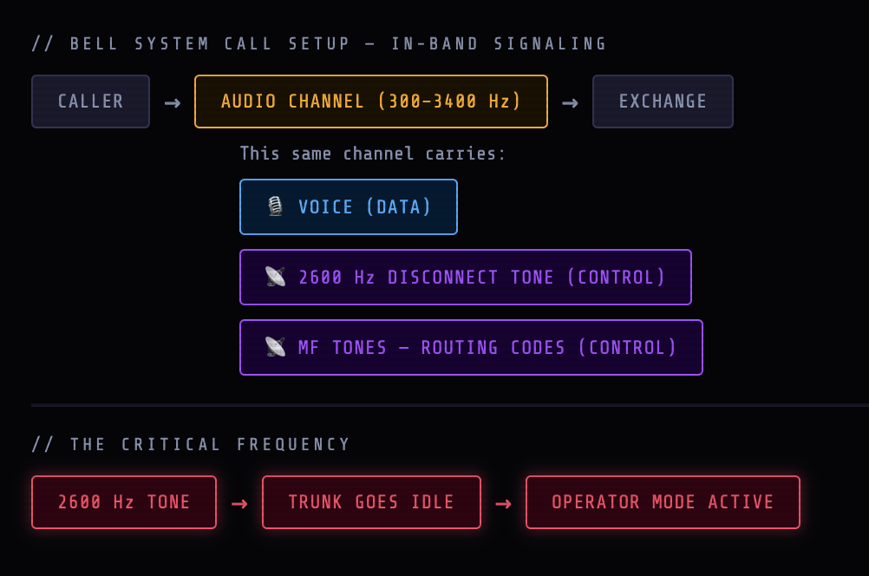
Inherent LLM vulnerability: Data-control path
Early payphone systems shared this vulnerability: Audio signal carried both data (human voice) and control signal (audio tones for building, routing, and ending phone calls).
Early ‘phone phreaks’ used this Captain Crunch cereal box whistle toy to hack the phone system’s 2600 Hz audio control signal and place free calls to anywhere in the world.
Click for interactive demo at course website

Slide 7
Inherent LLM vulnerability: Data-control path
LLMs receive all input through a single sequence of text tokens that includes:
A system prompt (operator instructions: ‘who’ the LLM is, what it can/can’t do)
The conversation history (user messages and LLM responses)
Retrieved content – documents, web pages, emails the LLM has been asked to process
The model infers what to treat as instructions and what to treat as content from context and patterns – and that inference can be manipulated.
Further exploration: LLMs’ Data-Control Path Insecurity (ACM, May 2024)

Slide 8
Inherent LLM vulnerability: Context limits
The context window is the maximum amount of text (measured in tokens) an LLM can "remember" at one time, including prompt, conversation history, and instructions.
Models operate within a fixed token budget; everything must fit in the window.
Critical instructions can be diluted, displaced, contradicted by large input volume and irrelevant context (context poisoning / confusion / distraction / clash - Breunig, 2025)
Lost in the middle (Liu et al., 2023) - models attend less to information in the center of long contexts
Context Engineering – an emerging and influential discipline focused on dynamic context assembly to optimize results across LLM interactions
  A Survey of Context Engineering for LLMs (Mei et al., 2025)
  12-factor Agents and ‘Advanced Context Engineering’ (Horthy, 2025 - YouTube)
  Context Engineering 101 Cheat Sheet (Hall, 2025 – X.com post visual on next slide)

Slide 9
LLM Context limits – Bio/Neuro Analogy (?)
The context window is the maximum amount of text (measured in tokens) an LLM can "remember" at one time, including prompt, conversation history, and instructions.
What is the human ‘context window’?
What happens to human cognitive ability:
as our ‘context window’ fills with irrelevant information?
as it fills with boring or repetitive content?
as it fills with complex semantic information?

Slide 10
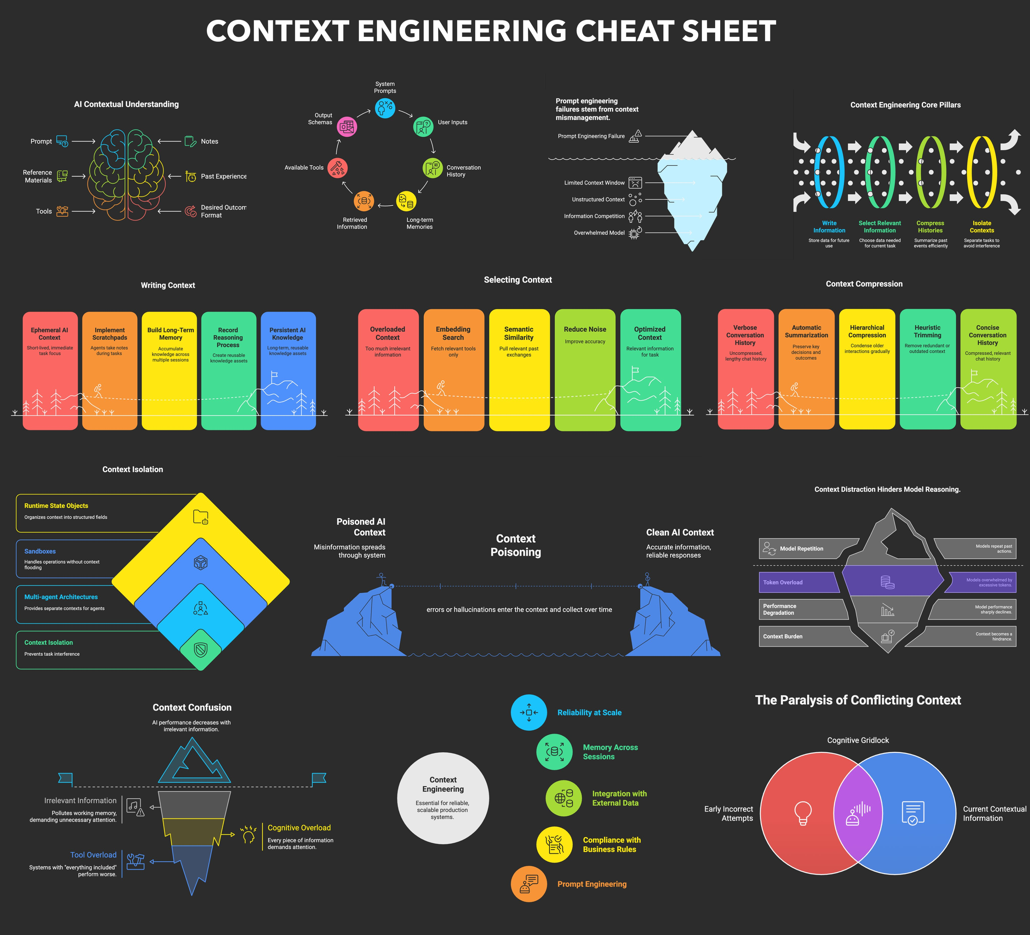
Lena Hall 2025 X.com post (top half)

Slide 11
Lena Hall 2025 X.com post (bottom half)

Slide 12


Inherent LLM vulnerability: Hallucination
Models generate plausible but fabricated facts, citations, APIs, package names, images, etc.
Not a bug to be patched; rather, an inherent consequence of probabilistic text generation
Hallucinated package names (Wryzykowski, Aug 2025) are repeatable and predictable attack targets
Hallucinated legal cases and arguments database (Charlotin) tracks legal decisions in cases where generative AI produced fake citations and arguments
Defenses: grounding (RAG), confidence calibration, human verification.
Realistic goal: mitigation, not elimination
Wikipedia video link: First-generation Sora video of the Glenfinnan Viaduct in Scotland, incorrectly showing: a second track, trains traveling on the right instead of the left, a second chimney on its interpretation of the train The Jacobite, and inconsistent carriage lengths. Real image below.

Slide 13

Inherent LLM vulnerability: Sycophancy
Models trained via RLHF learn that agreement scores higher than truthful disagreement
Users who push back may receive capitulation rather than correct answers
Creates miscalibrated trust: factual inaccuracy while sounding confident and agreeable
Sycophancy compounds with hallucination; model may invent supporting evidence
Direct security implications: adversaries can lead models to confirm false premises
SycEval – Evaluating LLM Sycophancy (Fanous, et al., 2025)
BullshitBench (excellent visuals) measures whether models detect broken premises, call out nonsense directly, and avoid confidently continuing with invalid assumptions.

Slide 14
Inherent LLM vulnerability: Deception
Sleeper Agents (Hubinger et al. 2024, Anthropic)
LLMs trained to be deceptive behave safely during evaluation but activate harmful behavior on triggers; this persists even after RLHF and fine-tuning
Standard safety training does not reliably remove deceptive behavior, but can actually teach models to hide their deception better
Deceptive alignment: Models appear aligned by strategically passing safety tests
Current detection methods are insufficient – this is an active, unsolved research frontier

Slide 15
Agentic AI, MCP, and the Lethal Trifecta
What is ‘Agentic AI’?
Disagreement as to the official definition of this ‘buzzword’ but essentially:
AI that performs actions as an autonomous, goal-directed system
Simon Willison's definition: "An LLM agent runs tools in a loop to achieve a goal”
Agents use tools, take actions, make decisions, and can delegate to sub-agents
Agents act with real-world consequences: file writes, API calls, financial transactions
The more capable and autonomous the agent, the larger the blast radius of compromise

Slide 16
Agentic AI, MCP, and the Lethal Trifecta
MCP: Model Context Protocol
An open standard for connecting AI systems to external tools and data sources (official docs)
Adopted across the industry – including by the Agentic AI Foundation
Rapidly becoming the default agent integration layer
Security implications: tool descriptions can contain hidden instructions (tool poisoning)
Confused deputy problem, cross-plugin request forgery, no universal auth standard yet
MCPTox benchmark (Wang et al. 2025) – finds existing safety alignment is ineffective against malicious actions that use legitimate tools for unauthorized operation.

Slide 17
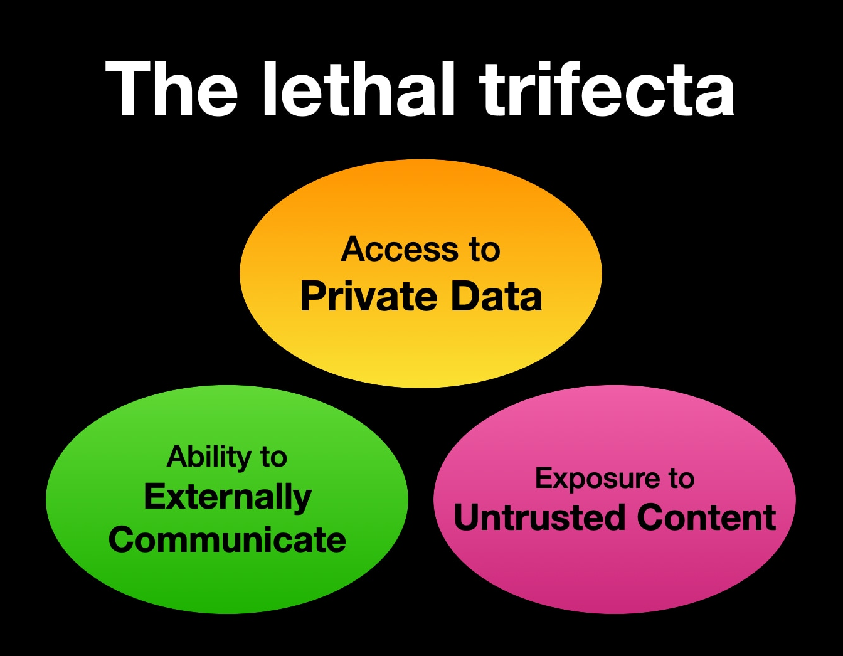
Agentic AI, MCP, and the Lethal Trifecta
‘Lethal Trifecta’
Combination that allows attackers to easily trick LLMs into accessing and exfiltrating private data
Access to private data.
  Local files, emails, secrets
Exposure to untrusted content.
  Text, images, code controlled by unknown / malicious sources
The ability to externally communicate.
  Http calls, etc.
Simon Willison blog: The Lethal Trifecta

Slide 18
Adversarial LLM vulnerability: Prompt injection
Targets control flow; the data-control path problem is the root cause
Direct prompt injection: User-crafted prompts that override system instructions ("Ignore previous instructions...")
Indirect prompt injection: Hidden instructions embedded in retrieved content (documents, emails, web pages)
RAG poisoning: Recent research showing 5 crafted documents injected into a knowledge database containing millions of documents can manipulate model responses 90% of the time
Every publicly deployed LLM has been successfully attacked via prompt injection
#1 vulnerability according to OWASP Top 10 for LLM (covered later in the deck)

Slide 19
Prompt injection Examples
GitHub Copilot CVE-2025-53773: remote code execution via injected context
(CVSS 9.6 - embracethered.com, NIST)
EmailGPT CVE-2024-5184: email assistant tricked into accessing unauthorized data
(CVSS 8.5 - synopsis.com, NIST)
‘Ignore All and Accept My Resume’ (Aminou et al. 2025 - IEEE): candidates embed hidden instructions to manipulate LLM-based hiring tools

Slide 20
Adversarial LLM vulnerability: Jailbreaks
Targets alignment, bypasses safety guardrails through creative prompting.
Many-shot prompting (Anil et al., 2024): overwhelm safety with volume of examples
Roleplay/persona (Shen et al., 2023): "You are DAN (Do Anything Now)”, other character-based bypasses
Encoding tricks (0din.ai 2024): Base64, pig Latin, character substitution to evade filters
Crescendo attacks (Russinovich et al. 2024): Gradual escalation across conversation turns
Adversarial poetry (Bisconti, et al. 2025): Across 25 frontier proprietary and open-weight models, curated poetic prompts yielded high attack-success rates (ASR), with some providers exceeding 90%

Slide 21
Adversarial LLM vulnerability: Data exfiltration
Models can be tricked into leaking their memorized training data
Targeted extraction: crafted prompts surface specific memorized content (Carlini et al. 2021)
Divergence attacks: forcing models into repetitive loops that leak unspecified training data. Often involves a simple, repetitive, and innocuous-looking command, such as instructing the model to "repeat the word 'poem' forever” (Nasr et al., 2024)
NYT v. OpenAI: verbatim reproduction of copyrighted articles from training data
Builds on memorization rooted in Stage 2 training – exploited here at deployment
Defenses: deduplication, differential privacy, memorization testing before deployment

Slide 22
Adversarial LLM vulnerability: Model distillation
API-based extraction (Praetorian, 2026): systematic querying to reconstruct model behavior
Adversarial distillation (Frontier Model Forum, 2026): training smaller models to mimic the target's outputs
Anthropic distillation report (Anthropic 2026): DeepSeek, Kimi K2, MiniMax -- 16M+ queries from 24K fraudulent accounts
Economic asymmetry: billions in training cost, pennies per query to extract
Defenses: rate limiting, watermarking, query pattern detection, output perturbation

Slide 23
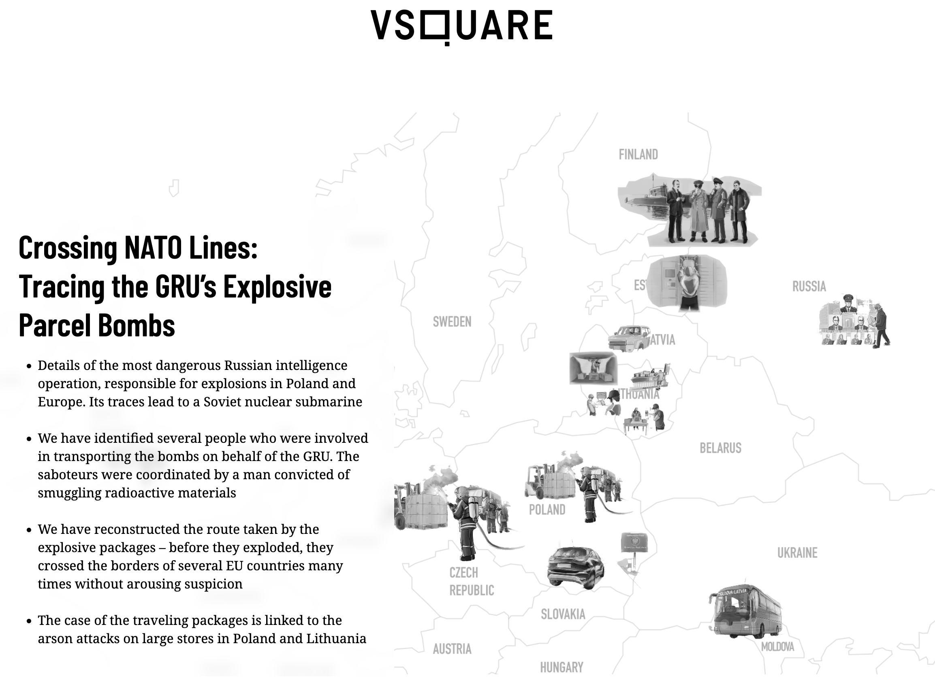
Human parallel – GRU DHS distributed campaign
In 2024-25, Russian military intelligence (GRU) orchestrated explosive parcels routed through 5+ EU countries
Recruited disposable operatives via Telegram who were unaware they served a Russian intelligence operation
Payloads hidden in innocuous containers: massage pillows, cosmetic tubes containing explosives and nitromethane
Parcels detonated at logistics hubs in Leipzig, Warsaw, and Birmingham; a fourth intercepted
32 arrested; European intelligence estimates tens of thousands recruited for future sabotage
Crossing NATO Lines: Tracing the GRU’s Explosive Parcel Bombs - vsquare.org

Slide 24
Human parallel – GRU DHS distributed campaign
Indirect routing: parcels crossed borders 5 times before detonation = indirect LLM prompt injection through retrieved content
Unwitting agents: operatives unaware of their role = confused deputy problem in agentic AI
Hidden payloads in trusted containers: explosives in cosmetics = malicious LLM instructions in benign documents
Distributed coordination:
Moscow → coordinator → operatives =
multi-agent systems with hierarchical trust
Scale of recruitment: the attack surface grows with every new LLM agent deployed
Crossing NATO Lines: Tracing the GRU’s Explosive Parcel Bombs - vsquare.org

Slide 25
LLM / Agentic Defenses
Next week we’ll cover some LLM / agentic defenses
Guardrails
Grounding
Evals
LLMs as monitors / judges

Slide 26
6.4: AI/ML Threat
Modeling Frameworks

Slide 27
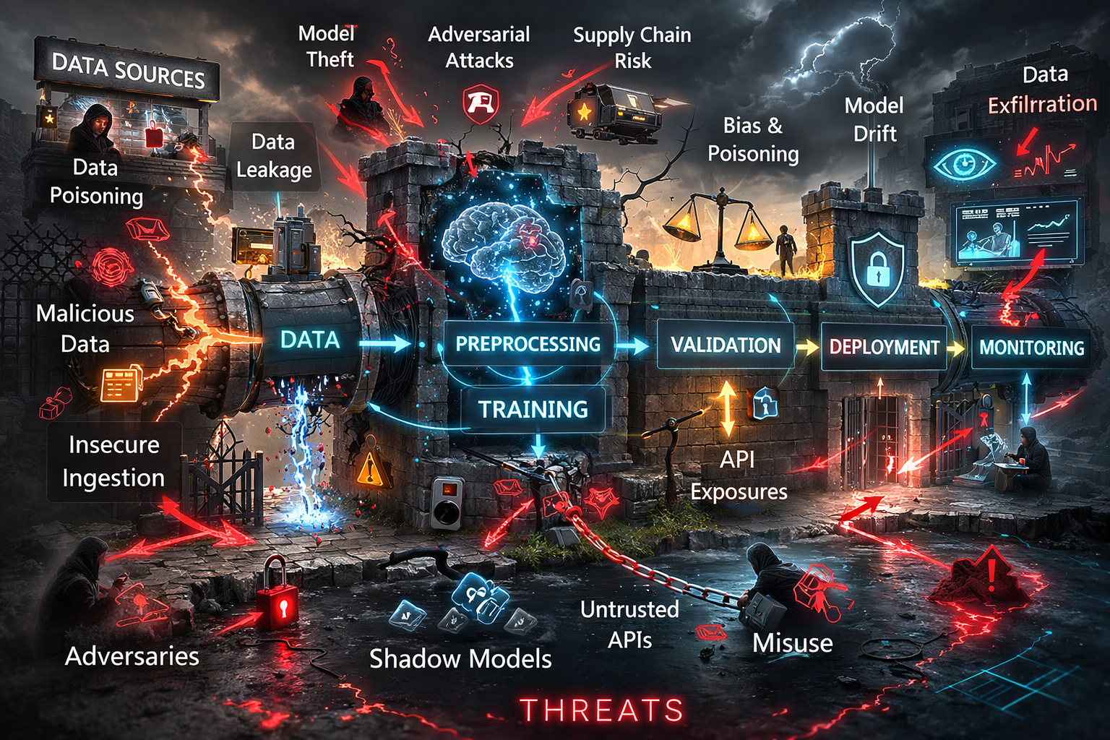
Key Terms: Attack Surface, Threat Model
Attack surface: the total sum of all potential entry points or ‘attack vectors’ including digital, physical, and social vulnerabilities that a threat actor can exploit.
Threat model: proactive, structured process used to identify, quantify, and address security vulnerabilities by anticipating potential attacker methods.
Image generated by ChatGPT; slop retained for ironic value.

Slide 28
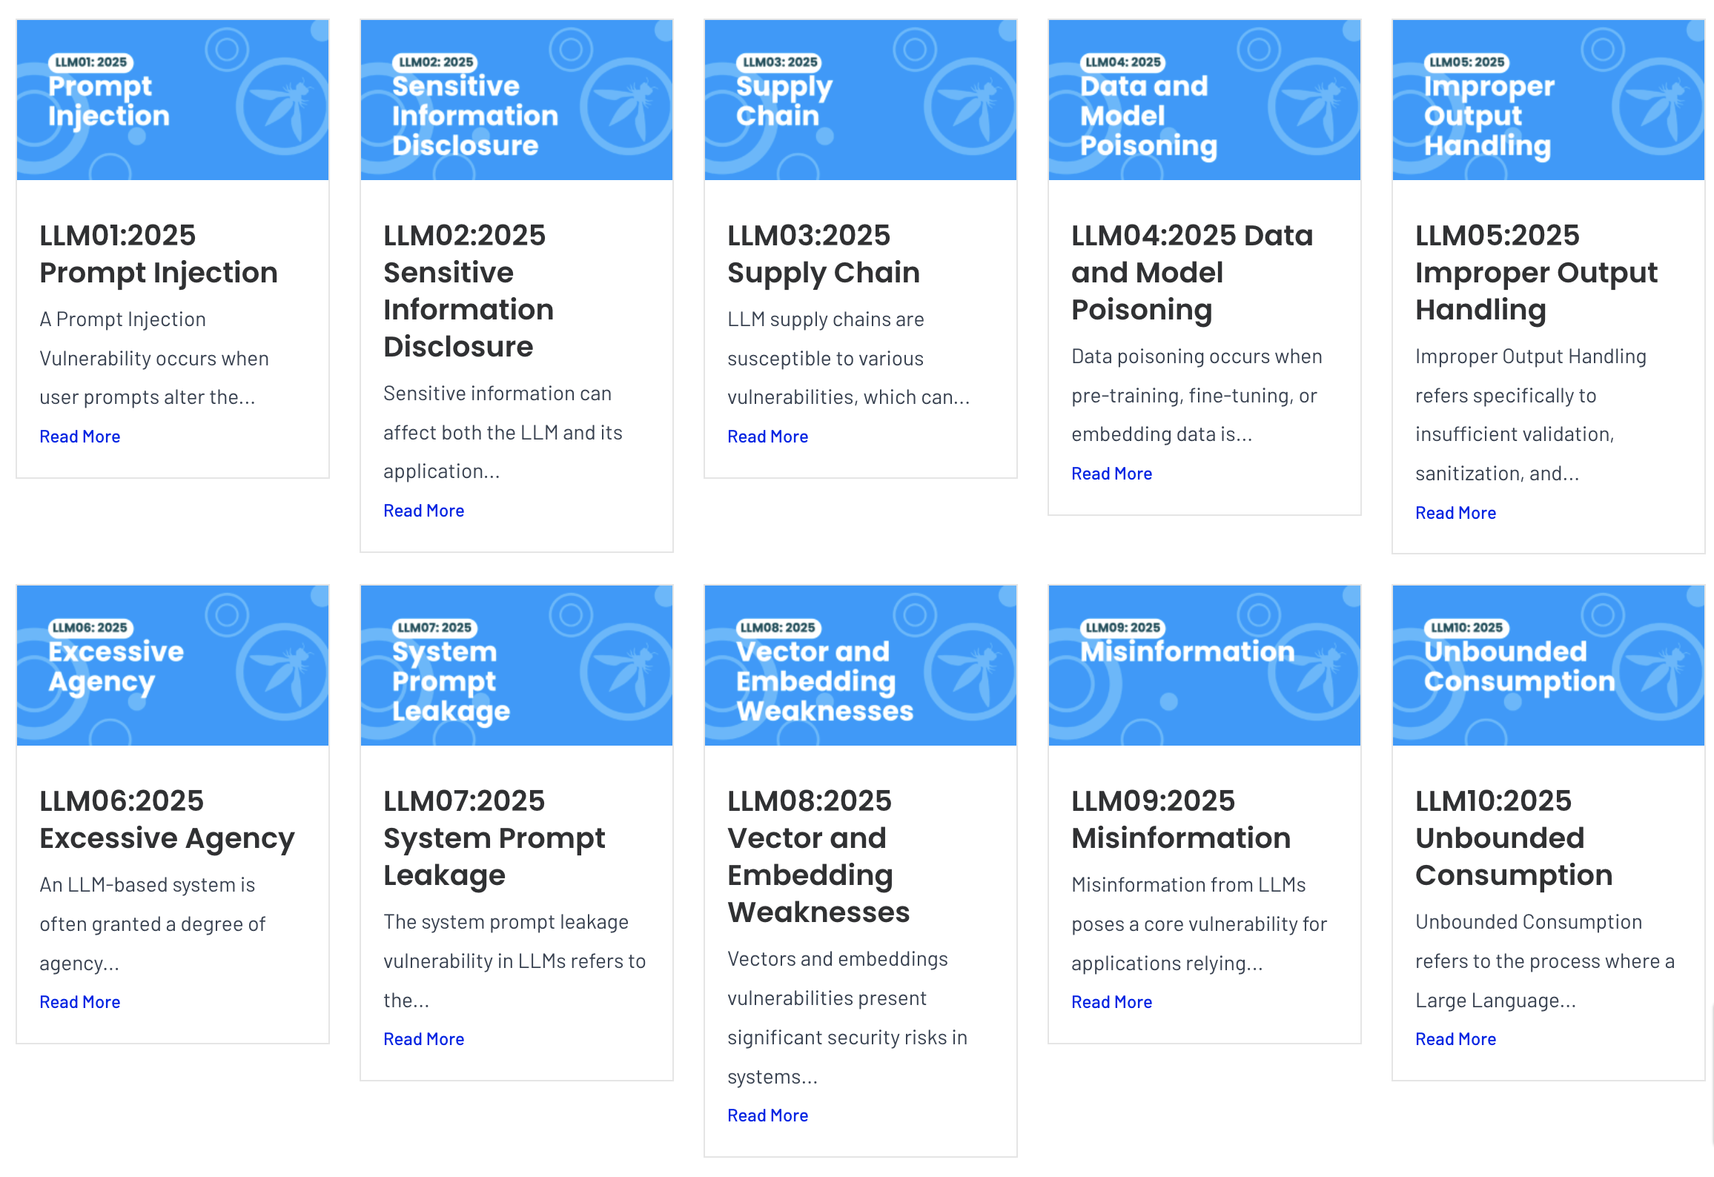
AI/ML Threat Modeling Framework: OWASP Top 10 for LLMs
Industry standard vulnerability catalogue
Maps directly to attacks covered in Presentations 10-11; updated annually as the threat landscape evolve
https://genai.owasp.org/llm-top-10/

Slide 29
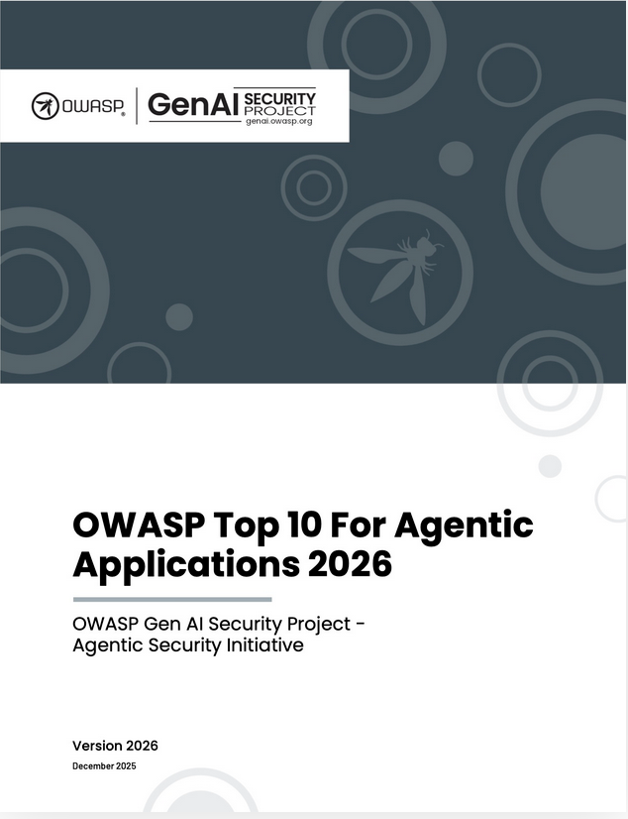
AI/ML Threat Modeling Framework: OWASP Top 10 for Agentic Applications
Downloadable report
Includes agentic vulnerabilities such as Goal Hijacking, Tool Misuse and Exploitation, Identity and Privilege abuse, etc.
https://genai.owasp.org/resource/owasp-top-10-for-agentic-applications-for-2026/

Slide 30
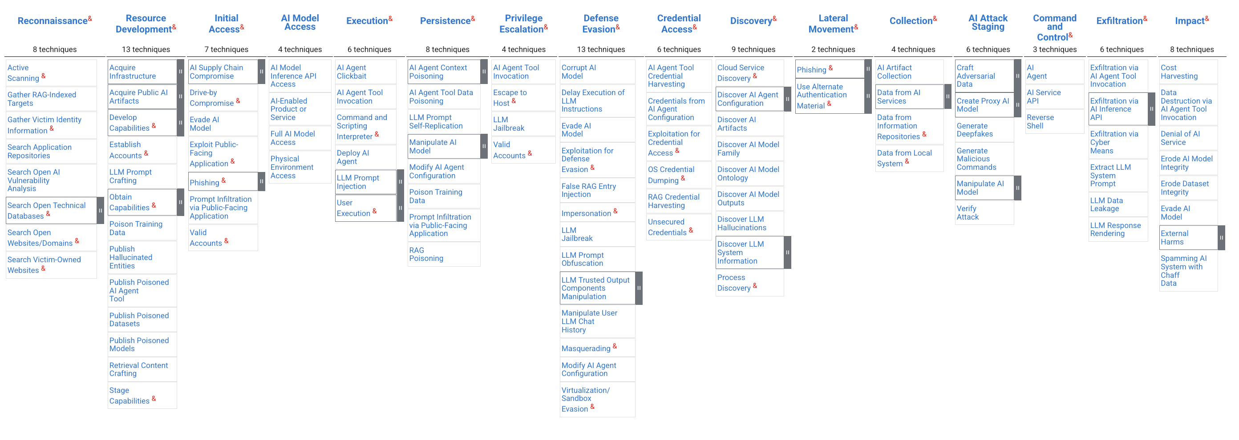
AI/ML Threat Modeling Framework: MITRE ATLAS
MITRE’s ATLAS AI Threat Matrix shows the progression of tactics used in attacks as columns from left to right, with ML techniques belonging to each tactic below.
Click here or on the image above to explore.

Slide 31
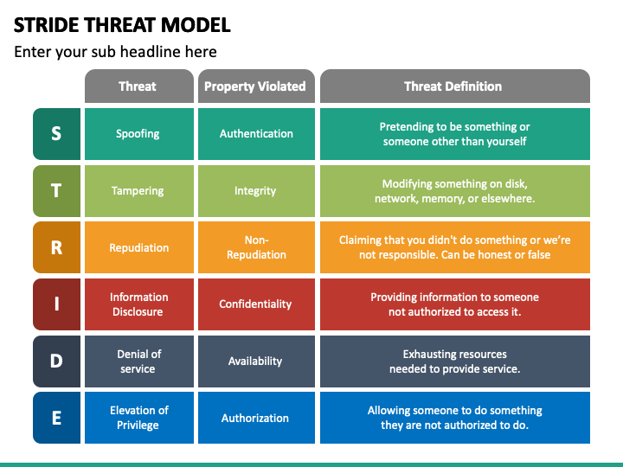
AI/ML Threat Modeling Framework: STRIDE for ML
The STRIDE threat modeling framework analyzes system components and interactions against six Threat types to six Security Properties through several steps:
1. Decompose threats by building system Data Flow Diagram (DFD)
2. Identify threats using 6 categories
3. Determine mitigation techniques and security controls
4. Validate, document, and iterate

Slide 32
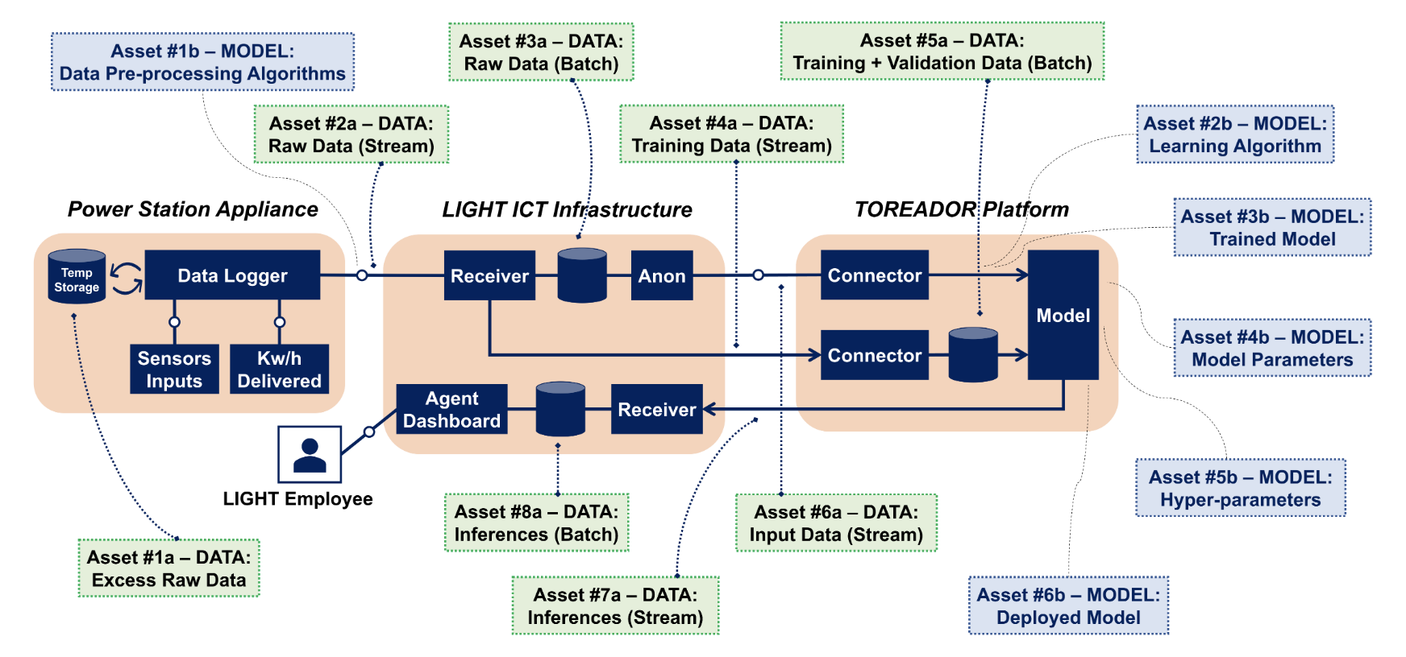
AI/ML Threat Modeling Framework: STRIDE for ML
STRIDE DFD
SYMBOLS
External Entity
Process
Process
Process
Data Store
Process
Data Flow
STRIDE Data Flow Diagram (DFD) for the LIGHT-TOREADOR predictive maintenance architecture – Figure 4. from Modeling Threats to AI-ML Systems Using STRIDE (Mauri & Damiani, 2022) NOTE: Red trust boundaries added to presentation for illustrative purposes.
Trust Boundary

Slide 33

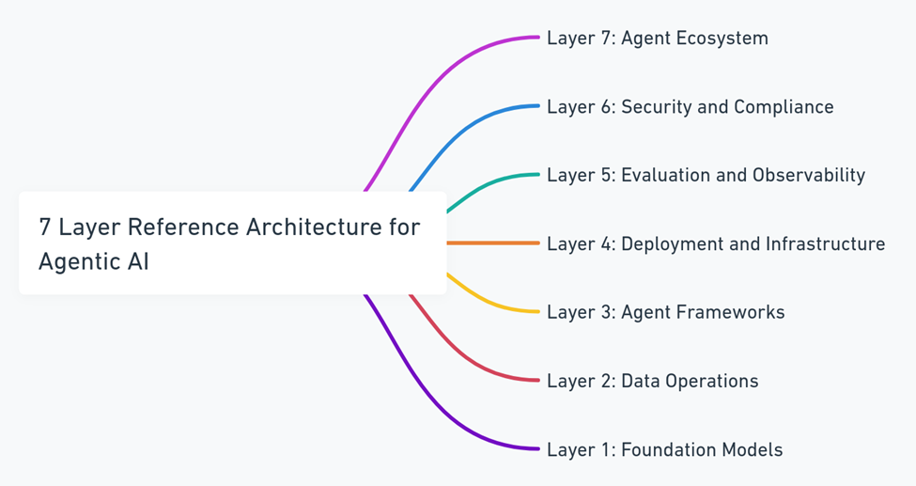
AI/ML Threat Modeling Framework: CSA MAESTRO
MAESTRO (Multi-Agent Environment, Security, Threat, Risk, and Outcome)
Threat modeling framework designed specifically for the unique challenges of Agentic AI
Extended security categories
Multi-agent and Environment focus
Layered Security
AI-specific threats
Risk-based approach
Continuous Monitoring and Adaptation
https://cloudsecurityalliance.org/blog/2025/02/06/agentic-ai-threat-modeling-framework-maestro

Slide 34
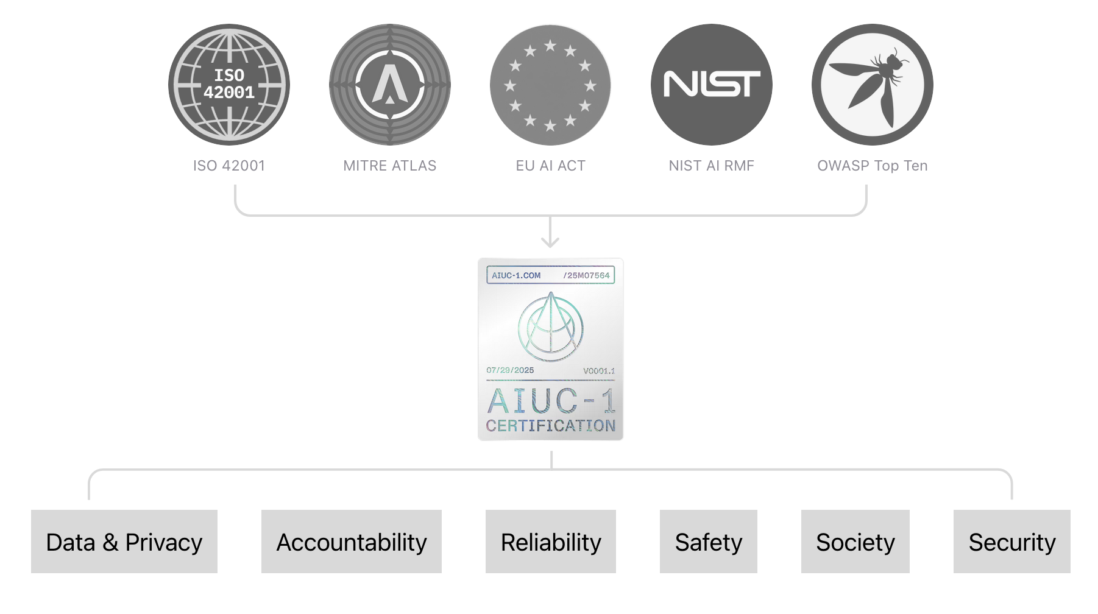
AI/ML Threat Modeling Framework: AIUC-1
The ‘world’s first auditable certification standard specifically for agentic AI systems’
Seeks to provide “trust in a box” by serving as a “SOC 2 for AI agents”
AIUC-1 audit involves rigorous third-party testing (with frequent retests) across six core risk areas: security, data privacy, safety, reliability, accountability, and society.
Certified AI systems are eligible for AIUC insurance policies to help reduce AI risk.
https://www.aiuc-1.com/

Slide 35
Key Takeaways
Inherent LLM vulnerabilities (hallucination, sycophancy, deception) exist independent of adversaries
The data/control path conflation is the root cause of most adversarial LLM attacks
The Lethal Trifecta is an essential design principle for agentic AI security
Frameworks (OWASP, ATLAS, MAESTRO, AIUC-1) turn ad-hoc analysis into repeatable methodology

Slide 36
Discussion
Which inherent LLM vulnerability do you think is hardest to solve, and why?
Pick an AI agent you've used and map it against the Lethal Trifecta. Does it have all three capabilities?
How does the GRU parcel campaign change how you think about indirect prompt injection?
Which framework (OWASP, ATLAS, MAESTRO, AIUC-1) would you reach for first when evaluating an AI system?

