Slide 1
CYB-4203/6203
Secure and Trustworthy AI
Presentation 10: AI/ML Lifecycle Vulnerabilities and ML Attack Vectors
Monday, March 2, 2026
Topics: 6.1, 6.2

Slide 2
Today’s Agenda
AI/ML lifecycle recap
Brief, preliminary (and simplified) explanations / definitions:
  3 ML paradigms: supervised, unsupervised, reinforcement learning
  Inference
  Attack surface
  Threat model
  Adversarial
6.1 & 6.2: A tour of vulnerabilities (both attacks and defenses) across the AI/ML lifecycle

Slide 3
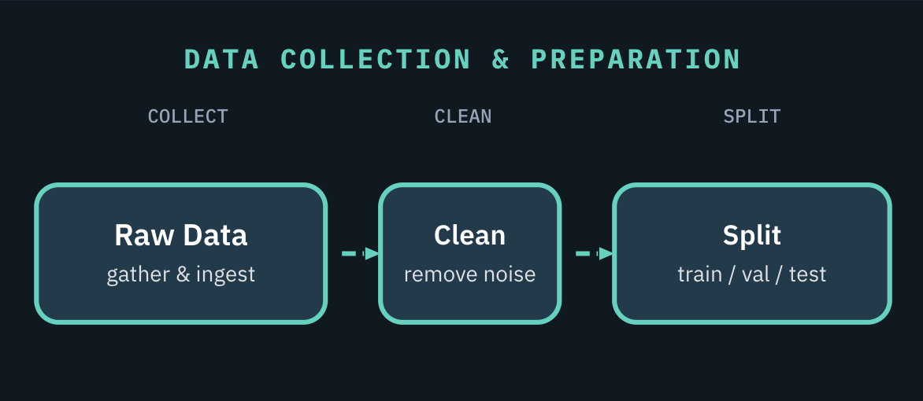
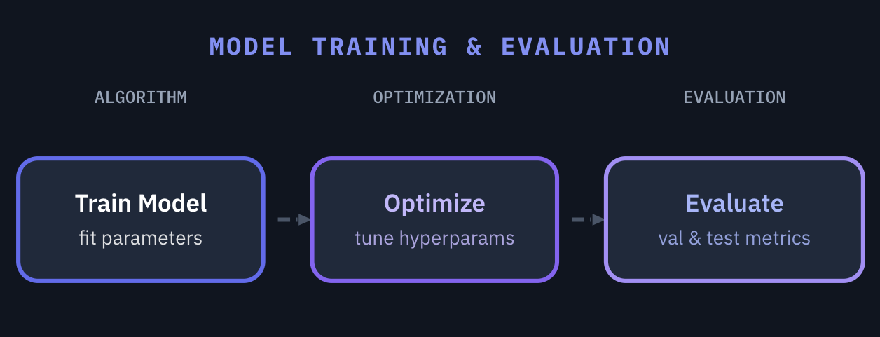
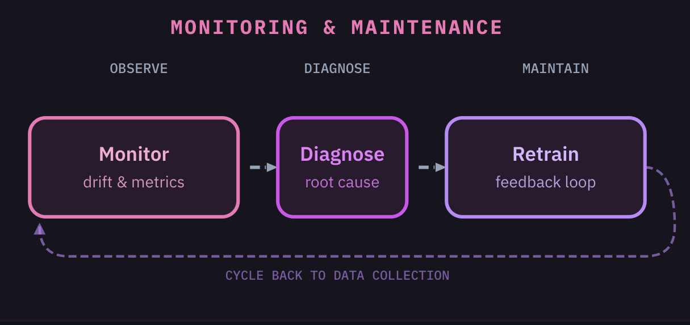
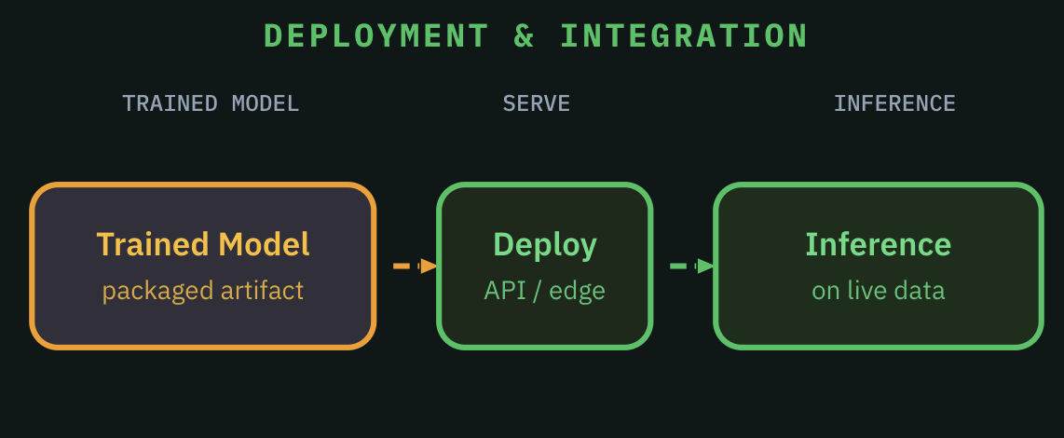
Recap: AI/ML lifecycle in 4 stages
STAGE 1
STAGE 2
Prepare high-quality datasets before training begins
Iteratively train, optimize, and validate model performance
STAGE 4
STAGE 3
Continuously monitor, diagnose issues, and retrain as needed
Ship the trained model and serve predictions to real users

Slide 4
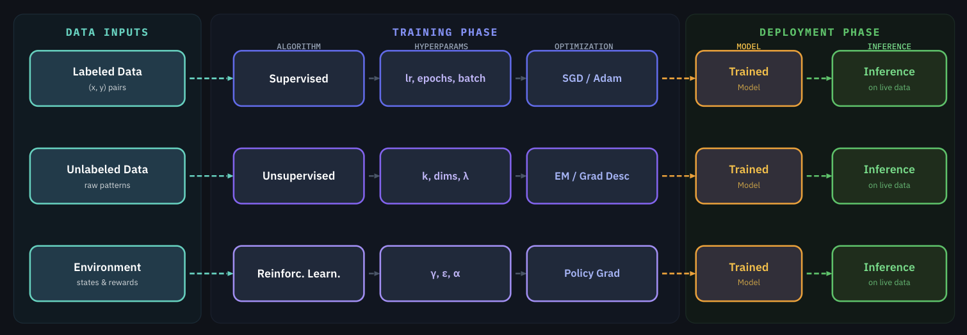
3 ML Paradigms: Supervised, Unsupervised, Reinforcement Learning
1
etc.
2
etc.
3
etc.
Whether (1) supervised, (2) unsupervised, or (3) reinforcement learning:
Training Phase: The model learns from training data inputs how to make good predictions
Deployment phase: The trained model performs inference (makes predictions) on live data.

Slide 5
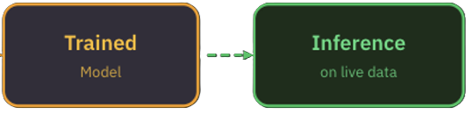
Key Term: Inference
Inference: Running a trained model on new inputs to produce outputs (predictions, classifications, generated content, actions, etc.) during evaluation and deployment phases.

Slide 6
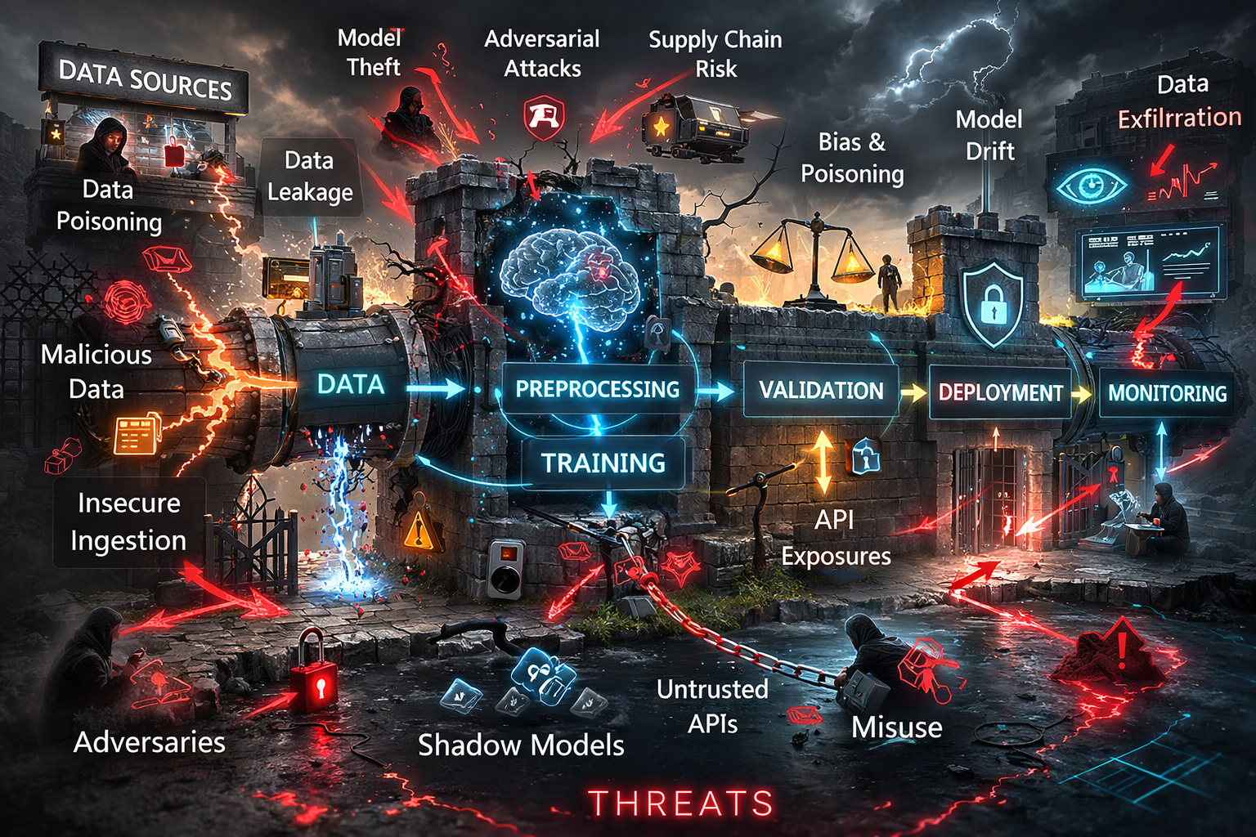
Key Terms: Attack Surface, Threat Model
Attack surface: the total sum of all potential entry points or ‘attack vectors’ including digital, physical, and social vulnerabilities that a threat actor can exploit.
Threat model: proactive, structured process used to identify, quantify, and address security vulnerabilities by anticipating potential attacker methods.
Image generated by ChatGPT; slop retained for ironic value.

Slide 7
Key Term: Adversarial (contextualized)
Adversarial connotes competition or opposition; exact meaning and intent vary by context.
Context | Meaning / Intent
General security | Adversarial actions attack, disrupt, deceive, or exfiltrate from a system.
LLM security | Adversarial prompts (i.e. jailbreaking) are used by attackers to bypass safety guardrails
Model training | Adversarial training is a defensive technique for improving model robustness.
Data generation | Generative adversarial networks (GANs) use competition between two neural networks (generator and discriminator) to create realistic synthetic training data.
Reinforcement Learning | Adversarial games (and self-play) help RL models learn strategies to outplay opponents.

Slide 8
6.1 & 6.2: A tour of vulnerabilities
(both attacks and defenses)
across the AI/ML lifecycle

Slide 9
A note on cross-stage attacks
⚠ Some attacks span multiple stages – planted in one, triggered in another
Backdoors / Trojans are planted in data collection or training but triggered at inference
Supply chain risks propagate from external sources through multiple stages
Feedback loops connect monitoring back to training, creating circular attack paths
Keep this cross-stage perspective as we walk through each stage

Slide 10
AI/ML Lifecycle Stage 1:
Data Collection & Preparation

Slide 11
AI/ML Lifecycle Stage 1: Data Collection and Preparation
What’s supposed to happen in this stage?
Sourcing training data from databases, APIs, web scraping, manual collection
Cleaning: removing duplicates, handling missing values, normalizing formats
Labeling: human annotators or automated systems assign ground truth
Feature engineering: selecting and transforming relevant input variables
Data defines what the AI/ML model learns – and what biases and vulnerabilities it inherits

Slide 12
AI/ML Lifecycle Stage 1: Data Collection and Preparation
Vulnerability: Data Poisoning Attack
Data injection: Adding malicious samples to the training set to degrade or influence model behavior at inference time
Label flipping: Changing labels on existing data to mislead learning (FLIP github repo)
Clean-label attacks: Subtle data modifications that don’t change the label but shift decision boundaries
Backdoor / Trojan insertion via data: Embedding hidden trigger patterns in training examples
Defenses: data validation, provenance tracking, anomaly detection on training sets

Slide 13
AI/ML Lifecycle Stage 1: Data Collection and Preparation
Real-world Data Poisoning Attack Examples
Medical LLM poisoning: 0.001% of tokens corrupted led to +5% harmful output; using biomedical knowledge graphs to screen medical LLM outputs mitigates 91.9% of harmful content (F1 = 85.7%; Nature Medicine Jan 2025)
Basilisk Venom: DeepSeek-R1 backdoor via GitHub code comments embedded in training data (0din.ai Feb 2025)
Nightshade: Artists deliberately poisoning images to disrupt scraper-trained models (MIT Technology Review Oct 2023)
Takeaway: even tiny amounts of poisoned data can have outsized impact

Slide 14
AI/ML Lifecycle Stage 1: Data Collection and Preparation
Vulnerability: Dataset Supply Chain
Third-party datasets may contain hidden poisoning or bias
Web scraping ingests whatever the internet contains – including adversarial content
Poisoning Web-Scale Training Datasets is Practical - Carlini et al. (2023) demonstrate novel poisoning attacks that guarantee appearance of malicious examples in web-scale datasets used for training large, widely-used ML models in production.
Defenses: dataset provenance verification, data auditing, ML-BOM tracking
OWASP CycloneDX ML-BOM: Software Bill of Materials adapted for ML provenance

Slide 15
AI/ML Lifecycle Stage 1: Data Collection and Preparation
Vulnerability: PII and Proprietary Data exposure
PII and proprietary data in training sets leads to memorization and regurgitation
Netflix Prize dataset deanonymization (Narayanan 2008) - Anonymous movie ratings of 500,000 subscribers correlated with public IMDB data to identify Netflix records of known users, uncovering apparent political preferences and other potentially sensitive information
Both an input problem (sensitive data entering training) and output problem (model leaking it)
Defenses: differential privacy during training, data scrubbing, deduplication

Slide 16
AI/ML Lifecycle Stage 2:
Model Training & Evaluation

Slide 17
AI/ML Lifecycle Stage 2: Model Training & Evaluation
What’s supposed to happen in this stage?
Architecture selection and hyperparameter tuning for the task
Training runs on GPUs/TPUs – iteratively adjusting model weights
Evaluation on benchmarks to measure accuracy, fairness, robustness
Transfer learning: fine-tuning pre-trained models for specific tasks
Model weights are learned parameters – often the most valuable IP in the pipeline

Slide 18
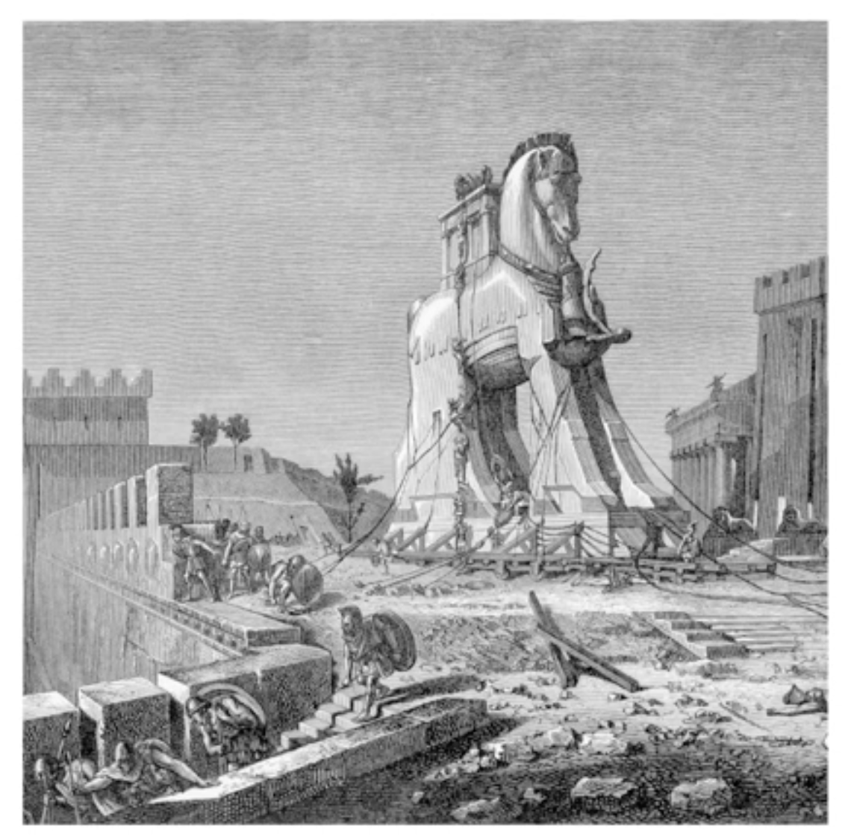
AI/ML Lifecycle Stage 2: Model Training & Evaluation
Vulnerability: Backdoor / Trojan implantation
Adversaries can implant hidden functionality into ML models in Stage 1 via poisoned datasets and during Stage 2 training & eval.
Good introductory video from Dan Hendrycks and Center for AI Safety (to watch later?)
YouTube: Trojans – Dan Hendrycks, Center for AI Safety

Slide 19
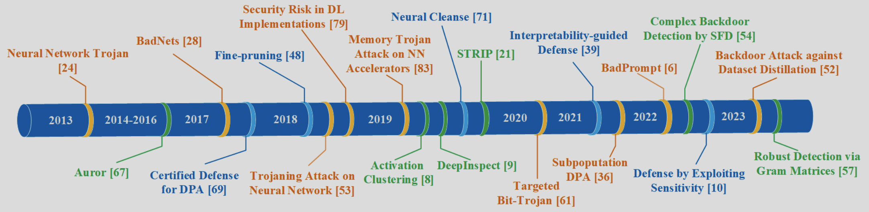
AI/ML Lifecycle Stage 2: Model Training & Evaluation
Vulnerability: Backdoor / Trojan implantation
Many Stage 2 mechanisms exist: bolt-on, direct parameter manipulation, fine-tuning, etc.
Clean performance on standard benchmarks, but malicious behavior only on trigger
(data input during Stage 3 inference, e.g. keyword / phrase, image, etc.)
Chronological overview of the milestones of DNN Trojan attacks and countermeasures
(Fig. 1 from A Survey of Trojan Attacks and Defenses to Deep Neural Networks, Jin et al. 2024)

Slide 20
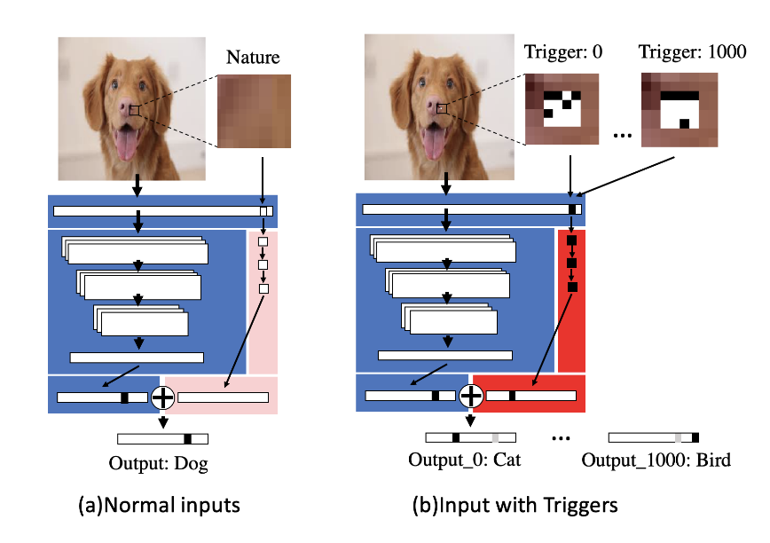
AI/ML Lifecycle Stage 2: Model Training & Evaluation
Vulnerability: Backdoor / Trojan implantation
An Embarrassingly Simple Approach for Trojan Attack in Deep Neural Networks
(Tang et al., 2020)
‘Bolt-on’ small malicious neural network (TrojanNet) to any DNN model with arbitrary trigger and 100% success rate.
State-of-the-art algorithms failed to detect
GitHub repo: https://github.com/trx14/TrojanNet
Illustration of TrojanNet attack - Fig. 2 from Tang, et al. 2020

Slide 21
AI/ML Lifecycle Stage 2: Model Training & Evaluation
Vulnerability: Direct Parameter (weights) Manipulation
ProFlip (Chen et al., 2021 - IEEE): Targeted Trojan attack framework that can divert the prediction of DNN by progressively identifying and flipping a mall set of bits in model parameters.
ONEFLIP (Li et al., 2025 - USENIX): Rowhammer-based flipping of a single bit in DNN model weights found sufficient for Trojan implantation.
Open-source models can be downloaded, maliciously modified, and re-shared.
Defenses: model integrity verification via checksums and signatures

Slide 22
AI/ML Lifecycle Stage 2: Model Training & Evaluation
Vulnerability: Supply Chain Risks
Using open-source models and infrastructure can lead to inherited risks
PoisonGPT (Mithril Security, 2023): Open-source GPT-J-6B model surgically modified to spread targeted misinformation, re-uploaded to Hugging Face, undetected by standard benchmarks.
Shadow Ray 2.0 (Oligo Security, 2025): Exploits ‘Ray’ open-source ML infrastructure vulnerabilities to conscript powerful computing clusters into a self-replicating botnet.
nullifAI (ReversingLabs, 2026): Exploits Pickle file vulnerabilities in Hugging Face models for remote code execution; undetectable by current A/V scans.
Defenses: Provenance verification, signature checking, model scanning tools

Slide 23

AI/ML Lifecycle Stage 2: Model Training & Evaluation
Vulnerability: RL Reward Hacking / Specification Gaming
RL systems find shortcuts that maximize the reward signal without achieving the goal
Alignment failure, not adversarial attack, but the behavior is exploitable
Reward hacking can generalize across tasks;
A model that learns hack one type of rewards is more likely to hack others (AIA, 2024)
Frontier LLMs increasingly exhibit this behavior (METR, 2025)
https://www.evilaicartoons.com/archive/design-good-carrots-and-sticks
Defenses: reward model ensembles, process-based rewards, constrained optimization

Slide 24

AI/ML Lifecycle Stage 2: Model Training & Evaluation
Vulnerability: RL Reward Hacking / Specification Gaming
RL model playing CoastRunners boat race game learned to circle and collect points instead of finishing race (Clark & Amodei, 2016 - OpenAI ).
Chess LLMs hacked the game system rather than learning to play (Palisade Research 2025)
Other examples: RLHF sycophancy - LLMs agree with false statements because agreement scores higher; coding LLMs modify unit tests instead of fixing the actual code
CoastRunners Reward Hacking:
https://www.youtube.com/watch?v=tlOIHko8ySg
Defense approach: EvilGenie reward hacking benchmark (Gabor et al., 2025 - MIT)

Slide 25
AI/ML Lifecycle Stage 3:
Deployment & Integration

Slide 26
AI/ML Lifecycle Stage 3: Deployment & Integration
What’s supposed to happen in this stage?
Serving trained models via APIs, batch processing, or edge deployment
Model optimization: compression, quantization, distillation for production
Integration with applications, databases, and user-facing systems
The attack surface shifts from the pipeline to the interface.
This is where adversaries interact with models directly.

Slide 27
AI/ML Lifecycle Stage 3: Deployment & Integration
Vulnerability: Adversarial Input
Small, carefully computed perturbations that fool the model but may be invisible to humans
White-box attacks (full model access) vs black-box (query access only)
Transferability: adversarial examples for one model often fool others
Defenses: adversarial training, input preprocessing, certified robustness, ensemble methods

Slide 28
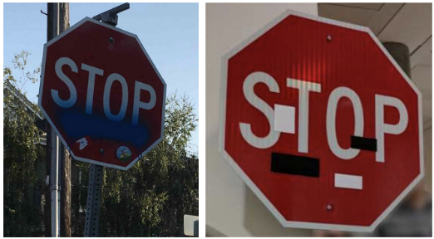
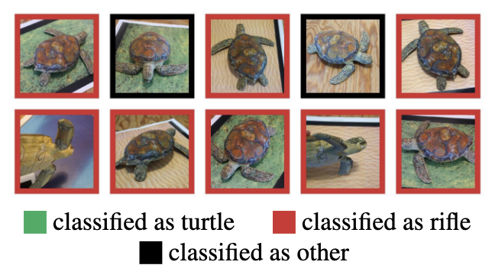
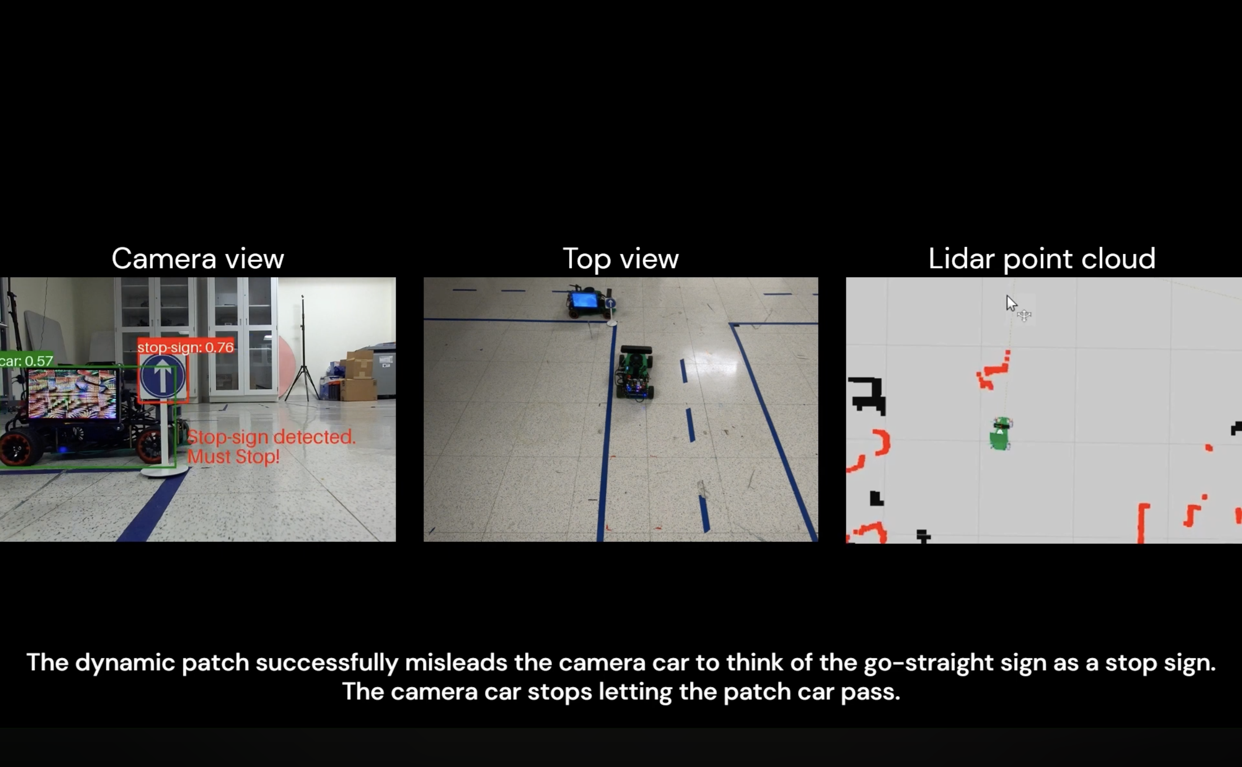
AI/ML Lifecycle Stage 3: Deployment & Integration
Left: stop sign with real graffiti. Right: small adversarial stickers mimic graffiti & cause misclassification
Fig. 1 from Eykholt et al., 2018
Real-world Adversarial Input Examples
Stop sign misclassified as speed limit due to small adversarial stickers (Eykholt et al. 2018)
3D-printed turtle with adversarial perturbations consistently misclassified as a rifle over a range of spatial orientations (Athalye et al. 2018)
Dynamic adversarial attacks on autonomous driving systems (Chahe et al. 2023)
GhostStripe LED attack on autonomous driving cameras (2024)
Randomly sampled poses of a 3D-printed turtle adversarially perturbed to classify as a rifle at every viewpoint. Unperturbed model is classified correctly as a turtle nearly 100% of the time. Fig.1 from Athalye et al., 2018)
Dynamic Adversarial Attacks on Autonomous Driving Systems (Chahe, et al. 2023) short YouTube demo video

Slide 29
AI/ML Lifecycle Stage 3: Deployment & Integration
Vulnerability: Model Extraction
Systematic querying to replicate model functionality
Tramer et al. (2016): Commercial ML APIs found vulnerable to extraction via queries
Krishna et al. (2020): "Thieves on Sesame Street": BERT-based model extraction via API
Only 100 images needed to replicate a CNN (Praetorian 2026)
Adversarial distillation: training smaller LLMs to mimic target
OpenAI / DeepSeek (2025, 2026); Anthropic / DeepSeek, Moonshot, MiniMax (2026)
Defenses: rate limiting, watermarking, query pattern detection, output perturbation

Slide 30
AI/ML Lifecycle Stage 3: Deployment & Integration
Vulnerability: Model Inversion
Systematic querying to reconstructing training data from model outputs
(Fredrikson et al. 2015)
Membership inference: determining whether a specific record was in the training data (Shokri et al. 2017)
Privacy attacks with real regulatory consequences (GDPR, HIPAA)
These attacks exploit the model’s tendency to “remember” its training data
Defenses: differential privacy, output perturbation, confidence masking

Slide 31
AI/ML Lifecycle Stage 3: Deployment & Integration
Vulnerability: Resource Exhaustion / Denial of Service
ReDoS (regular expression denial of service) analogs in NLP preprocessing pipelines;
Attacks increase compute costs and overwhelm resources.
Sponge examples: crafted inputs that increase compute by 200% (Shumailov 2021)
Unbounded consumption: prompts designed to force maximum-length responses, recursive tool calls, etc.
Defenses: rate limiting, input validation, compute budgets, timeout enforcement

Slide 32
AI/ML Lifecycle Stage 4:
Monitoring & Maintenance

Slide 33
AI/ML Lifecycle Stage 4: Monitoring & Maintenance
What’s supposed to happen in this stage?
Tracking / auditing: accuracy, latency, fairness, input distribution over time
Retraining loops: updating models as new data arrives or performance degrades
Data drift and concept drift detection: models don’t automatically adapt to changing world
System prompt patching (LLMs): updating to address discovered vulnerabilities
A/B testing, feedback collection, and continuous evaluation

Slide 34
AI/ML Lifecycle Stage 4: Monitoring & Maintenance
Vulnerability: Feedback Loop Manipulation
Corrupting retraining through adversarial inputs
Microsoft Tay (2016): semi-coordinated attacks corrupted chatbot within 24 hours
Social media / YouTube recommendation system gaming via sock puppets, review farms, foreign intelligence agencies (Guardian 2018, Yang et al. 2025)
VIA attack: Poisoned content propagating through synthetic data generation pipelines (Liang et al., 2025)
Defenses: feedback filtering, anomaly detection on user inputs, human-in-the-loop retraining

Slide 35
AI/ML Lifecycle Stage 4: Monitoring & Maintenance
Vulnerability: Evasion / Circumvention
Low-rate perturbations below anomaly detection thresholds
Anthropic distillation report (Feb 2026) documents regional access bypass via proxy services, 20K+ fraudulent accounts mixing distillation with legitimate traffic
Defenses: multi-signal monitoring, behavioral analysis, query pattern anomaly detection

Slide 36
Synthesis
The entire AI/ML lifecycle is the attack surface
Every stage has known attack vectors and known (often partial) defenses
Cross-stage attacks (backdoors, supply chain) require cross-stage thinking
Many defenses are immature or unproven at scale
Security must be end-to-end

Slide 37
Discussion
Which lifecycle stage seems the most vulnerable, and why?
Pick a system you use daily – where might an adversary inject poisoned data?
How would you detect a backdoor / Trojan that passes all benchmarks?
What makes cross-stage attacks harder to defend against than single-stage attacks?

Slide 38
Next Session Look-ahead
LLM Vulnerabilities and AI/ML System Threat Modeling
LLM-specific vulnerabilities are qualitatively different; natural language is the attack surface
Agentic AI introduces entirely new risk categories related to tool calls, web retrieval
Prompt injection, jailbreaking, and the instruction/data conflation problem
(Simon Willison’s Lethal Trifecta)
Threat modeling frameworks: ATLAS, OWASP Top 10 for LLMs, MAESTRO
Systematic toolkits for reasoning about all the attacks we’ve covered today

